Slide 1
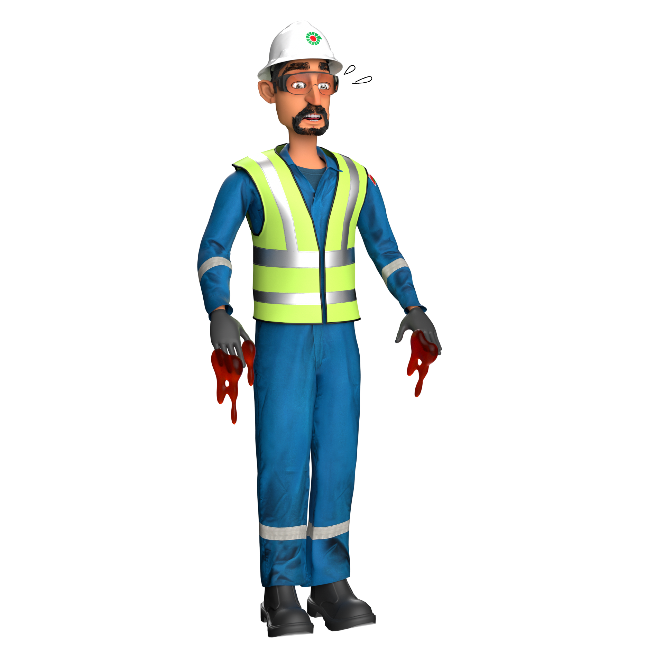
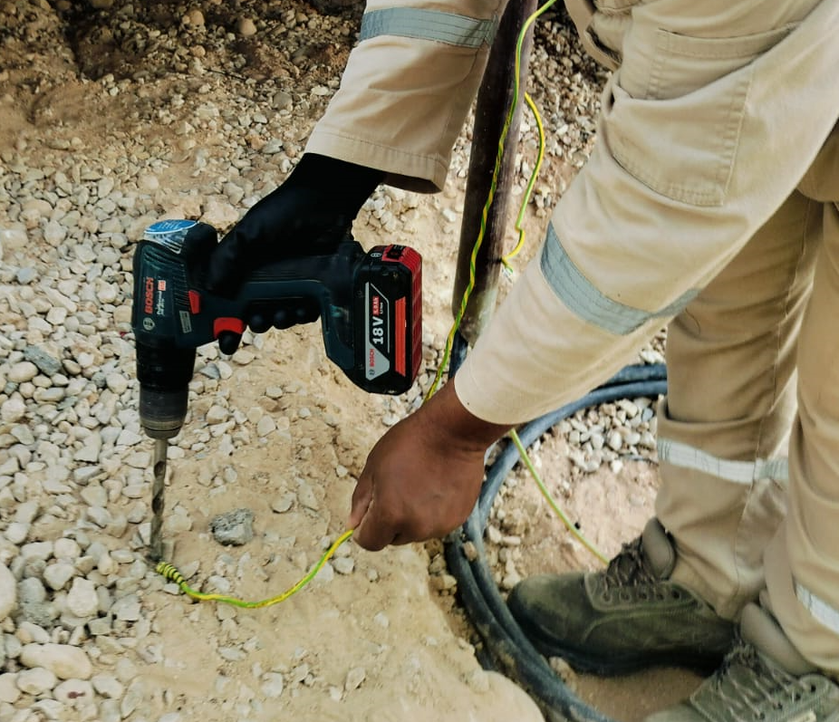
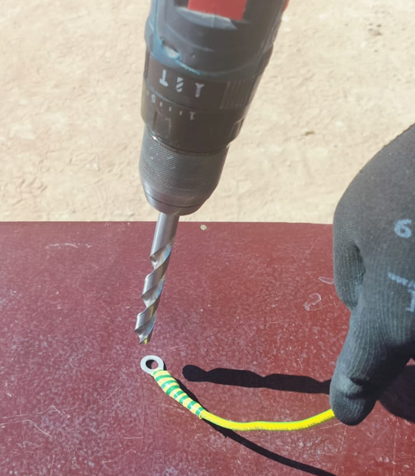
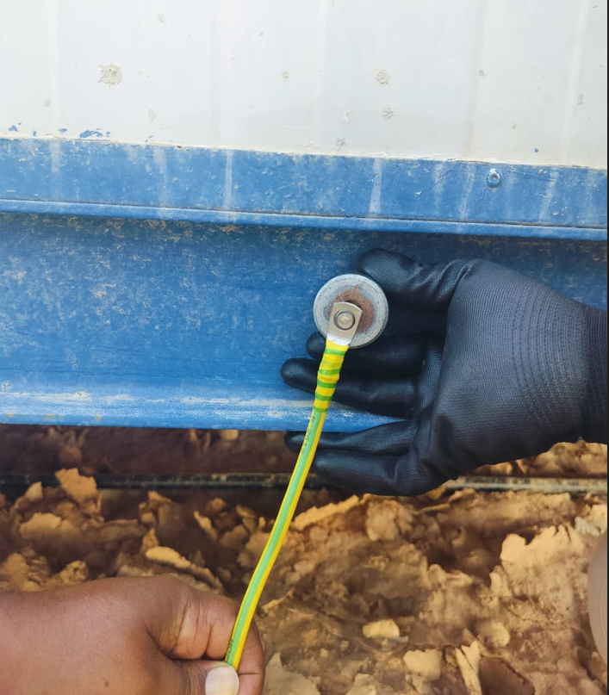
Learning From Incident - First Alert
Prevent
PIM # | 1170729 | Date & Time | 25.09.2024, 03:35 PM | Location | Harweel
Incident Type | LTI#19 | Category | Hit/Struck By; Hands & Fingers | Activity | Using cordless drill machine
Target Audience: All
What happened:
Cable lug hole enlarging with drill machine
On 25th September 2024 around 03:35pm, at Harweel contractor camp, a Senior Carpenter from camp maintenance team was trying to enlarge the hole of an earth cable's lug (size into M8 to M10), since it was not matching the earth boss stud bolt.
To enlarge the hole of the cable lug, the carpenter used a cordless hand drill machine which had been attached with a 11.5 mm HSS drill bit and started enlarging the hole by holding the cable by left hand and keeping the cable lug on the ground under his foot. When the drill machine started, the cable lug immediately slipped from under his foot, causing the rotating drill bit to come in contact with the cable and the Carpenter’s left hand. This resulted in the amputation of his left-hand index finger and middle finger.
Initial Findings:
The Carpenter took a personal decision to carry out the task, which was not assigned to him.
Using the drill to expand the cable lug hole is not an authorized activity.
The Electrician had communicated the need to change the cable lug to the right size instead of drilling it.
Correct size Cable lug is used
Engagement Questions:
Do you ensure you have the right authorization before starting the job?
How do you ensure your hands are kept away from line of fire when using rotating equipment?
How do you ensure employees are aware of the hazards and risks before commencing any task?
How do you ensure you have the right equipment before starting any task?
ALWAYS obtain authorization before starting work!
In case of an emergency please call PDO Emergency Number (Toll Free): 2467-5555
Notes:
Mr Musleh image on the top right will change according to incident pattern, MSE3 will provide you with the image as per the pattern
What happened: A short description should be provided without mentioning names of contractors or individuals. You should include, what happened, to who (by job title) and what injuries this resulted in. Nothing more!
Initial Finding: Four to five bullet points highlighting the initial main findings from the investigation. Remember the target audience is the front-line staff so this should be written in simple terms in a way that everyone can understand.
Learnings: Four to five learning message in the form of questionnaires linked with initial findings
The strap line should be the main learning point you want to get across
The images should be self explanatory, what went wrong (if you create a reconstruction please ensure you do not put people at risk) and below how it should be done.

