Slide 1
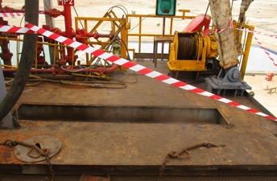
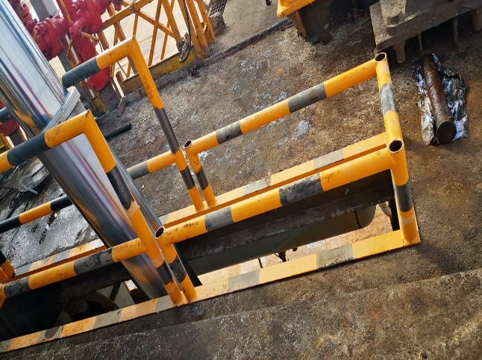
PDO Second Alert
Date: 20.08.2021 Incident type: LTI#19 (Fall from height)
What happened?
On August 20th, 2021, at around 05:30 hours, the operational team removed the off-driller side (ODS) plate to connect the off drillers side MRC (mast raising cylinder) to lower the rig floor. Once the floorplate was removed, the air winch operator floorman stayed at the ODS air winch area, whereas his coworkers resumed other tasks. Suddenly the rig floor crew members (driller/ assistant driller and one Floor man) heard yelling from the substructure and realized that their coworker Air winch operator fell (fall distance 08.35 m height) and rested on the substructure area. The rig medic administered first aid to the Floor man before transporting him to Nimr PDO facility via MEDIVAC. The Floor man was conscious, oriented, and responding during his evaluation to Nimr clinic, then referred to Salalah hospital for further medical care.The floor man sustained head trauma (superficial wound), Pelvic fracture.
Your learning from this incident..
Ensure that step by step activity, risk, control and responsibilities are discussed with all involved personnel.
Always ensure to intervene and apply the stop-work authority when deemed necessary.
Always ensure to always supervise the task physically. Never leave the work site unattended
Always ensure to maintain good housekeeping at the work area.
Always stick with the plan otherwise inform your supervisor.
Apply dynamic risk assessment review for any changes in the activity.
Plates removed and no barricading
Always ensure to barricade immediately any opening/gaps or shifted handrails
Notes:
Ensure all dates and titles are input
A short description should be provided without mentioning names of contractors or individuals. You should include, what happened, to who (by job title) and what injuries this resulted in. Nothing more!
Four to five bullet points highlighting the main findings from the investigation. Remember the target audience is the front line staff so this should be written in simple terms in a way that everyone can understand.
The strap line should be the main point you want to get across
The images should be self explanatory, what went wrong (if you create a reconstruction please ensure you do not put people at risk) and below how it should be done.

Slide 2
Management self audit
Date: 20.08.2021 Incident type: LTI#19
As a learning from this incident and ensure continual improvement all contract
managers must review their HSE HEMP against the questions asked below
Confirm the following:
Do you ensure effective management of change to control deviation from procedure?
Do you ensure effective dynamic risk review when workplace condition changed?
Do you ensure effective task supervision?
Do you ensure effective monitoring of employees' mental state?
Do you ensure adequate control/design for rig floor opening while rig up/down activity?
Do you ensure rig up/down procedure updated and rig specific?
* If the answer is NO to any of the above questions please ensure you take action to correct this finding.
Notes:
Ensure all dates and titles are input
Make a list of closed questions (only ‘yes’ or ‘no’ as an answer) to ask others if they have the same issues based on the management or HSE-MS failings or shortfalls identified in the investigation.
Imagine you have to audit other companies to see if they could have the same issues.
These questions should start with: Do you ensure…………………?

