Slide 1
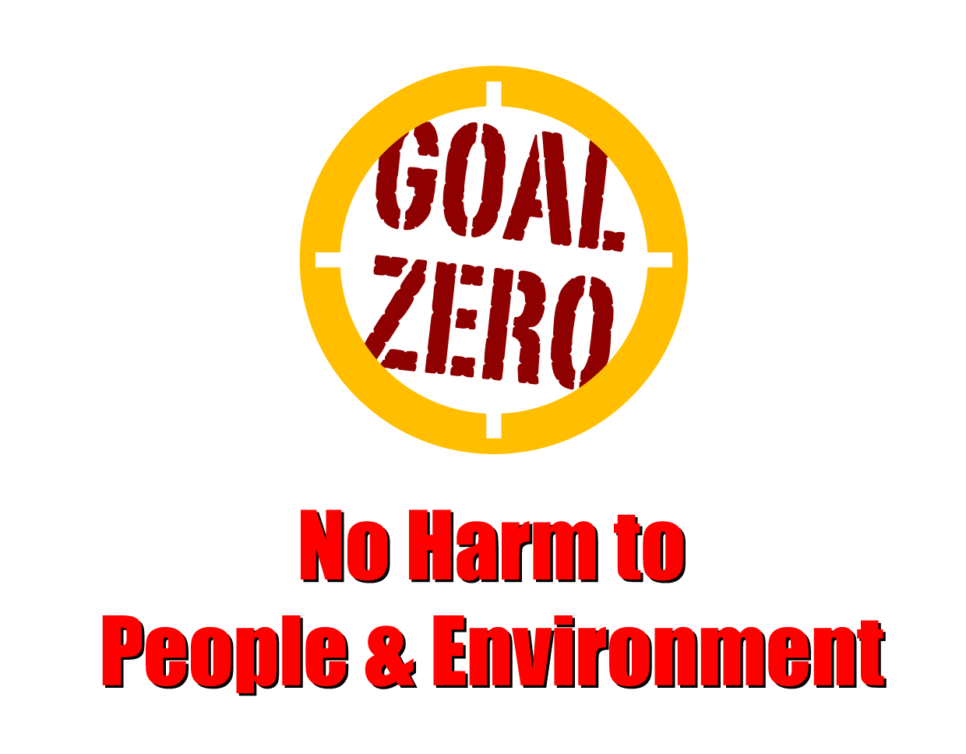
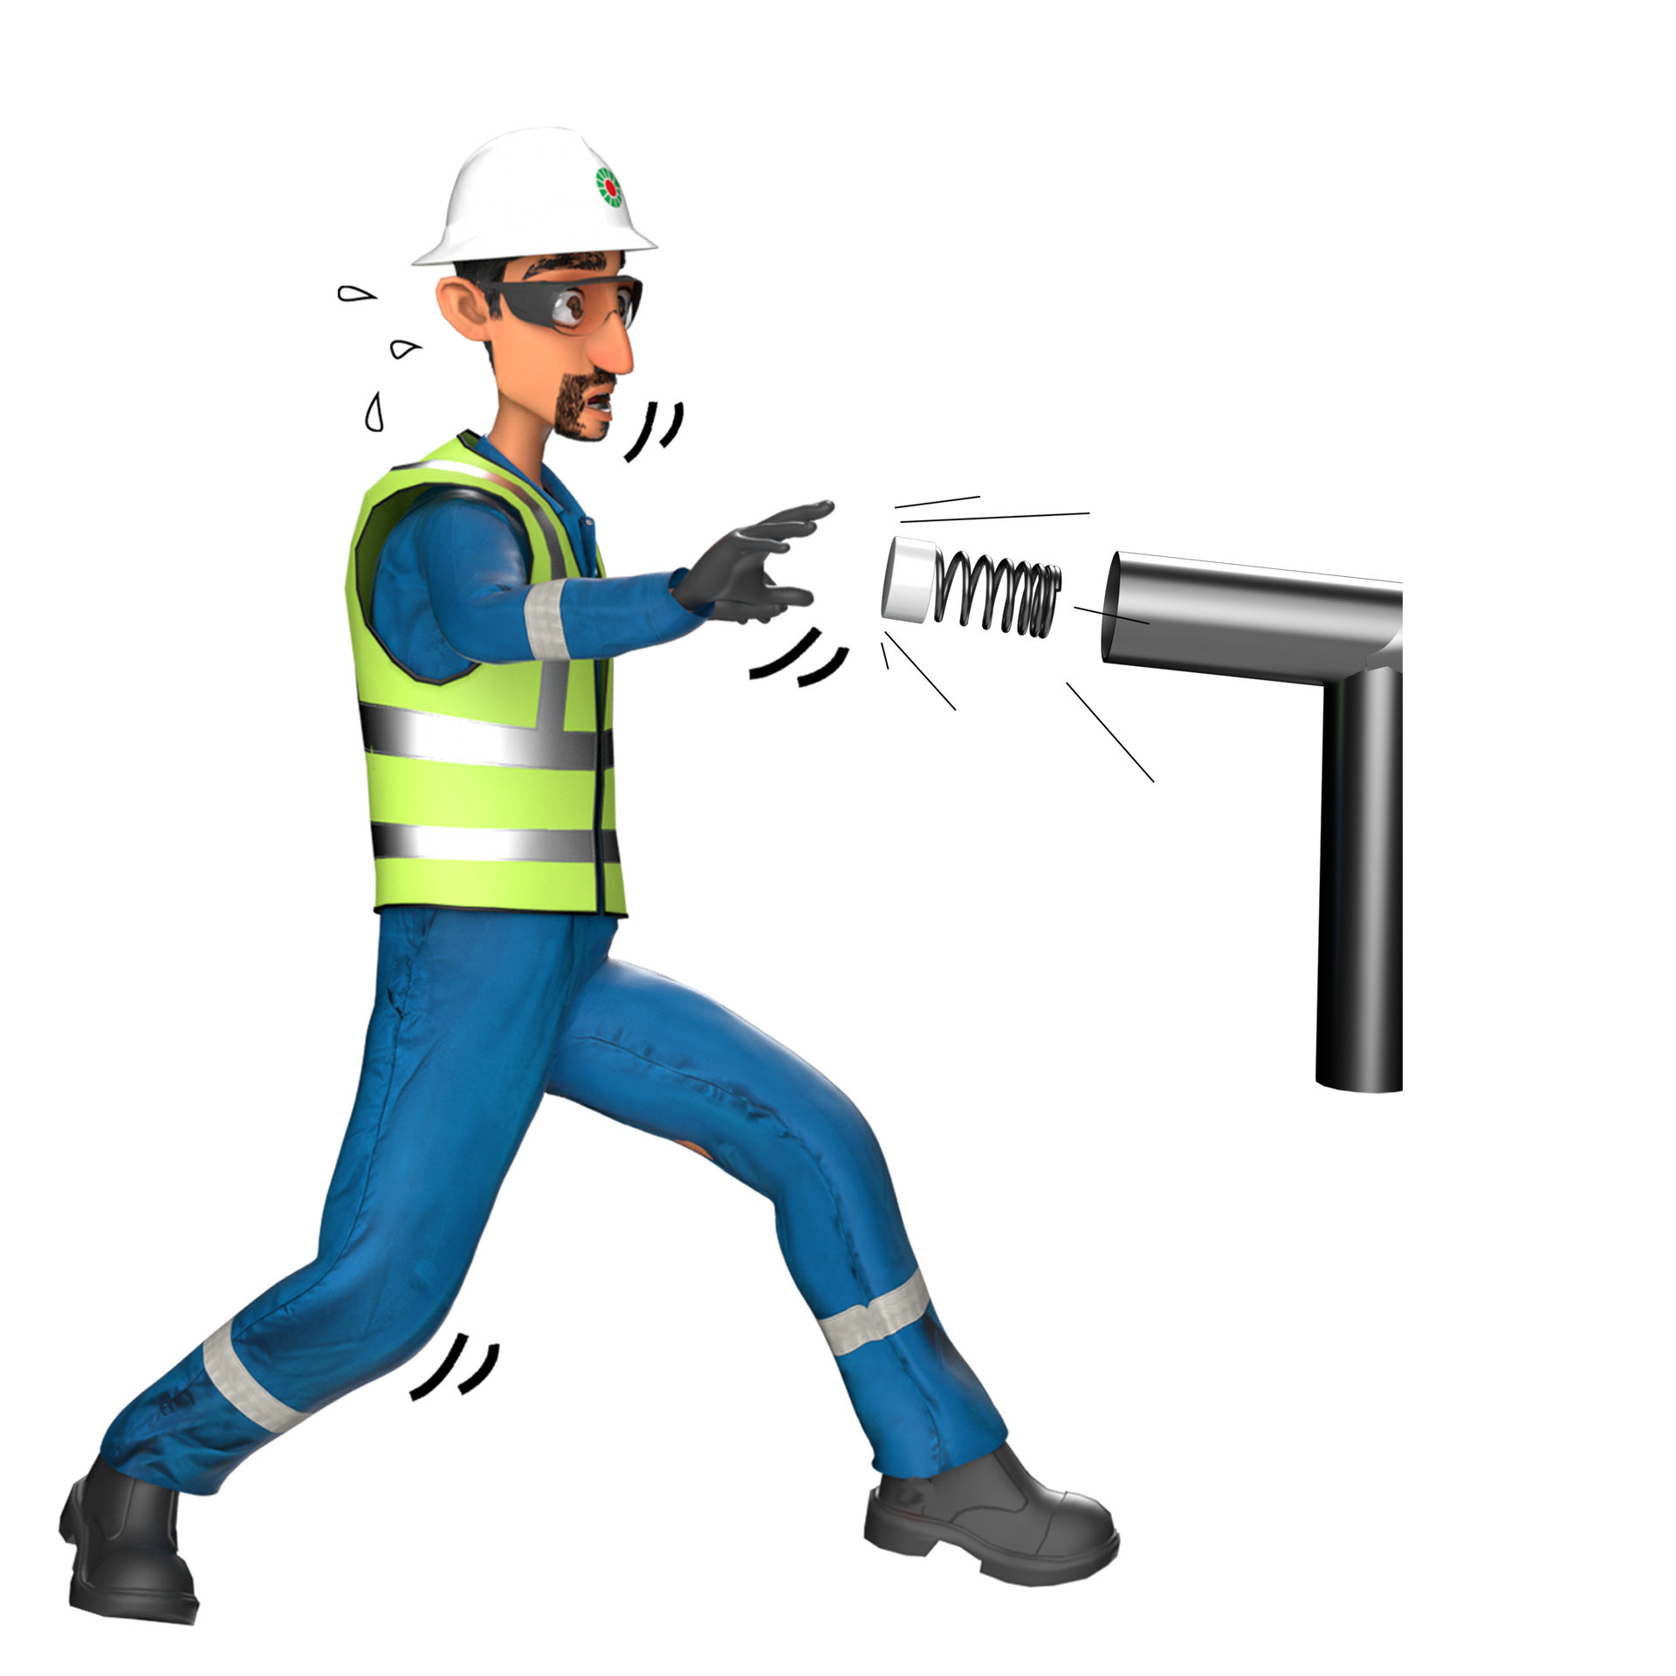
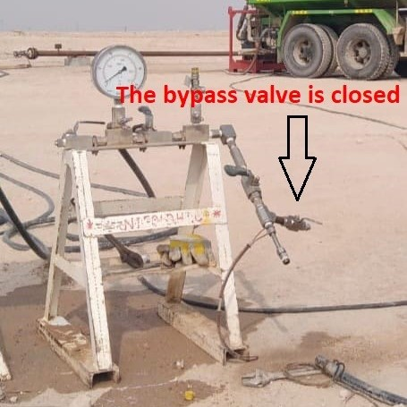
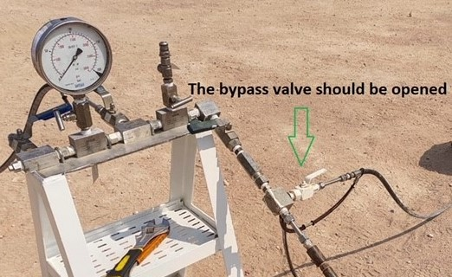
Learning From Incident - First Alert
Prevent
PIM # | 1160459 | Date | 27.10.2023 | Direct / Depart
Incident Type | LTI#19 | Time | 09:15 Hrs | Location | Qurn Alam
Pattern | Released energy | Contractor |  | Activity | Hydrotest
Target Audience: All.
What happened
While carrying hydrotest for the flow line in Burhan, technician went to open the valve and suddenly the hose got detached from the manifold and hit his right hand dorsum and right leg resulted in a fracture to fourth metacarpal bone right hand.
Initial Findings
The hydro test manifold inlet bypass/discharge valves were in closed condition.
Pre-start inspection to the hydro test manifold was not done.
The whip lock arrestor not properly tightened with hose connected to manifold.
Initial Learnings
How do you ensure the compliance to the hydro test procedures?
How do you ensure the pre-start inspection for the task performed?
How do you ensure availability of valid certifications for the setup and testing equipment ?
Are you aware of all pressure release hazards before starting the task
In case of an emergency please call PDO Emergency Number (Toll Free): 2467-5555
Notes:
Mr Musleh image on the top right will change according to incident pattern, MSE3 will provide you with the image as per the pattern
What happened: A short description should be provided without mentioning names of contractors or individuals. You should include, what happened, to who (by job title) and what injuries this resulted in. Nothing more!
Initial Finding: Four to five bullet points highlighting the initial main findings from the investigation. Remember the target audience is the front-line staff so this should be written in simple terms in a way that everyone can understand.
Learnings: Four to five learning message in the form of questionnaires linked with initial findings
The strap line should be the main learning point you want to get across
The images should be self explanatory, what went wrong (if you create a reconstruction please ensure you do not put people at risk) and below how it should be done.

