Slide 1
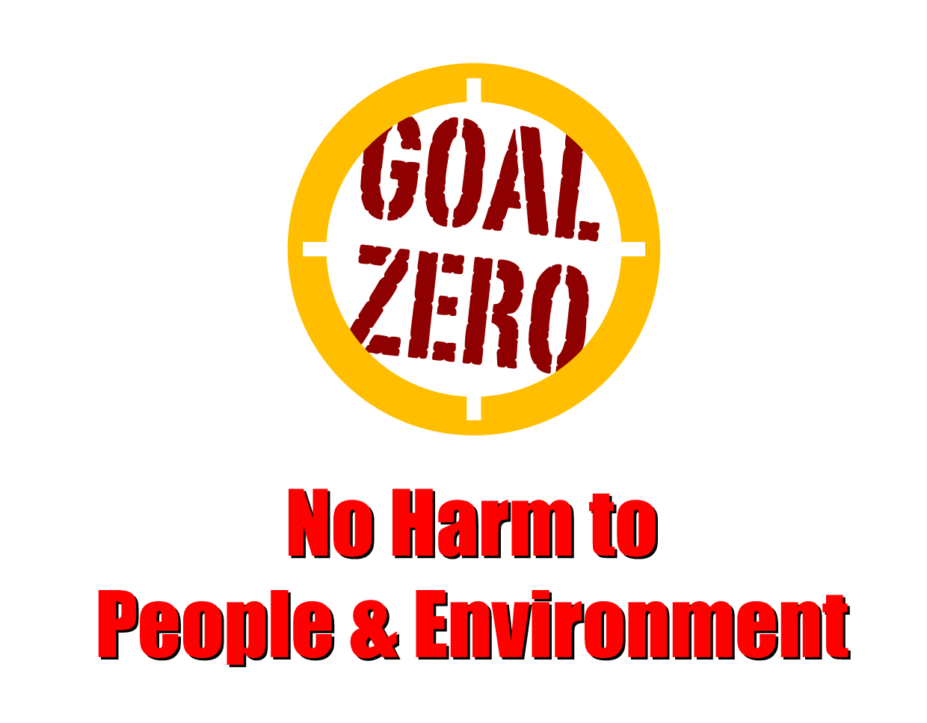
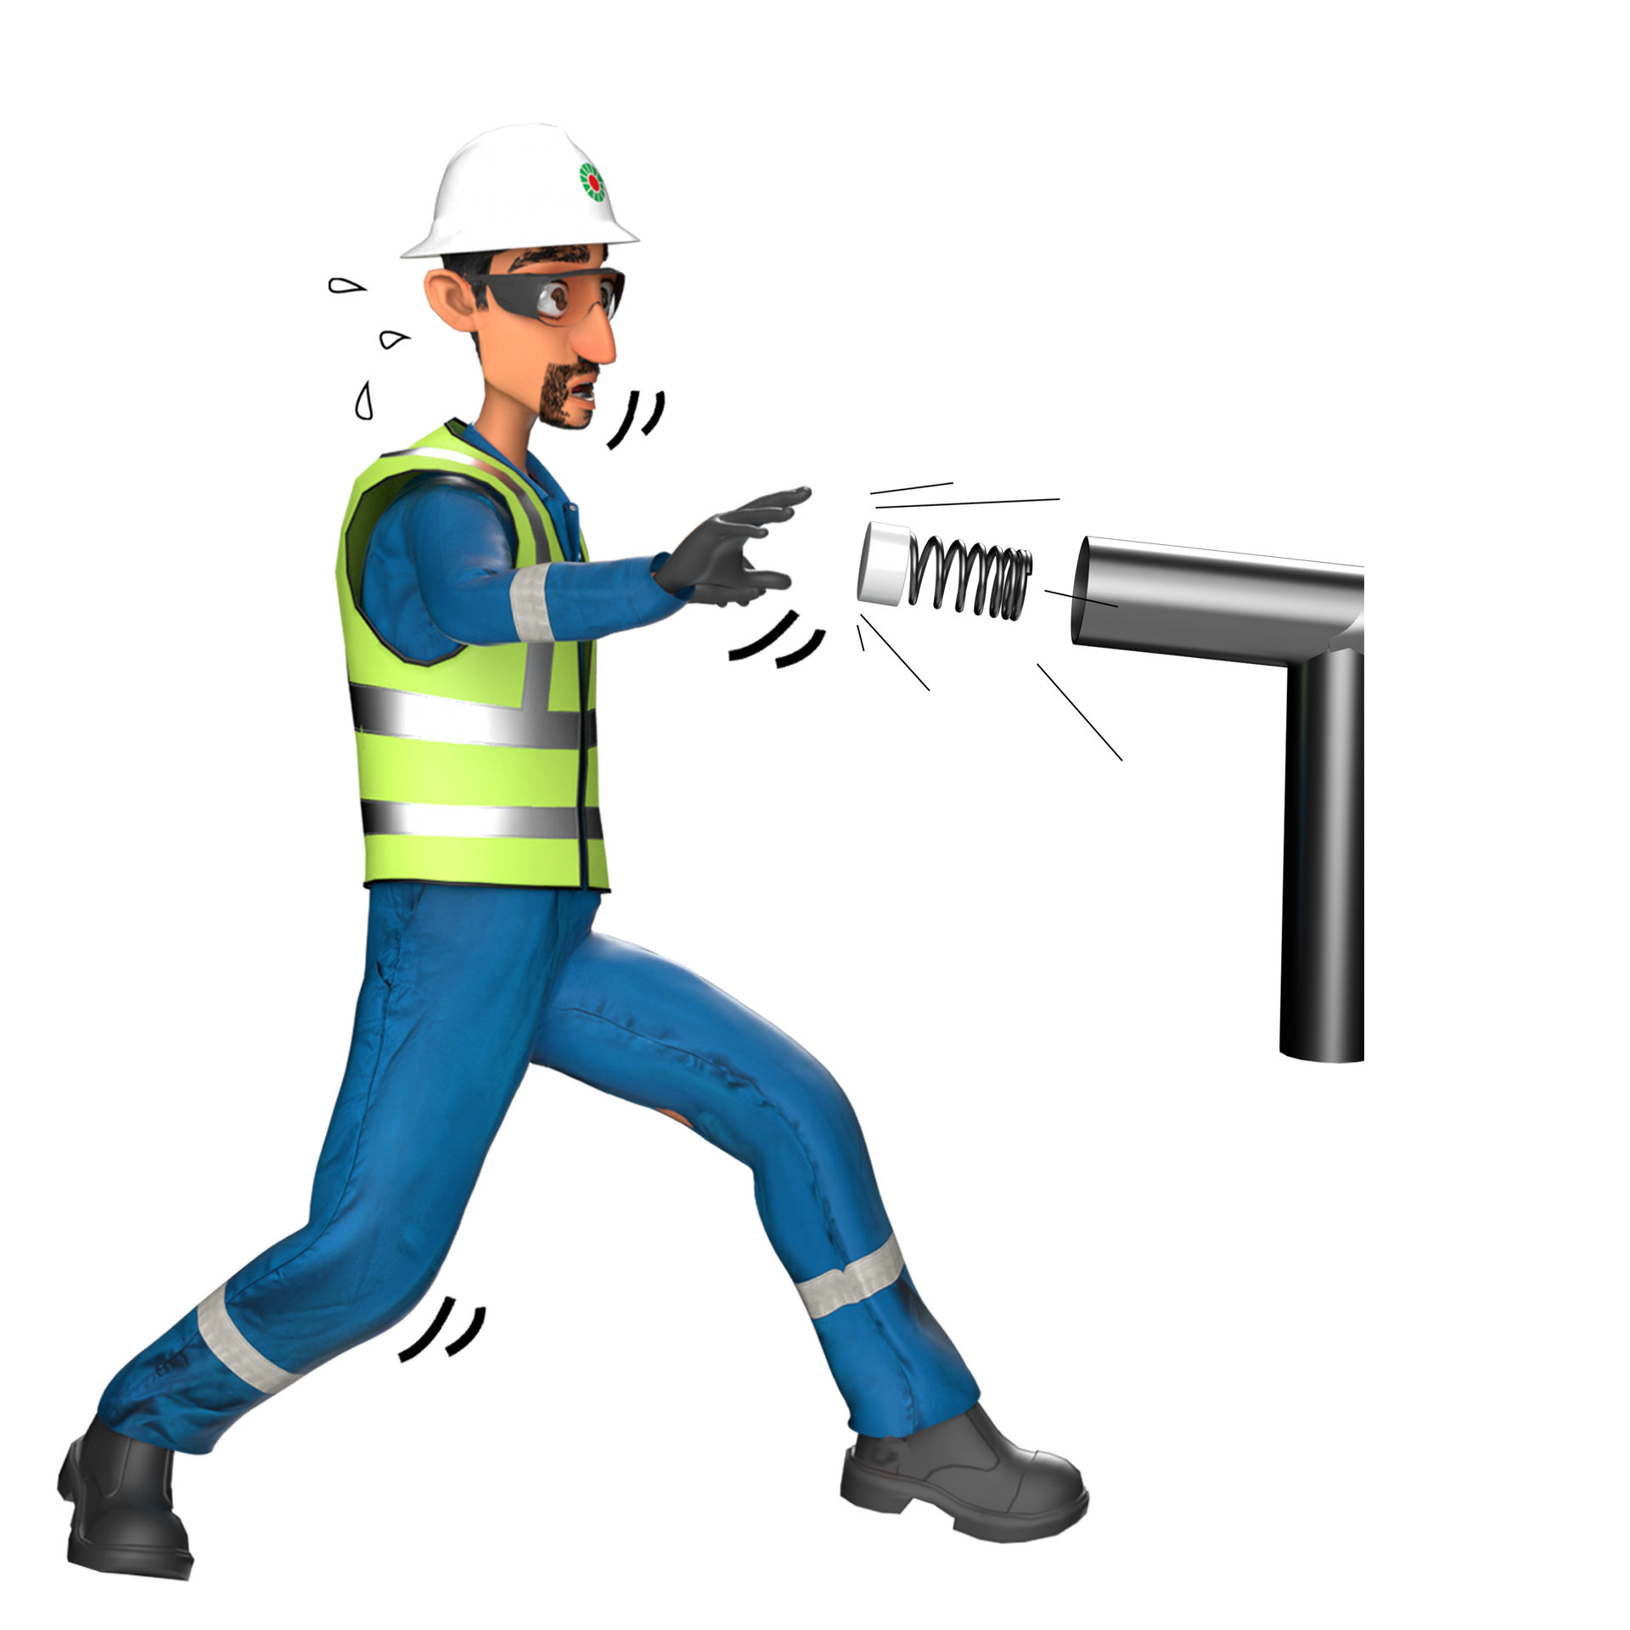
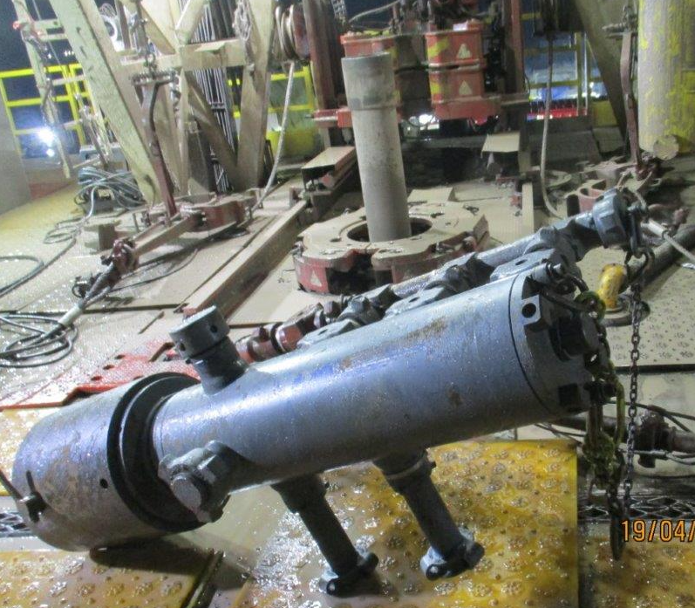
Learning From Incident - First Alert
Prevent
PIM # | 1160514 | Date | 29.10.2023 | Direct / Depart
Incident Type | LTI#20 | Time | 12:02 AM | Location | Nimr
Pattern | Released energy | Contractor |  | Activity | Cementing Job
Target Audience: All.
What happened
In preparation for cementing (CMT) job operation , the crew connected the quick latch CMT head on the landing joint. While initiating the circulation, the CMT head disconnected from landing joint; hit the Floorman on his back and fell down he was diagnosed with lower back & pelvic injuries
Initial Findings
Red/ No Go zone was not barricaded
Cement head pull test was not part of OEM/ procedural requirements
Latching of the cement head dog lock was not confirmed
The mud pump was started without ensuring personnel are clear from the No Go zone area.
Cementing head dislodged and rested on the rig floor.
Initial Learnings
How do you ensure Red/ No Go zone are barricaded?
How do you ensure personnel are away from No Go zone prior energizing the pipe lines?
Ensure secondary retention is provided for temporary installations which has the potential to dislodge due to stored energy
Ensure No go zone fully respected during any operation
Always ensure personnel are clear from the No Go zone area
In case of an emergency please call PDO Emergency Number (Toll Free): 2467-5555
Notes:
Mr Musleh image on the top right will change according to incident pattern, MSE3 will provide you with the image as per the pattern
What happened: A short description should be provided without mentioning names of contractors or individuals. You should include, what happened, to who (by job title) and what injuries this resulted in. Nothing more!
Initial Finding: Four to five bullet points highlighting the initial main findings from the investigation. Remember the target audience is the front-line staff so this should be written in simple terms in a way that everyone can understand.
Learnings: Four to five learning message in the form of questionnaires linked with initial findings
The strap line should be the main learning point you want to get across
The images should be self explanatory, what went wrong (if you create a reconstruction please ensure you do not put people at risk) and below how it should be done.

