Slide 1
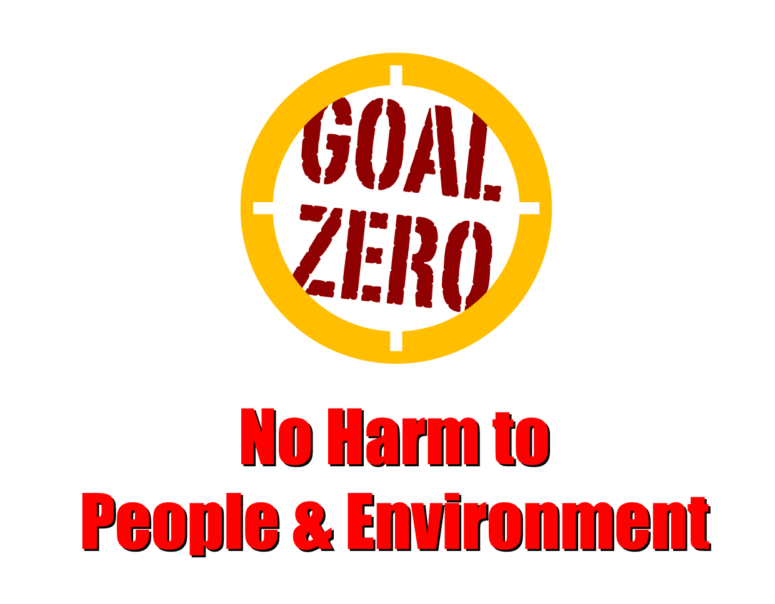
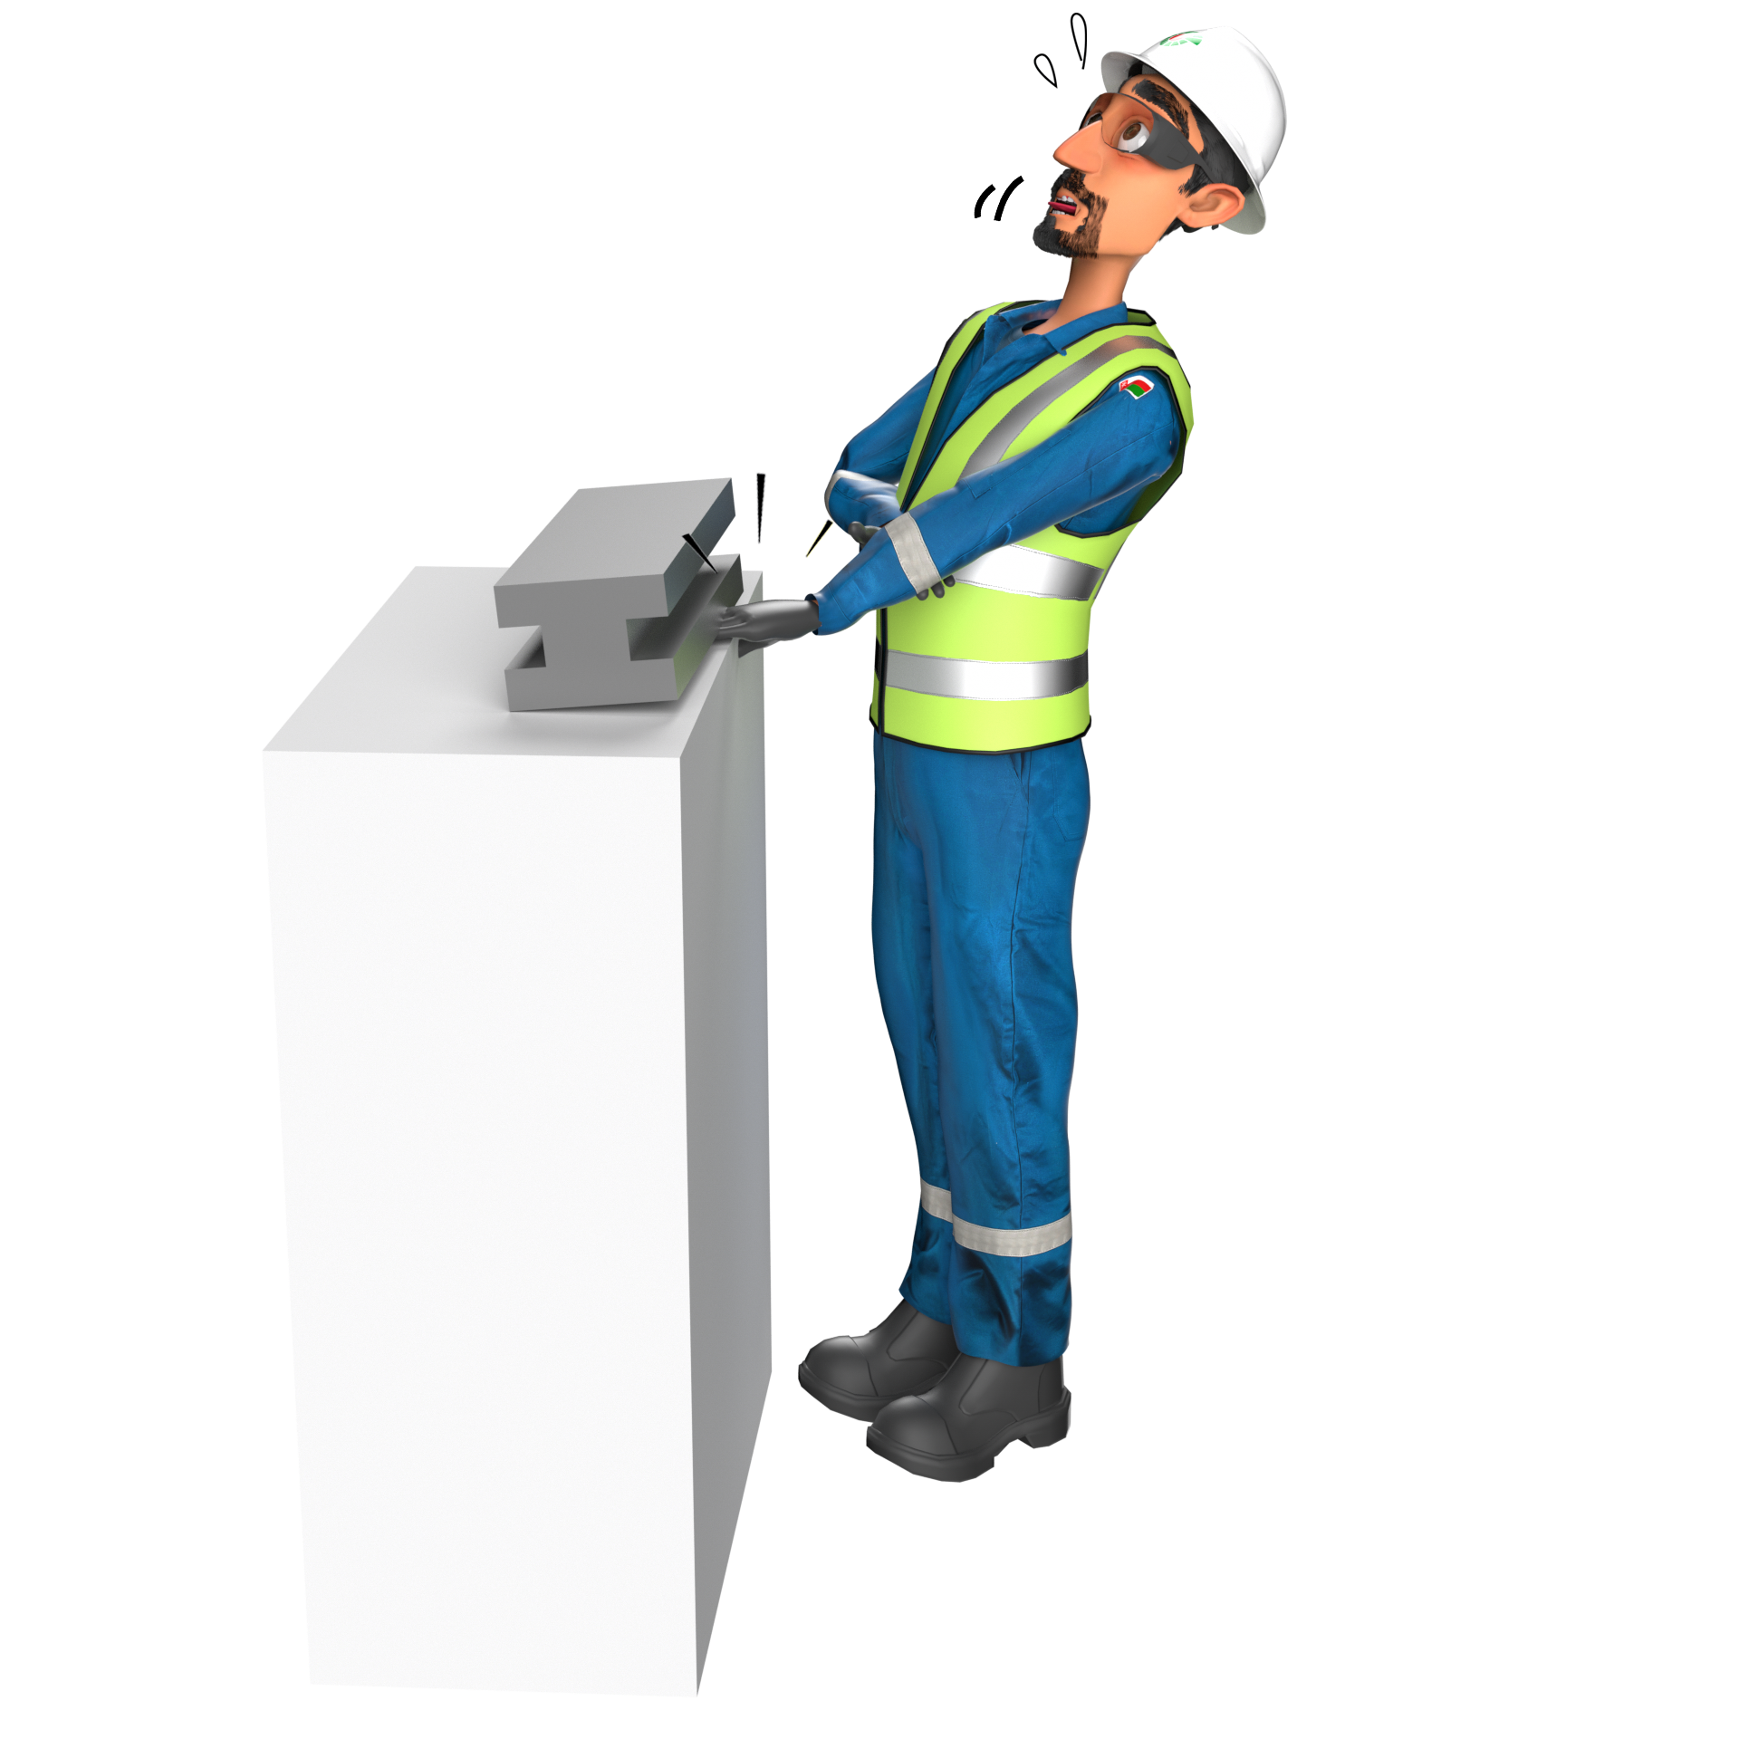
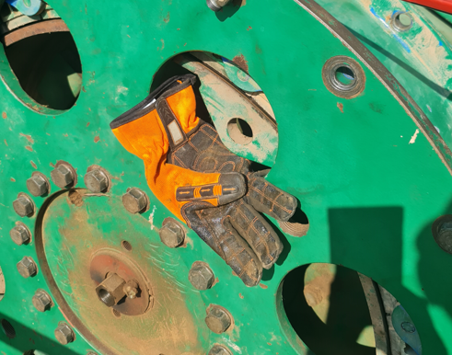
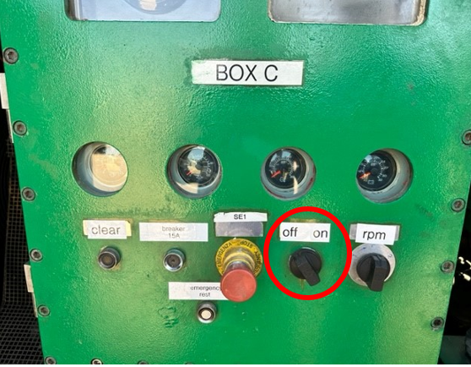
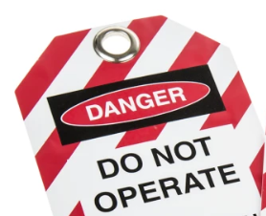
Learning From Incident - First Alert
Prevent
PIM # | 1160936 | Date & | 14.11.2023 | Direct / Dept
Incident Type | LTI#21 | Time | 15:52 hrs | Location | Nimr insourcing workshop
Incident Category | Hands & Fingers ‘Line of Fire” | Contractor |  | Activity | Checking clutch fitting on Draw works
Target Audience: All
What happened
During the routine check of hoist clutch at the workshop, an air leak was observed in the draw work clutch circuit. While examining the leak, the clutch unexpectedly rotated trapping the Mechanical Supervisor's right hand between clutch parts resulting a compound fracture at his right hand’s little finger.
Initial Findings
The rotating equipment was not isolated before working on the clutch.
The risk of line of fire was not assessed before attempting to do the task.
The communication between work parties was inadequate.
Initial Learnings
How do you ensure all energies are isolated before working on any machinery?
How do you ensure the tasks are risk assessed and all hazards discussed in TBT?
How do you ensure line of fire risks are identified prior to starting the job?
How do you ensure proper communication exists between work parties?
Always ensure proper isolation before working on any machinery
In case of an emergency please call PDO Emergency Number (Toll Free): 2467-5555
Notes:
Mr Musleh image on the top right will change according to incident pattern, MSE3 will provide you with the image as per the pattern
What happened: A short description should be provided without mentioning names of contractors or individuals. You should include, what happened, to who (by job title) and what injuries this resulted in. Nothing more!
Initial Finding: Four to five bullet points highlighting the initial main findings from the investigation. Remember the target audience is the front-line staff so this should be written in simple terms in a way that everyone can understand.
Learnings: Four to five learning message in the form of questionnaires linked with initial findings
The strap line should be the main learning point you want to get across
The images should be self explanatory, what went wrong (if you create a reconstruction please ensure you do not put people at risk) and below how it should be done.

