Slide 1
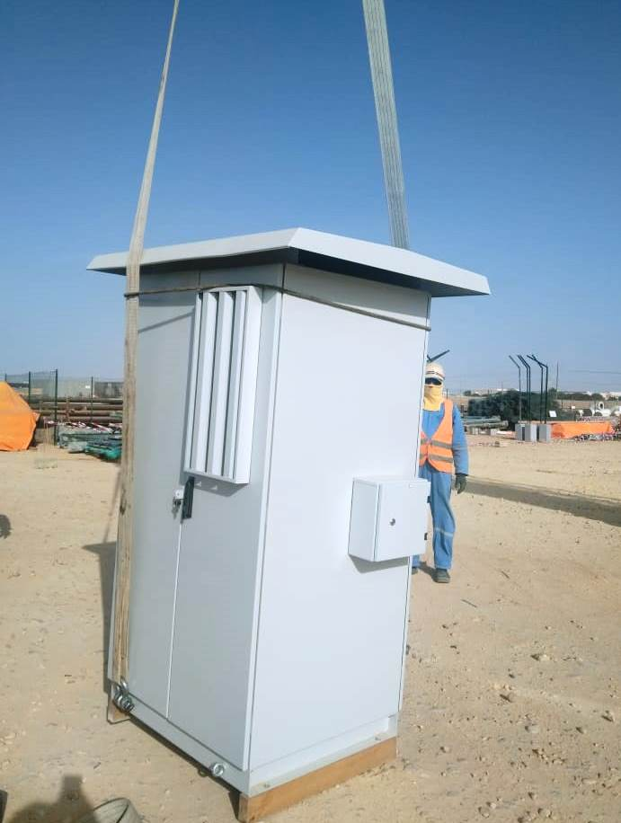
PDO Second Alert
Date: 22nd September 2021 Incident title: LTI # 21 Pattern: Drop Potential severity: C3P
Target Audience: Drilling, Logistics, Operation & Construction
What happened?
An Electrician suffered injury while engaged in VFD (Variable Frequency Drive) panel replacement activity at MM-576 location as the lifted VFD panel toppled over him. The panel brought from the supplier yard to site was unloaded to the ground from the canter using a crane and was again lifted a feet above ground to remove the wooden base (shipping skid). The Electrician was hammering the wooden base to dislodge it when the panel lost balance and toppled over.
Why it happened/Finding :
Work executed in an urgency without sufficient planning and preparation.
Inappropriate design provision of lifting eye bolts below its center of gravity.
Lifting of inadequately secured load (using 2 lifting points instead of 4)
Allowing personnel in close proximity of the lifted load.
Hammering to dislodge the wooden skid of the lifted load (panel).
Your learning from this incident..
Always ensure the lifting points are above the center of gravity of the load being lifted
Do not resort to short cuts; ask when in doubt.
Do not allow personnel within the lift radius and close to lifted load.
Any work such as skid removal should be carried out on firm surface.
Use your empowerment to stop unsafe work.
Notes:
Ensure all dates and titles are input
A short description should be provided without mentioning names of contractors or individuals. You should include, what happened, to who (by job title) and what injuries this resulted in. Nothing more!
Four to five bullet points highlighting the main findings from the investigation. Remember the target audience is the front line staff so this should be written in simple terms in a way that everyone can understand.
The strap line should be the main point you want to get across
The images should be self explanatory, what went wrong (if you create a reconstruction please ensure you do not put people at risk) and below how it should be done.

Slide 2
Management self audit
Date: 22nd September 2021 Incident title: LTI # 21 Pattern: Drop Potential severity: C3P
As a learning from this incident and ensure continual improvement all contract managers must review their HSE risk management against the questions asked below
Confirm the following:
Do you ensure manufacturer instruction is available and it includes safe way of lifting?
Do you ensure correct lift plan is established with reference to manufacturer instructions for the load to be lifted?
Do you ensure lift area is barricaded and personnel are kept away from the lifted load?
Do you ensure personnel are aware of the safe method of executing a task and are not taking shortcuts?
Do your ensure personnel are aware of their empower to stop unsafe work?
* If the answer is NO to any of the above questions please ensure you take action to correct this finding
Notes:
Ensure all dates and titles are input
Make a list of closed questions (only ‘yes’ or ‘no’ as an answer) to ask others if they have the same issues based on the management or HSE-MS failings or shortfalls identified in the investigation.
Imagine you have to audit other companies to see if they could have the same issues.
These questions should start with: Do you ensure…………………?

