Slide 1
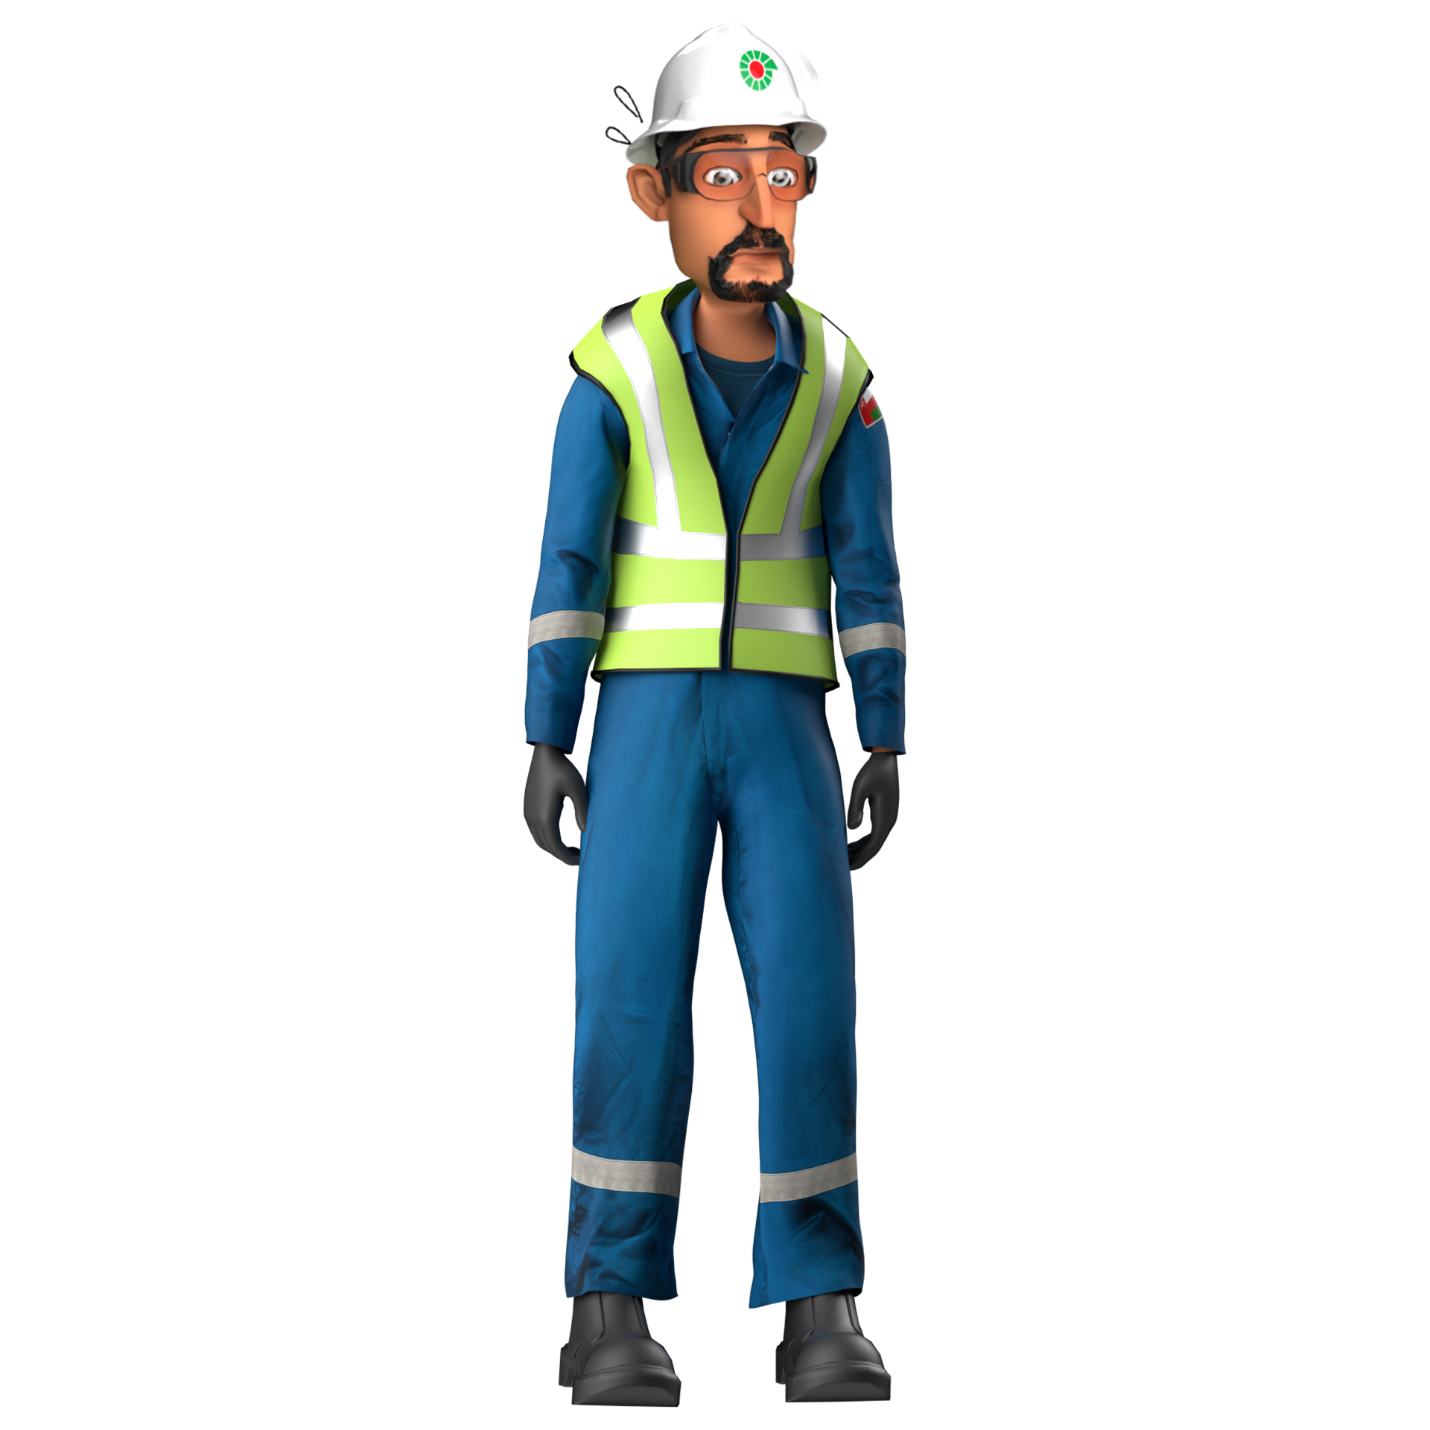
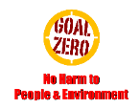
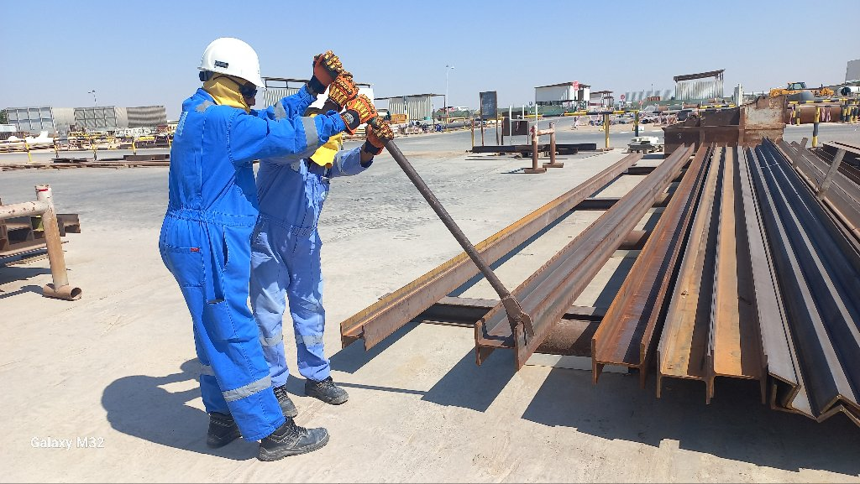
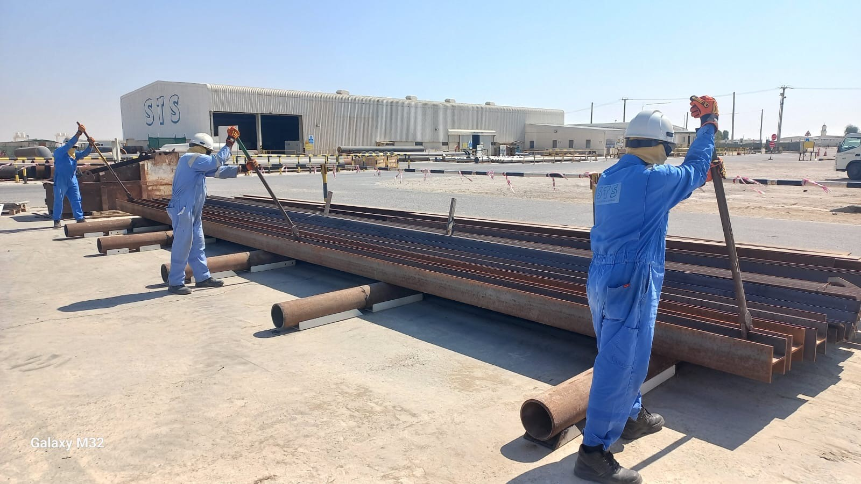
Learning From Incident - First Alert
Prevent
PIM # | 1171897 | Date & Time | 28.10.2024, 11:45 AM | Location | Yibal
Incident Type | LTI#22 | Category | Manual Handling Injury | Activity | Structural fabrication
Target Audience: All
What happened:
Beam lifted from one end
While a Mechanical crew was engaged in structural fabrication work at the Yibal Industrial Yard, the crew’s Chargehand decided to rotate an H-shaped structural beam, for marking and cutting purposes with the support of a Rigger. While rotating the beam using a lever clamp, the Rigger experienced an unexpected jolt, causing dislocation in his left shoulder joint.
Initial Findings:
The weight of beam was approx. 720 Kg which was rotated manually using one lever clamp at one end of the beam.
While rotating, the beam moved from initial pipe support to the adjacent beam support with height difference of 9.8 cm.
The risk of rotating the beam from one end and elevation difference of the supports were not anticipated.
Three personnel spread across the length of the beam
Reflective Engagement Questions:
How do you evaluate the hazards involved in the task ?
Are you aware of the manual handling risks associated with the task?
Have you normalized the risk involved in pushing, pulling & rotating activities ?
How do you comply with right method of handling heavy material ?
Always be alert to potential hazards involved in manual handling tasks
In case of an emergency please call PDO Emergency Number (Toll Free): 2467-5555
Notes:
Mr Musleh image on the top right will change according to incident pattern, MSE3 will provide you with the image as per the pattern
What happened: A short description should be provided without mentioning names of contractors or individuals. You should include, what happened, to who (by job title) and what injuries this resulted in. Nothing more!
Initial Finding: Four to five bullet points highlighting the initial main findings from the investigation. Remember the target audience is the front-line staff so this should be written in simple terms in a way that everyone can understand.
Learnings: Four to five learning message in the form of questionnaires linked with initial findings
The strap line should be the main learning point you want to get across
The images should be self explanatory, what went wrong (if you create a reconstruction please ensure you do not put people at risk) and below how it should be done.

