Slide 1
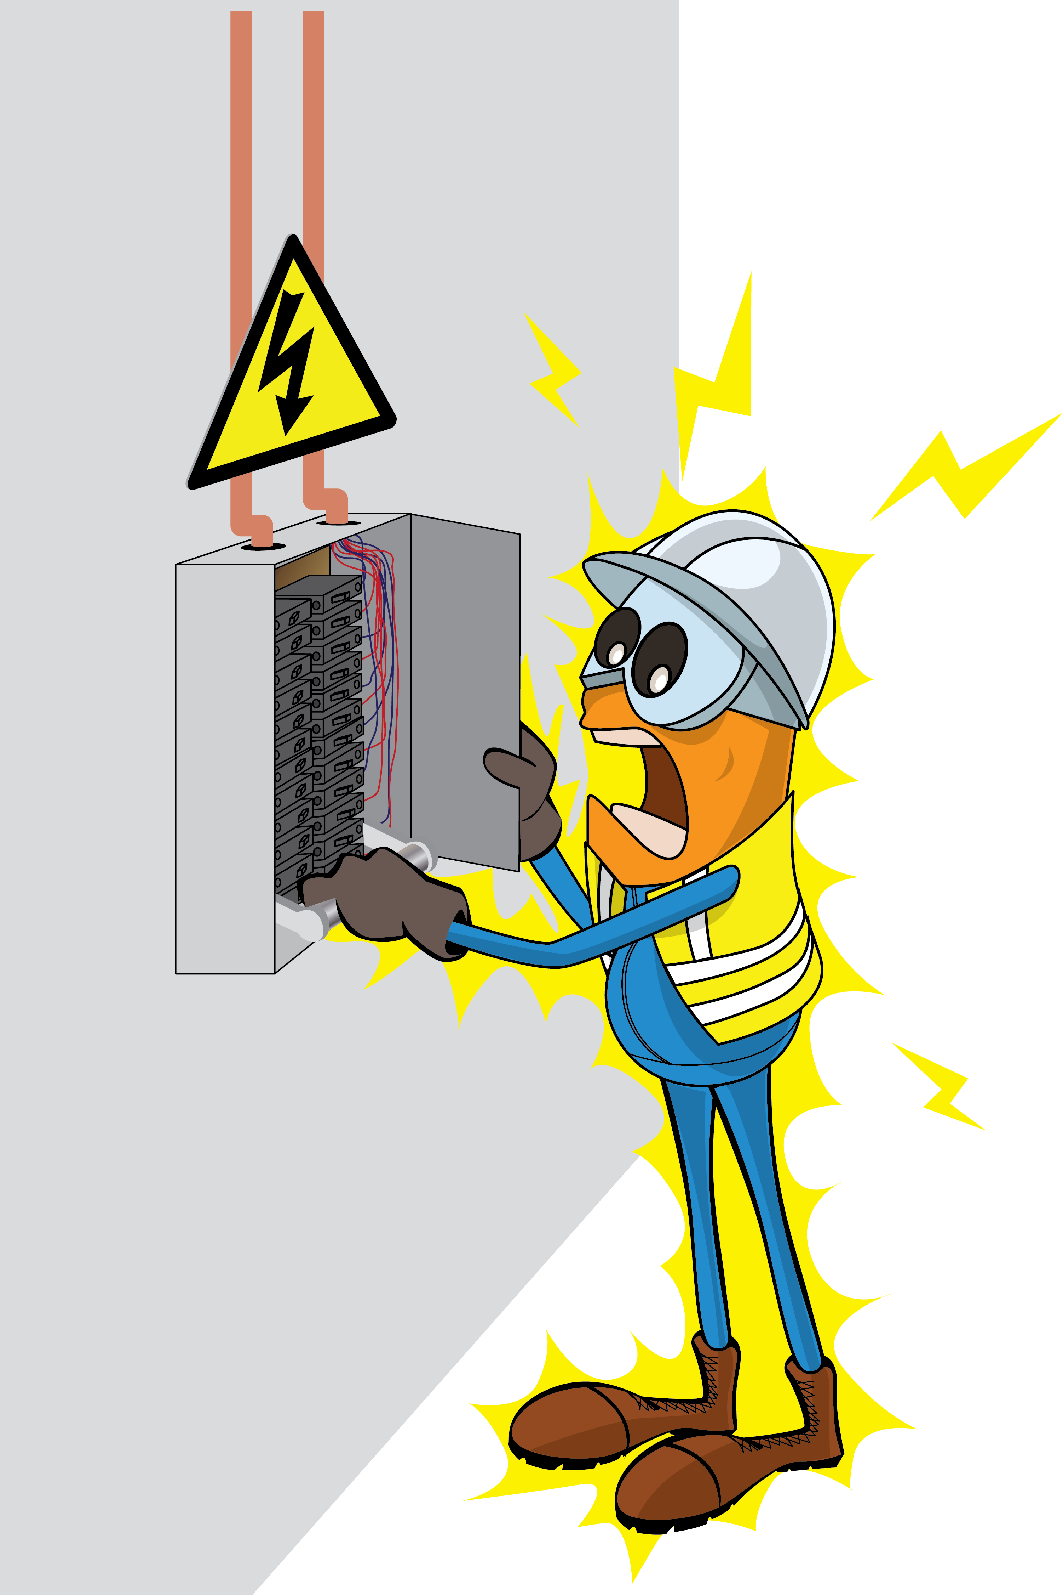
PDO Incident First Alert
Incident Type | LTI#22 | Pattern | Released energy | In case of an emergency please call PDO Emergency Number (Toll Free): 2467-5555
Date / Time | 14.06.2022@09:30hrs | Directorate
Location | Lekhwair | Dept
Target Audience: Well Engineering, Infrastructure, Operations, Engineering, Project Delivery & External Affairs
What happened
During troubleshooting in distribution board, Electrician noticed the fuse was not seated properly on the holder, he tried with both hands to push the fuse back to its holder causing the tool held in his hand to contact live part resulted in flash over causing 2nd degree burn on the right palm.
Mr. Musleh asks the questions of can it happen to you?
Have you obtained all safety documents prior to commencing the work?
Do you have right authorization to work in electrical?
Do you ensure the power is isolated before working on electrical distribution panel?
How do you ensure you identified all hazards before starting a task?
How do you ensure that every member of the team is fully aware about the hazards?
Are you using the right tools to carry out the job?
Please disseminate this LTI notification to your teams and use it in your tool box talks and HSE meetings and notice boards.

