Slide 1
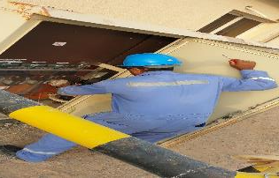
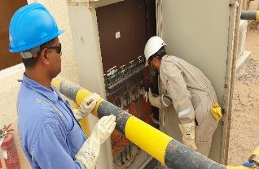
PDO Second Alert
Date:14/06/2022 Incident title: LTI#22 Pattern: Released Energy Potential severity: C4P
Target Audience: Drilling, Operation & Construction
What happened?
On June 14, 2022, at approximately 09:30 hrs. an electrical flashover occurred in a distribution board fuse unit at the site office. The incident occurred while the electrician (Office maintenance) was fixing a fuse unit on a live panel. The electrician was immediately taken to the PAC motel clinic for first aid administration, then transported to the hospital. The electrician suffered 2nd Degree Burn on his right hand.
Why it happened/Finding :
The electrician while fixing the fuse had screwdriver in his hand, which slipped and came into contact with live bus bar.
Electrician didn’t wear insulated electrical gloves.
The electrician was holding a metal screwdriver while fixing the fuse unit.
The electrical panel door was left open by CEP.
Your learning from this incident..
Always Comply with electrical equipment maintenance procedures PR 1947 & PR 1948
Always use Appropriate PPE while working on live electrical systems.
Always de energize, lock and tag out electrical systems prior to carrying out any work on Panel.
Always ensure only authorized persons are allowed to work on electrical systems.
Always ensure appropriate permits are in place prior to working any electrical systems.
Always use appropriate PPE whilst working with electrical systems
Notes:
Ensure all dates and titles are input
A short description should be provided without mentioning names of contractors or individuals. You should include, what happened, to who (by job title) and what injuries this resulted in. Nothing more!
Four to five bullet points highlighting the main findings from the investigation. Remember the target audience is the front line staff so this should be written in simple terms in a way that everyone can understand.
The strap line should be the main point you want to get across
The images should be self explanatory, what went wrong (if you create a reconstruction please ensure you do not put people at risk) and below how it should be done.

Slide 2
Management self audit
Date:14/06/2022 Incident title: LTI#22 Pattern: Released Energy Potential severity: C4P
As a learning from this incident and ensure continual improvement all contract managers must review their HSE risk management against the questions asked below
Confirm the following:
Do you ensure compliance to electrical safety system and procedures?
Do you ensure isolation, LOTO system prior to start work in electrical systems?
Do you ensure adequate supervision while working in electrical systems?
Do you ensure appropriate PPE is used prior to working in electrical panels and fuse boards?
Do you ensure learning from incidents implemented and sustained?
* If the answer is NO to any of the above questions please ensure you take action to correct this finding
Notes:
Ensure all dates and titles are input
Make a list of closed questions (only ‘yes’ or ‘no’ as an answer) to ask others if they have the same issues based on the management or HSE-MS failings or shortfalls identified in the investigation.
Imagine you have to audit other companies to see if they could have the same issues.
These questions should start with: Do you ensure…………………?

