Slide 1
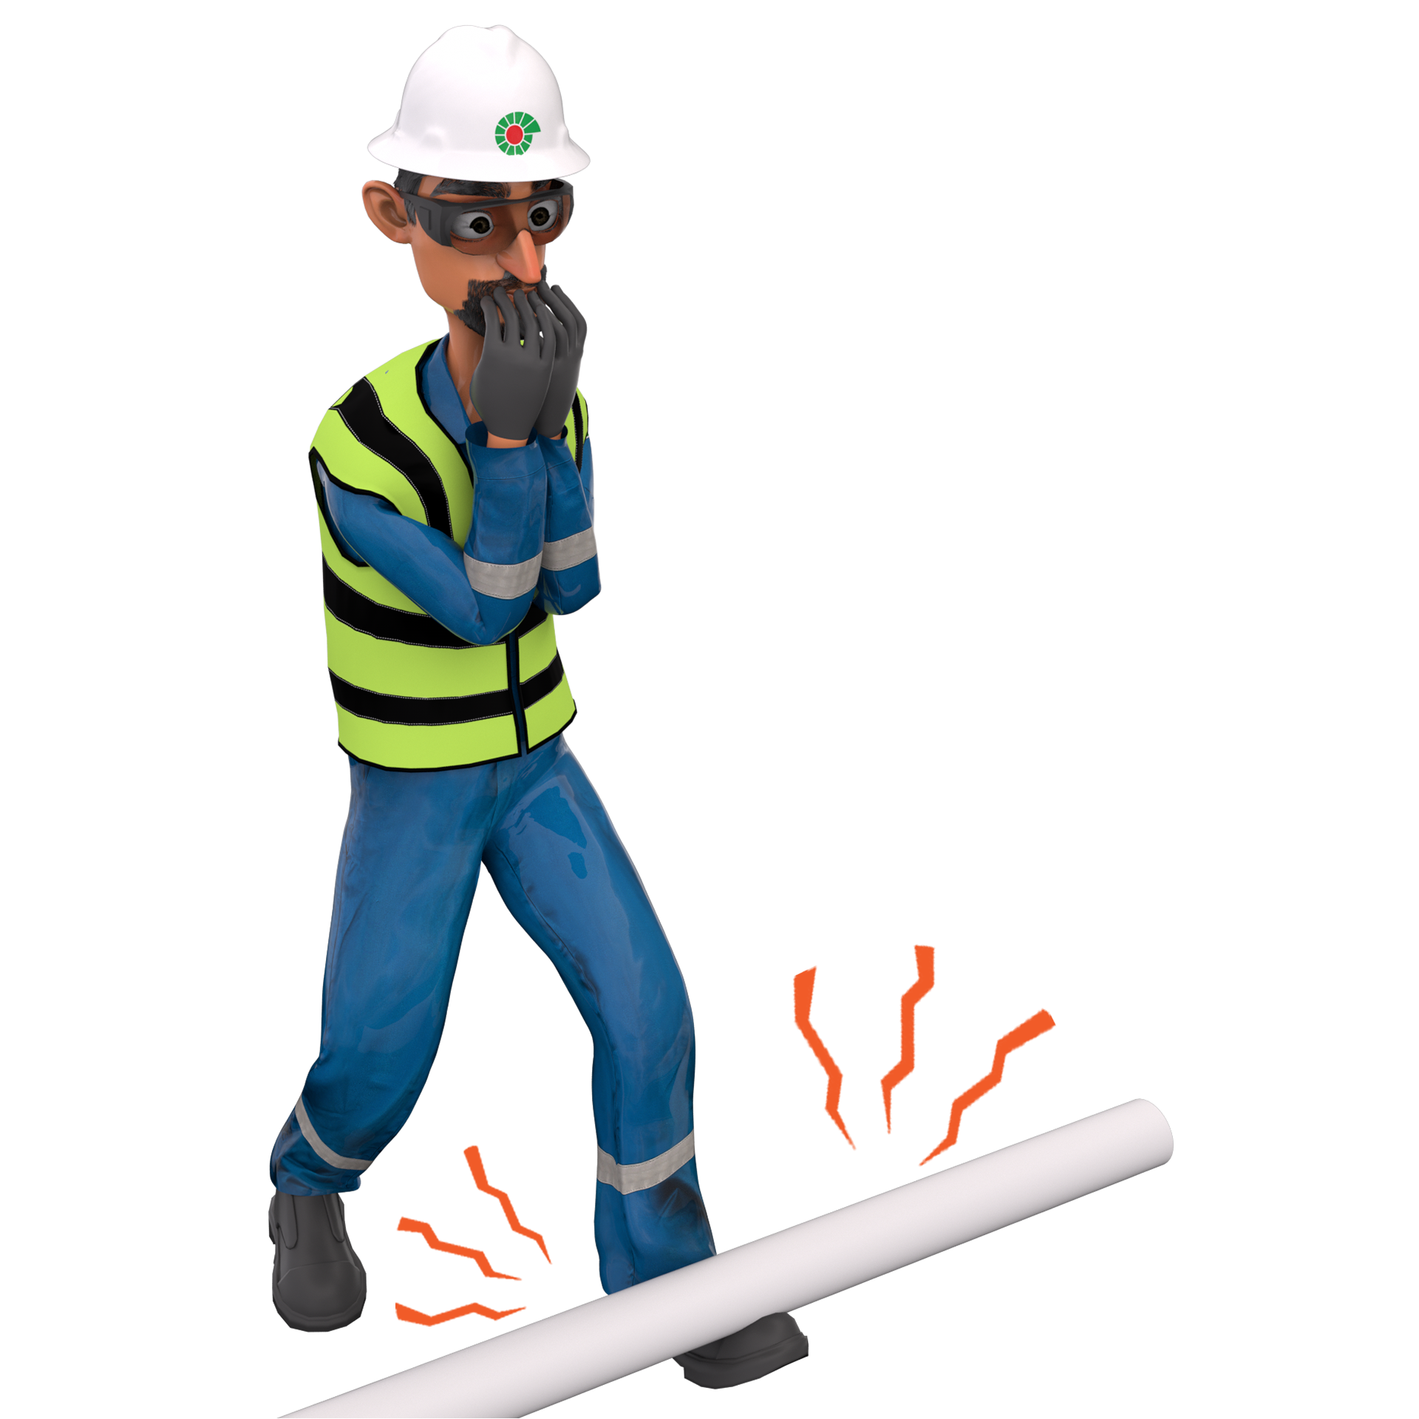
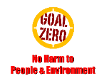
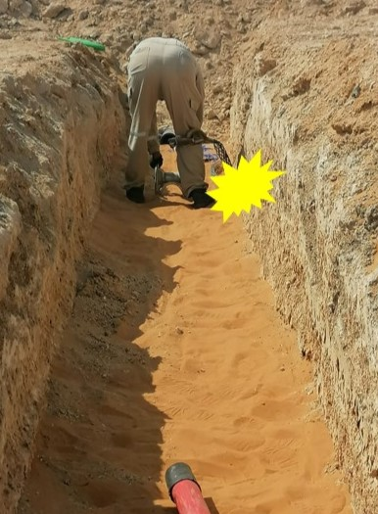
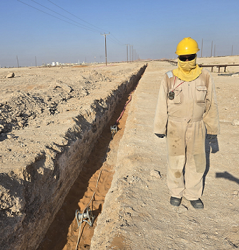
Learning From Incident - First Alert
Prevent
PIM # | 1171904 | Date & Time | 29.10.2024, 12:10 PM | Location | Lekhwair
Incident Type | LTI#23 | Category | Released Energy | Activity | Pulling HV Cable
Target Audience: All
What happened:
On 29th October 2024 around 12:10pm, the crew were carrying out a HV cable pulling activity. During the activity, the roller suddenly flipped, and the Lineman went inside the cable trench to fix it. Suddenly the HV cable socks got detached from the cable and hit the Lineman’s right leg. This resulted in a fracture of his right thigh bone.
Initial Findings:
Employee went into the trench while a the HV cable was tensioned with stored energy.
Employee was standing in the line of fire.
The risk of the cable sock detaching was not anticipated.
Engagement Questions:
How do you ensure you are always aware of line of fire risks?
How do you ensure employees are aware of the hazards and risks before commencing any task?
Do you ensure you know how to conduct dynamic risk assessment?
Be careful, avoid standing in the line of fire….!
In case of an emergency please call PDO Emergency Number (Toll Free): 2467-5555
Notes:
Mr Musleh image on the top right will change according to incident pattern, MSE3 will provide you with the image as per the pattern
What happened: A short description should be provided without mentioning names of contractors or individuals. You should include, what happened, to who (by job title) and what injuries this resulted in. Nothing more!
Initial Finding: Four to five bullet points highlighting the initial main findings from the investigation. Remember the target audience is the front-line staff so this should be written in simple terms in a way that everyone can understand.
Learnings: Four to five learning message in the form of questionnaires linked with initial findings
The strap line should be the main learning point you want to get across
The images should be self explanatory, what went wrong (if you create a reconstruction please ensure you do not put people at risk) and below how it should be done.

