Slide 1
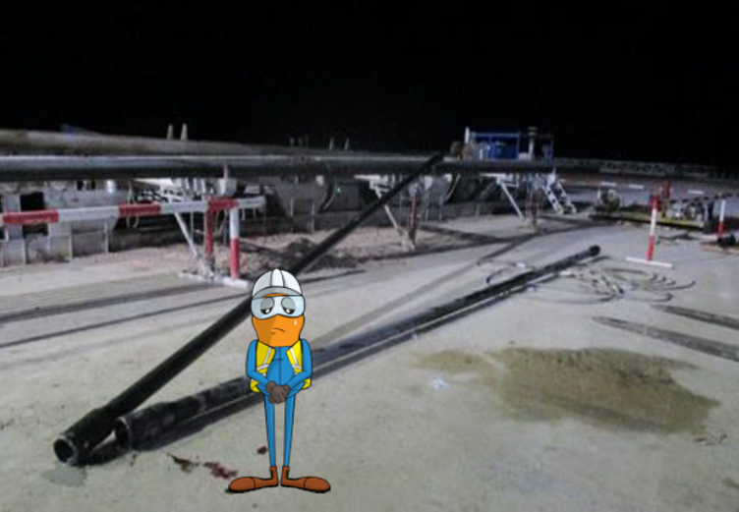
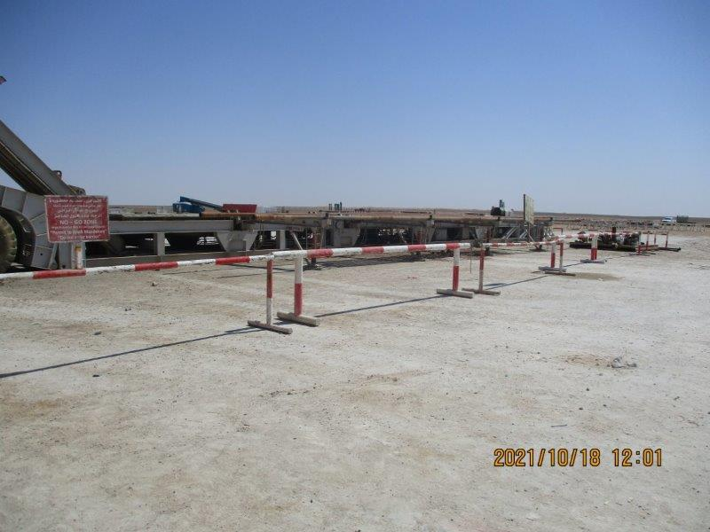
PDO Second Alert
Date:16/10/2021 Incident title: LTI#23 Pattern: Drops Potential severity: C3P
Target Audience: Drilling, Operations
What happened?
On October, 16 at around 23:51 Hrs after completing 7” liner job, 2 singles and 7 stands of 5” drill pipe were laid down on to the catwalk pipe racks. While forklift was trying to remove the two 5” singles of drill pipe they fell from the tilted-out riggers of the catwalk pipe rack. The NTP came to stop the forklift and assess the next operation During this intervention the loader reversed unit away from piperacks. One Drill pipe rolled across second dill pipe hitting the IP on his left leg.
Why it happened/Finding :
Poor planning on removing Singles of Drill Pipe
Pipe racks were in laydown mode contributed to make the task difficult.
Could have stopped the job and elevated the racks to horizontal and removed the two singles
SWA was partially enacted -
Line of fire was not identified and poorly recognized
No JSA /TBT were not held prior removing the two singles.
Your learning from this incident..
Ensure all the crew members respect the No Go zone management available at location.
Ensure review of POOH JSA while laying tubulars adding:
Recovery of tubular if miss handled (falls from racks)
Line of fire in the above event
Ensure when the task changes apply SWA , assess the risk associated to the task.
Ensure proper Job Planning is key to a successful for safe operation
Notes:
Ensure all dates and titles are input
A short description should be provided without mentioning names of contractors or individuals. You should include, what happened, to who (by job title) and what injuries this resulted in. Nothing more!
Four to five bullet points highlighting the main findings from the investigation. Remember the target audience is the front line staff so this should be written in simple terms in a way that everyone can understand.
The strap line should be the main point you want to get across
The images should be self explanatory, what went wrong (if you create a reconstruction please ensure you do not put people at risk) and below how it should be done.

Slide 2
Management self audit
Date:16/10/2021 Incident title: LTI#23 Pattern: Drops Potential severity: C3P
As a learning from this incident and ensure continual improvement all contract managers must review their HSE risk management against the questions asked below
Confirm the following:
- Do you ensure that line of fire are a part of TBT and identify.
- Do you ensure that banks man is in place during TBT.
- Do you ensure that when the task changes you require to re-assess the hazard
- Do you ensure that engagement of applying stop authority is practiced
- Do you ensure that supervisor controls the work Place
* If the answer is NO to any of the above questions please ensure you take action to correct this finding
Notes:
Ensure all dates and titles are input
Make a list of closed questions (only ‘yes’ or ‘no’ as an answer) to ask others if they have the same issues based on the management or HSE-MS failings or shortfalls identified in the investigation.
Imagine you have to audit other companies to see if they could have the same issues.
These questions should start with: Do you ensure…………………?

