Slide 1
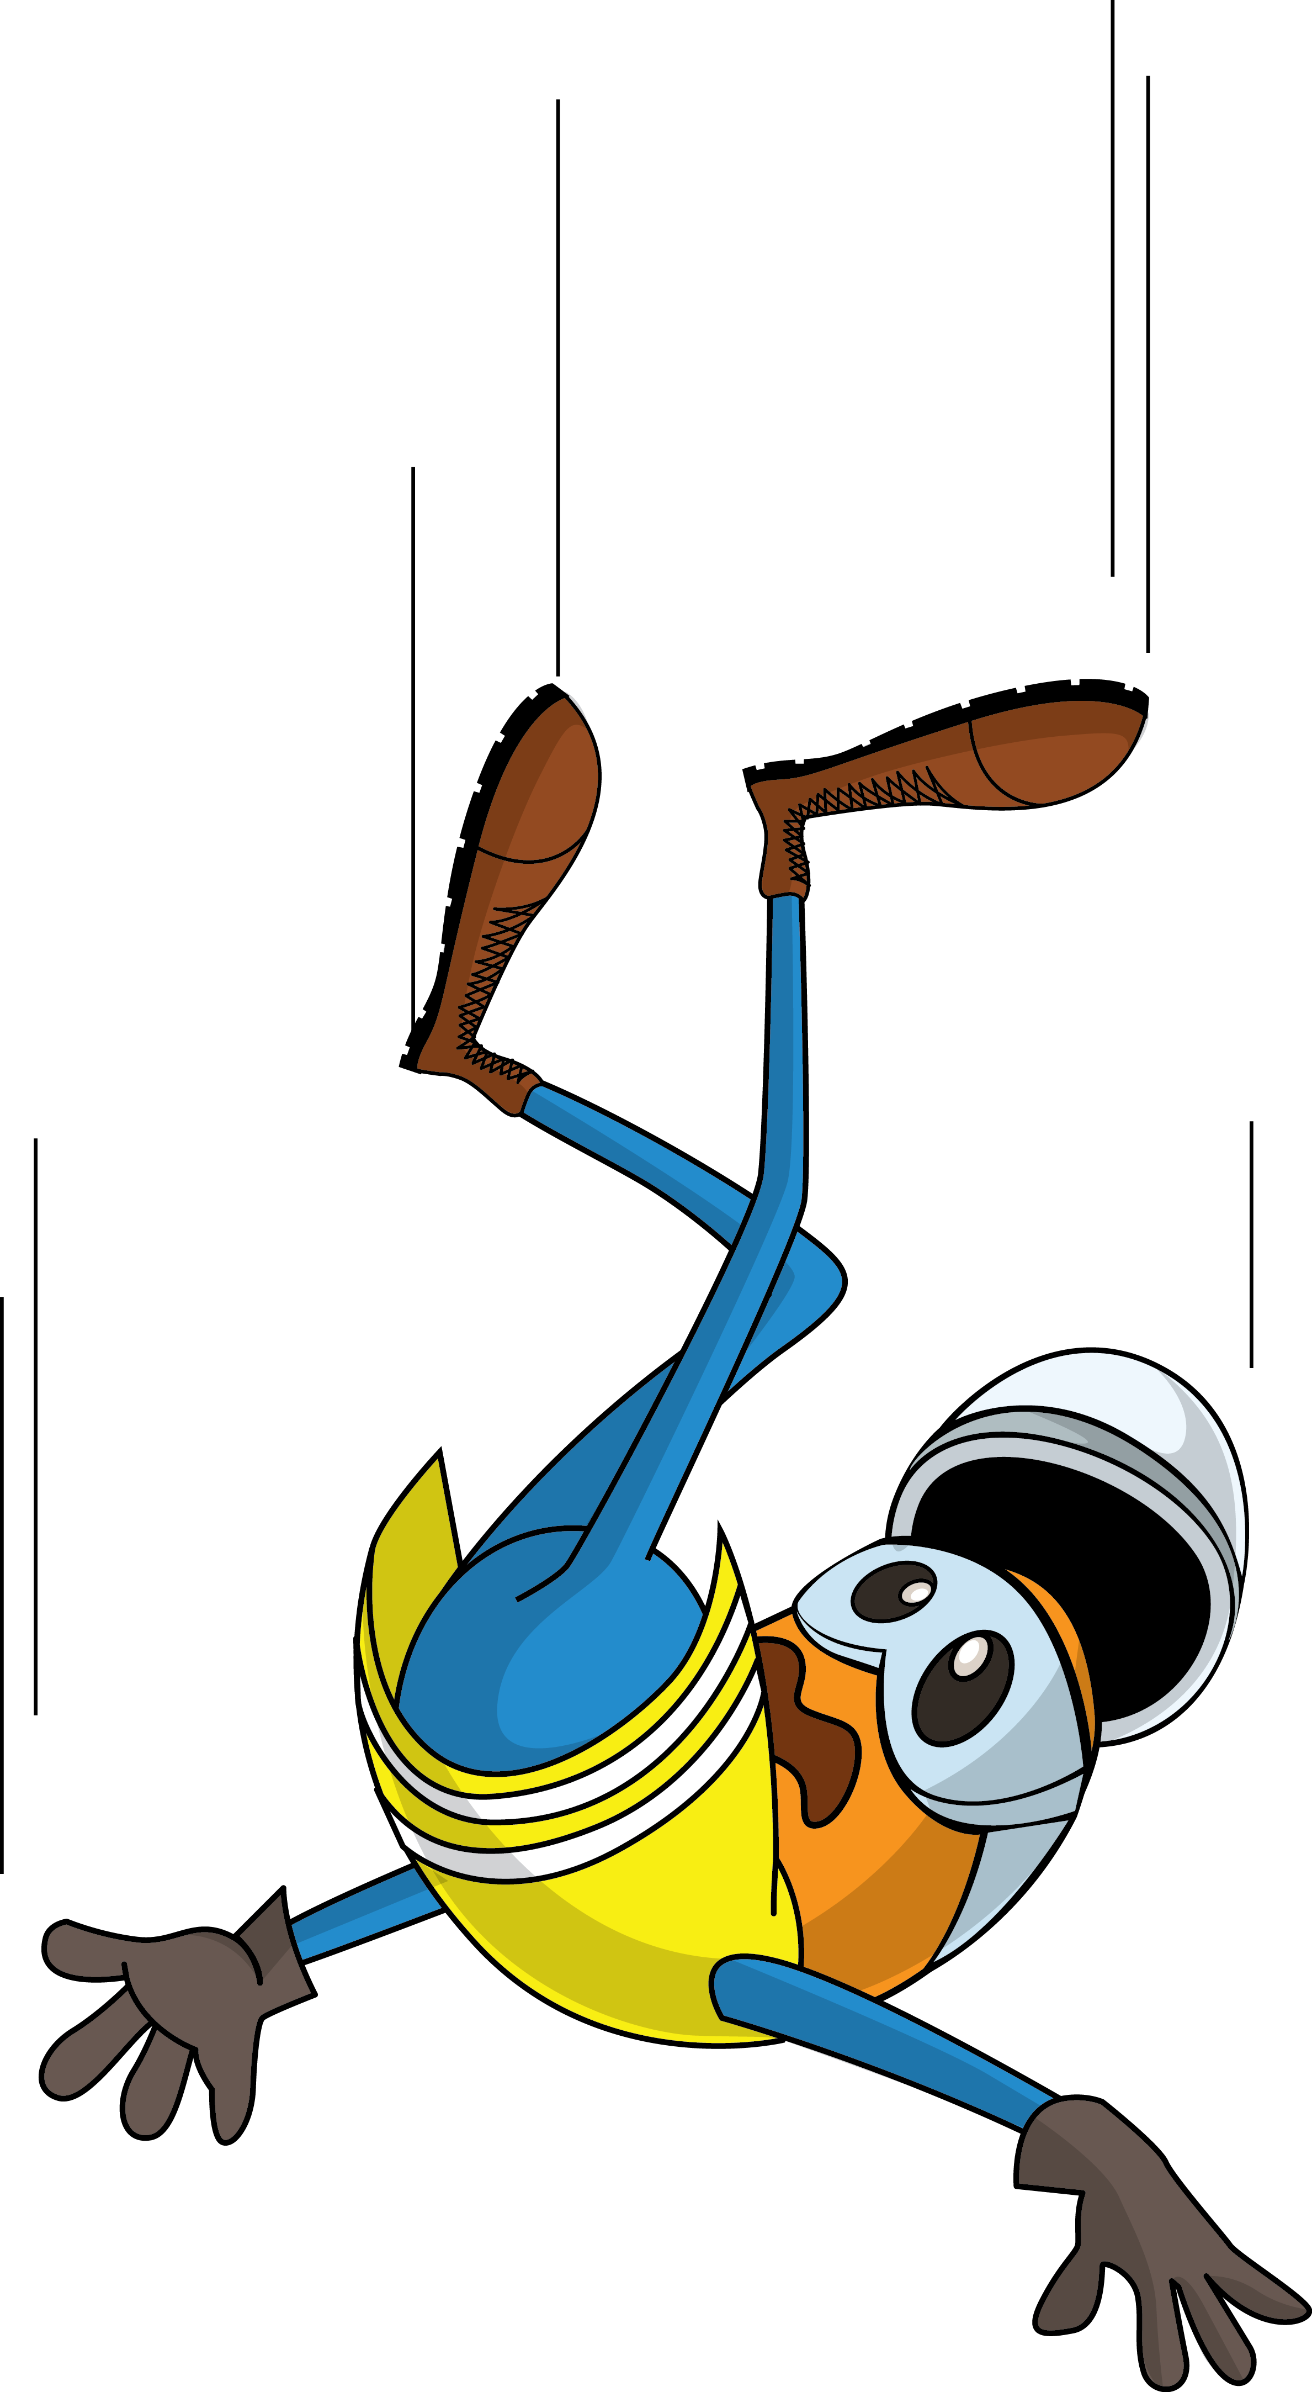
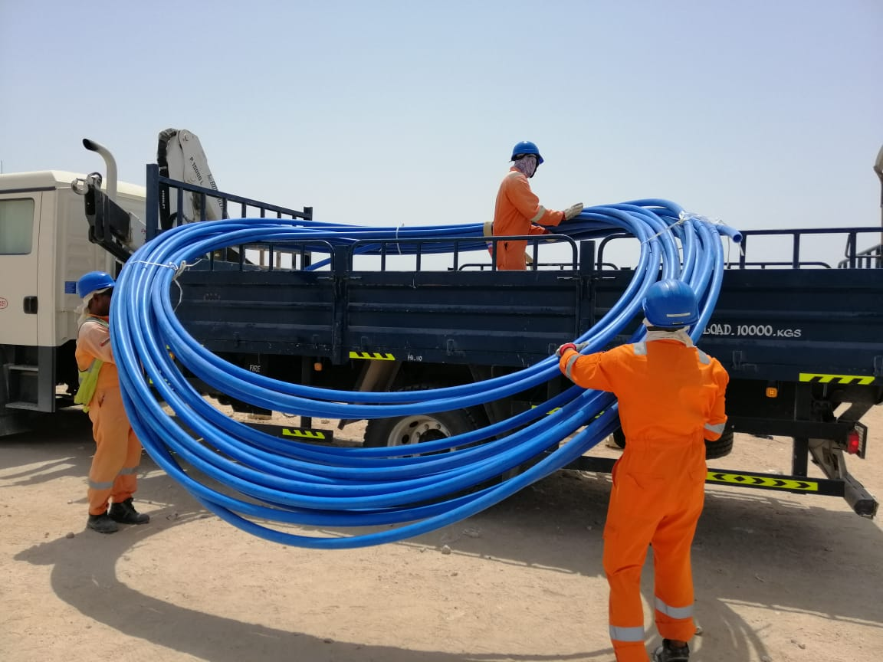
PDO Incident First Alert
Incident Type | LTI#23 | Pattern | Slip, Trip & Fall | In case of an emergency please call PDO Emergency Number (Toll Free): 2467-5555
Date / Time | 20.06.2022@12:10hrs | Directorate
Location | Saihrawl - Burhan | Dept
Target Audience: Well Engineering, Infrastructure, Operations, Engineering, Project Delivery & External Affairs
What happened
While crew were offloading the HDPE duct roll from the HIAB. The instrument technician manually pushed the HDPE duct from the HIAB and He lost balance and hit his right-hand elbow to the right side of the HIAB causing fracture elbow.
Mr. Musleh asks the questions of can it happen to you?
Do you ensure proper supervision to perform the task?
Do you ensure that you are stood in a safe place?
Do you ensure you are away from “Line of fire”?
Do you consider “what could go wrong?”
Do you observe your colleague’s action during task and intervene if required?
Please disseminate this LTI notification to your teams and use it in your tool box talks and HSE meetings and notice boards.

