Slide 1
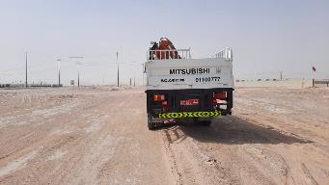
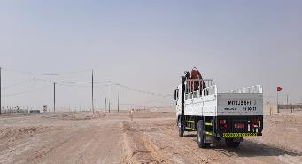
PDO Second Alert
Date: 04/11/2021 Incident title: LTI#27 & 28/ Fatality 3 & 4 Pattern: MVI Potential severity: C4P
Target Audience: Drilling, Logistics, Operation & Construction
What happened?
On the 4th of November 2021 at approximately 14:30 hrs. Whilst travelling from Ibri to Yibal, a pickup with driver and 2 passengers has collided with the rear of a stationary Hiab on a straight section of graded road. As a result of this incident both pickup passengers passed away, while the driver of the pickup sustained only minor injuries. The Hiab driver was out of the vehicle and uninjured in this event
Why it happened/Finding :
Driver of the pickup was not paying attention to the road causing to collide with the stationary parked truck
Driver of pickup failed to stop the vehicle when he was distracted
Driver of the Hiab truck parked 1 meter inside the road resulting in the pickup colliding with the stationary truck
Driver of the pickup was driving a vehicle with a disconnected IVMS system
Your learning from this incident..
Always focus on the road and do not get distracted
Always STOP the vehicle when you are facing any distraction.
Always park the vehicles outside the road during an emergency and put warning signs to ensure visibility
Always inspect IVMS devices before starting the journey.
Notes:
Ensure all dates and titles are input
A short description should be provided without mentioning names of contractors or individuals. You should include, what happened, to who (by job title) and what injuries this resulted in. Nothing more!
Four to five bullet points highlighting the main findings from the investigation. Remember the target audience is the front line staff so this should be written in simple terms in a way that everyone can understand.
The strap line should be the main point you want to get across
The images should be self explanatory, what went wrong (if you create a reconstruction please ensure you do not put people at risk) and below how it should be done.

Slide 2
Management self audit
Date: 04/11/2021 Incident title: LTI#27 & 28/ Fatality 3 & 4 Pattern: MVI Potential severity: C4P
As a learning from this incident and ensure continual improvement all contract managers must review their HSE risk management against the questions asked below
Confirm the following:
Do you ensure that you park your vehicles in case of emergency outside the road?
Do you ensure that you check the IVMS is working before moving the vehicle?
Do you ensure that your drivers are learning from incidents?
Do you ensure that you are focused on the road and always apply defensive driving?
Do you ensure that the IVMS system sends the required alarms to the system?
Do you ensure that the passengers of moving vehicles escalate if they observe a distracted driver or fatigued driver
* If the answer is NO to any of the above questions please ensure you take action to correct this finding
Notes:
Ensure all dates and titles are input
Make a list of closed questions (only ‘yes’ or ‘no’ as an answer) to ask others if they have the same issues based on the management or HSE-MS failings or shortfalls identified in the investigation.
Imagine you have to audit other companies to see if they could have the same issues.
These questions should start with: Do you ensure…………………?

