Slide 1
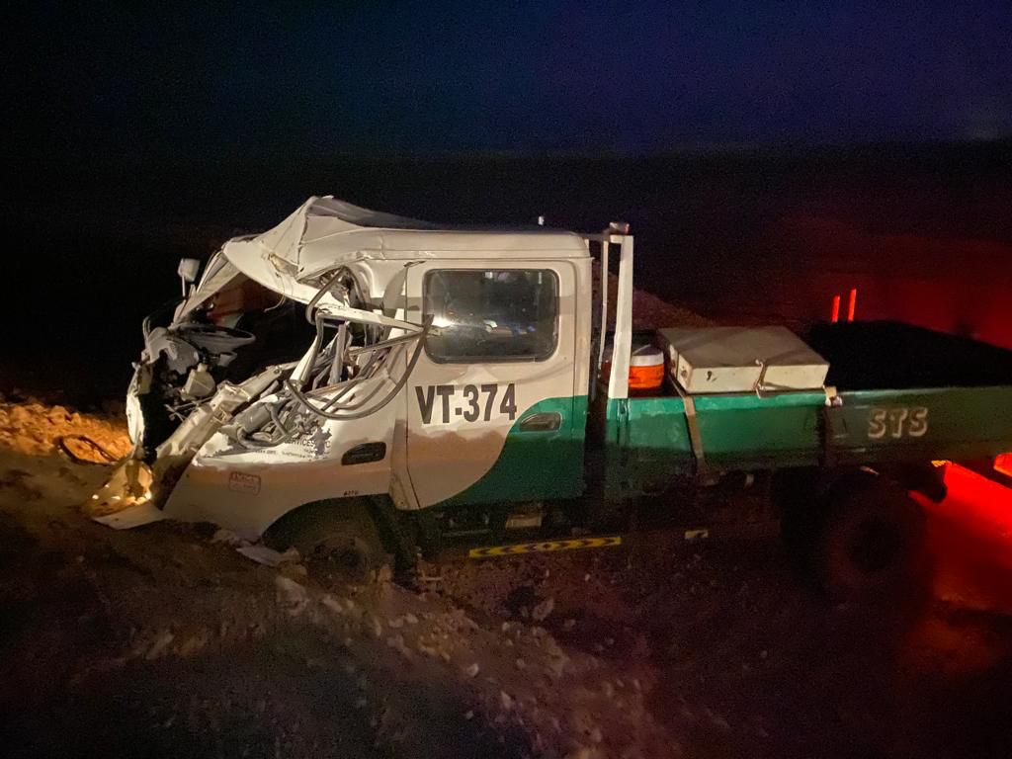
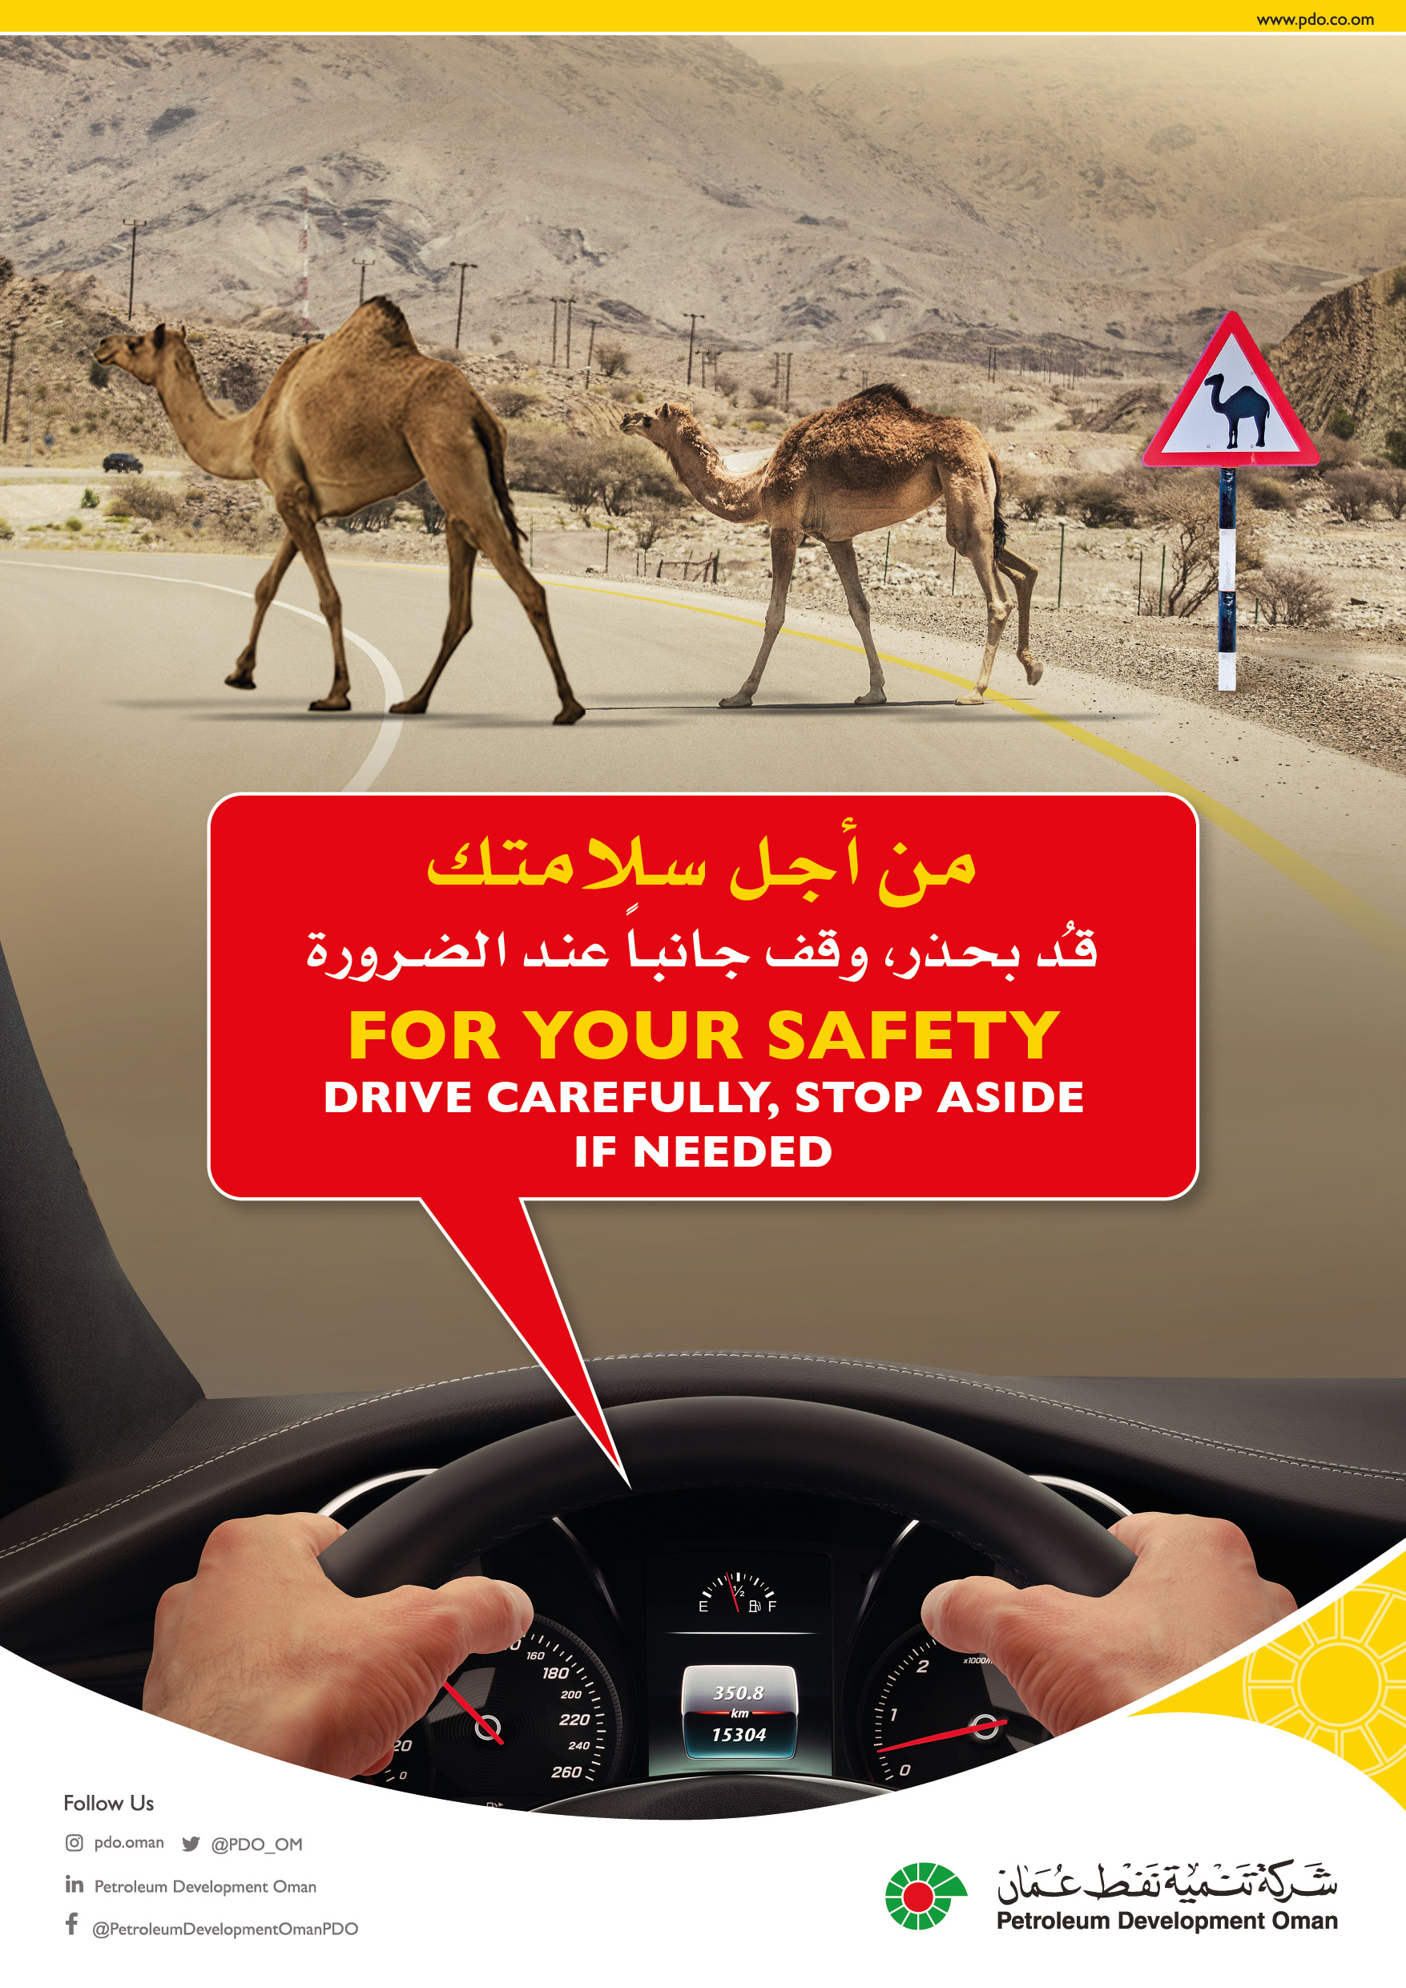
PDO Second Alert
Date: 07/11/2021 Incident title: LTI#29/ Fat#05 Pattern: MVI (Fatality) Potential severity: C4P
Target Audience: Drilling, Logistics, Operation & Construction
What happened?
On 07th Nov 2021 around 18:10 hrs, a Canter driver with 3 passengers were travelling from Mabrouk to Qarn Alam. While travelling on blacktop road after Saih Rawl T-junction, a Camel entered the road from left side and hit the canter causing driver to lose control over the vehicle. The vehicle went off the road, jumped over the first windrow and halted at second windrow. The incident resulted in Fatal head injury & multiple face injuries to the driver, minor injuries (First Aid) to 3 passengers and significant damage to the vehicle.
Why it happened/Finding :
Over speeding during night and didn’t follow defensive driving techniques
Desert animals passing on the road
Night driving speed limit not set in IVMS considering the seasonal changes.
Your learning from this incident..
Always follow defensive driving techniques
Always reduce speed of vehicle as per the conditions on road
Always expect the unexpected on road and take necessary precautions
Always intervene unsafe actions and behavior
Always follow defensive driving, and expect the unexpected
Notes:
Ensure all dates and titles are input
A short description should be provided without mentioning names of contractors or individuals. You should include, what happened, to who (by job title) and what injuries this resulted in. Nothing more!
Four to five bullet points highlighting the main findings from the investigation. Remember the target audience is the front line staff so this should be written in simple terms in a way that everyone can understand.
The strap line should be the main point you want to get across
The images should be self explanatory, what went wrong (if you create a reconstruction please ensure you do not put people at risk) and below how it should be done.

Slide 2
Management Self Audit
Date:07/11/2021 Incident title: FAT#05/LTI#29, Pattern: MVI, Fatality. Potential severity: C4P
As a learning from this incident and ensure continual improvement all contract managers must review their HSE risk management against the questions asked below
Confirm the following:
Do you ensure your drivers always follow defensive driving techniques for night driving?
Do you remind your drivers about the night journey requirements including speed limits?
Do you ensure familiarization and Site management engagement with drivers coming from other locations for shutdown?
Do you ensure HSE readiness prior to shutdown?
Do your consider accommodation requirements and arrangements against road safety exposure?
Do you ensure that additional control measures are in place to mitigate the risk of not setting the IVMS parameters according to seasonal changes?
* If the answer is NO to any of the above questions please ensure you take action to correct this finding
Notes:
Ensure all dates and titles are input
Make a list of closed questions (only ‘yes’ or ‘no’ as an answer) to ask others if they have the same issues based on the management or HSE-MS failings or shortfalls identified in the investigation.
Imagine you have to audit other companies to see if they could have the same issues.
These questions should start with: Do you ensure…………………?

