Slide 1
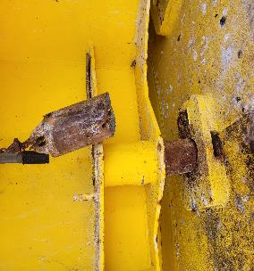
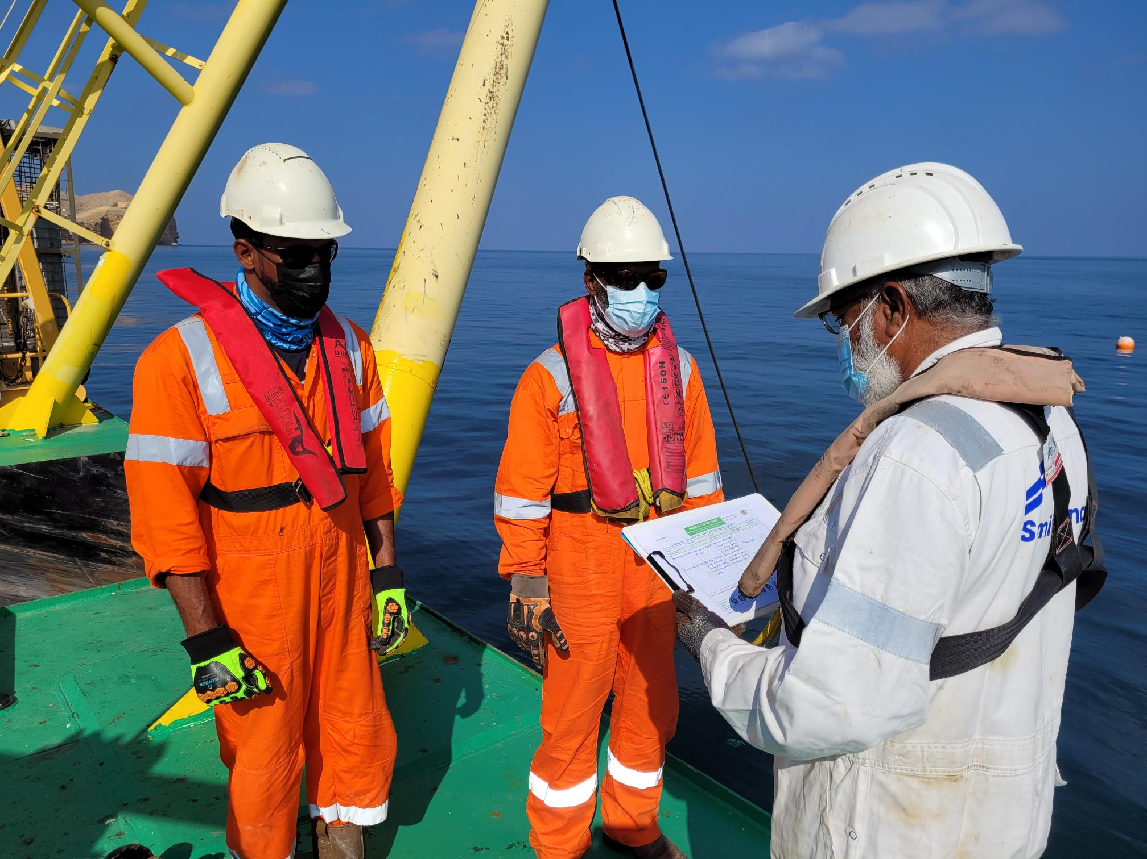
PDO Second Alert
Date: 08/11/2021 Incident title: LTI#30 Pattern: Hands & Fingers Potential severity: D3P
Target Audience: Drilling, Logistics, Operation & Construction
What happened?
On 8th November @19:20hrs. The maintenance barge Fahal 2 was moored alongside Single Mooring Buoy (SBM) 1, continuing work to install a subsea loading hose string. To prevent the SBM turret from rotating the provided locking pin had been fitted at the start of the day. A sea swell was causing the barge to surge with the SBM. The locking pin sheared inside the guide tube and was being extracted by three members of the team, when the SBM turret began to rotate, a call to ‘keep clear’ was shouted, however the Diver did not remove his hand from the line of fire in time and the SBM turntable locking pin fell on the diver's hand causing a fracture to the right-hand index finger.
Why it happened/Finding :
Sea swell and current acting on SBM & barge caused the locking pin to fail
The broken locking pin was too heavy to move by hand
The task had not been risk assessed
The supervisors were not informed of the failure or present during the task
Your learning from this incident..
Employ the use of TRIC during changes in tasks
Raise awareness of PDO Golden Rules, Comply, Intervene, Respect
Always ensure you keep your hands and fingers away from pinch points (Line of Fire)
Always ensure you identify all hazards before starting a task
Always ensure you have considered the use of a tool instead of using your hands
Always wear impact gloves wherever required
Notes:
Ensure all dates and titles are input
A short description should be provided without mentioning names of contractors or individuals. You should include, what happened, to who (by job title) and what injuries this resulted in. Nothing more!
Four to five bullet points highlighting the main findings from the investigation. Remember the target audience is the front line staff so this should be written in simple terms in a way that everyone can understand.
The strap line should be the main point you want to get across
The images should be self explanatory, what went wrong (if you create a reconstruction please ensure you do not put people at risk) and below how it should be done.

Slide 2
Management self audit
Date: 08/11/2021 Incident title: LTI#30 Pattern: Hands & Fingers Potential severity: D3P
As a learning from this incident and ensure continual improvement all contract managers must review their HSE risk management against the questions asked below
Confirm the following:
Do you ensure that all hazards are identified and captured in Risk Management?
Do you ensure that you have a procedure for all your activities?
Do you ensure that all TBTs are effective?
Do you ensure that all Learning from incident are effectively implemented at site?
* If the answer is NO to any of the above questions please ensure you take action to correct this finding
Notes:
Ensure all dates and titles are input
Make a list of closed questions (only ‘yes’ or ‘no’ as an answer) to ask others if they have the same issues based on the management or HSE-MS failings or shortfalls identified in the investigation.
Imagine you have to audit other companies to see if they could have the same issues.
These questions should start with: Do you ensure…………………?

