Slide 1
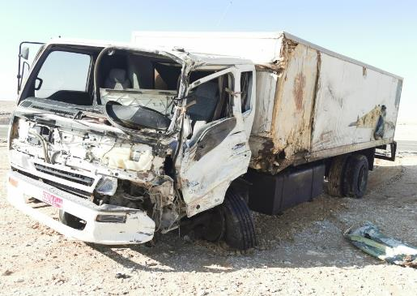
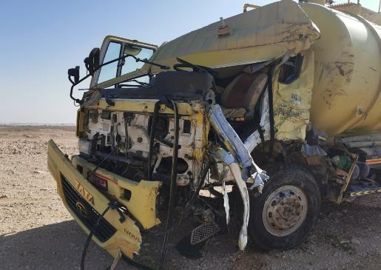
PDO Second Alert
Date:25/11/2021 Incident title: LTI#32 Pattern: MVI Potential severity: C4P
Target Audience: Drilling, Logistics, Operation & Construction
What happened?
On 25th Nov 2021 at approximately 04:25 hours, sewage tanker driver was driving from Rima toward HAIMA to offload the sewage water in HAIMA sewage treatment plant. Once he reached Al Ghubar south village about 25 KM from start point (Abraj Camp) a third-party vehicle (fish truck) coming from opposite side of the road and entered the sewage tanker lane causing head on collision with sewage tanker. As a result of this incident, sewage tanker driver sustained minor injuries and third-party driver had fracture of his right arm, also major damages to both vehicles. Both drivers were evacuated to HAIMA Hospital by ROP for treatment.
Why it happened/Finding :
3rd party vehicle entered the sewage tanker lane
Unpermitted night driving journey
Driver was above 60 years old without medical waver
Internal self-verification did not identify gaps with contractors
Driver was Driving in foggy weather
Sewage Driver Driving with expire Defensive Driving permit
IVMS system fitted in the sewage tanker but non-functional
Sewage driver start night driving without informing anyone
Your learning from this incident..
Always make sure to follow Road safety / Journey management requirements
Always communicate with journey manager prior any journey
Always make sure not to drive in foggy weather
Always be attentive to other road users
Make sure the Vehicles are fitted with IVMS and it’s in working condition
Ensure defensive driving training of all drivers is valid
Notes:
Ensure all dates and titles are input
A short description should be provided without mentioning names of contractors or individuals. You should include, what happened, to who (by job title) and what injuries this resulted in. Nothing more!
Four to five bullet points highlighting the main findings from the investigation. Remember the target audience is the front line staff so this should be written in simple terms in a way that everyone can understand.
The strap line should be the main point you want to get across
The images should be self explanatory, what went wrong (if you create a reconstruction please ensure you do not put people at risk) and below how it should be done.

Slide 2
Management self audit
Date:25/11/2021 Incident title: LTI#32 Pattern: MVI Potential severity: C4P
As a learning from this incident and ensure continual improvement all contract managers must review their HSE risk management against the questions asked below
Confirm the following:
Do you ensure all the drivers are aware about OPAL Road Safety Standard?
Do you ensure all the drivers attended OPAL Defensive Driving Trainings?
Do you ensure to verify drivers training record?
Do you monitor employees, contractors and sub contractors age ?
Do you verify vehicle inspections?
Do you monitor contractors and sub contractors IVMS?
Do you ensure to conduct Audits/Inspections for sub contractors?
* If the answer is NO to any of the above questions please ensure you take action to correct this finding
Notes:
Ensure all dates and titles are input
Make a list of closed questions (only ‘yes’ or ‘no’ as an answer) to ask others if they have the same issues based on the management or HSE-MS failings or shortfalls identified in the investigation.
Imagine you have to audit other companies to see if they could have the same issues.
These questions should start with: Do you ensure…………………?

