Slide 1
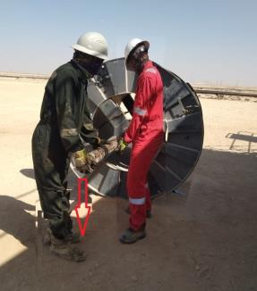
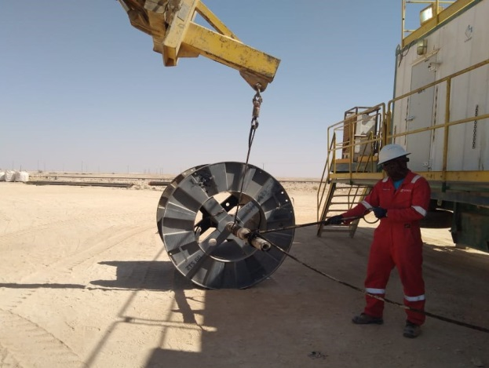
PDO Second Alert
Date: 30/11/2021 Incident title: LTI # 34 Pattern: Drops Potential severity: C3P
Target Audience: Drilling, Logistics, Operation & Construction
What happened?
On the 30th November at around 6:30hrs Borets Crew leader attempted to remove the shaft for ESP (Electronic Submersible Pump) cable reel by pulling it manually from one end . The Roustabout decided to provide help, while the Roustabout was assisting in pulling the shaft from cable spooler, the shaft got detached from the reel and fell on his right foot causing fracture.
Why it happened/Finding :
Incorrect decision made by the supervisor to pull shaft manually.(Shaft is 2.3 meter long , weighed around 100 kg and fall from a height of 77 cm above ground level.)
No permission was taken from hoist supervisor to perform this task.
Roustabout stand in wrong position (LOF) while pulling the shaft.
Specific JSA for installation/removal of shaft from the reel was not available.
Proper Safety boots were worn by the roustabout at the time of incident.
No intervention by roustabout and service company crew team lead.
Your learning from this incident:
Always Enhance Supervision and practice empowerment to stop work.
Always ensure to Develop and communicate SOP/JSA for any task
Always ensure not to involve / perform any task if you are not been assigned or instructed by your supervisor.
Always ensure to manage third party at your location.
Always ensure to stay away from LOF.
Notes:
Ensure all dates and titles are input
A short description should be provided without mentioning names of contractors or individuals. You should include, what happened, to who (by job title) and what injuries this resulted in. Nothing more!
Four to five bullet points highlighting the main findings from the investigation. Remember the target audience is the front line staff so this should be written in simple terms in a way that everyone can understand.
The strap line should be the main point you want to get across
The images should be self explanatory, what went wrong (if you create a reconstruction please ensure you do not put people at risk) and below how it should be done.

Slide 2
Management self audit
Date: 30/11/2021 Incident title: LTI # 34 Pattern: Drops Potential severity: C3P
As a learning from this incident and ensure continual improvement all contract managers must review their HSE risk management against the questions asked below
Confirm the following:
Do you ensure that Third party checklist was properly utilized in the unit?
Do you ensure that TBT was conducted by Third party Supervisor covering all hazards and risk mitigation?
Do you ensure SOP/JSA covers the full operation related to ESP jobs?
Do you ensure that employee stand in a safe place away from line of fire?
Do you ensure that employees are intervening/SWA for all unsafe act/condition?
Do you ensure that SOP/JSA provided by service company upon arrival at site?
* If the answer is NO to any of the above questions please ensure you take action to correct this finding
Notes:
Ensure all dates and titles are input
Make a list of closed questions (only ‘yes’ or ‘no’ as an answer) to ask others if they have the same issues based on the management or HSE-MS failings or shortfalls identified in the investigation.
Imagine you have to audit other companies to see if they could have the same issues.
These questions should start with: Do you ensure…………………?

