Slide 1
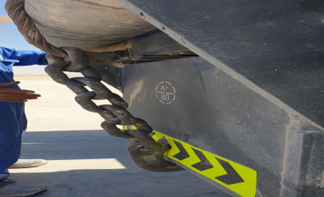
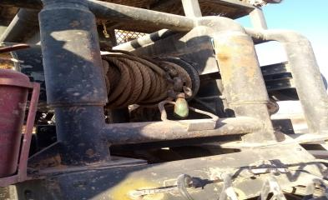
PDO Second Alert
Date: 05/12/2021 Incident title: LTI#35 Pattern: Hands & Fingers Potential severity: C3P
Target Audience: Drilling, Logistics
What happened?
A helper was assisting prime mover driver to hook up the wire rope onto the chassis, whilst doing so his 2 fingers on his right hand were trapped between the hook and the chassis as the driver was winching the wire rope into the winch drum. The Helper was transferred to Haima Hospital (approx. 50km away from the incident location) with assistant rig move Supervisor in Truckoman pickup. The Helper was later referred to Muscat for advanced treatment where he received surgery approx. 12 hours following the incident
Why it happened/Finding :
The winch rope was hooked onto the chassis instead of built-in D-ring (shortcut)
The helper placed his finger on the line of fire
The driver did not wait for signal to spool the rope (communication)
No intervention has been made by the third person
No Supervision was provided to the task
Your learning from this incident..
Always ensure to place your body parts away from line of fire
Always ensure you can see and be seen
Always communicate properly before performing any task with other colleague
Always ensure proper Supervision in place
Always do Intervention on seeing any unsafe act or unsafe condition
Notes:
Ensure all dates and titles are input
A short description should be provided without mentioning names of contractors or individuals. You should include, what happened, to who (by job title) and what injuries this resulted in. Nothing more!
Four to five bullet points highlighting the main findings from the investigation. Remember the target audience is the front line staff so this should be written in simple terms in a way that everyone can understand.
The strap line should be the main point you want to get across
The images should be self explanatory, what went wrong (if you create a reconstruction please ensure you do not put people at risk) and below how it should be done.

Slide 2
Management self audit
Date: 05/12/2021 Incident title: LTI#35 Pattern: Hands & Fingers Potential severity: C3P
As a learning from this incident and ensure continual improvement all contract managers must review their HSE risk management against the questions asked below
Confirm the following:
Do you ensure all activities performed are included in HEMP and SOP ?
Do you ensure all hazards are captured in each document review for critical tasks?
Do you regularly communicate the pinch points risks?
Do you ensure that you conduct regular task / worksite observations?
Do you encourage staff to use their empowerment to STOP if required?
Do you ensure audits covers all safety critical activities ?
* If the answer is NO to any of the above questions please ensure you take action to correct this finding
Notes:
Ensure all dates and titles are input
Make a list of closed questions (only ‘yes’ or ‘no’ as an answer) to ask others if they have the same issues based on the management or HSE-MS failings or shortfalls identified in the investigation.
Imagine you have to audit other companies to see if they could have the same issues.
These questions should start with: Do you ensure…………………?

