Slide 1
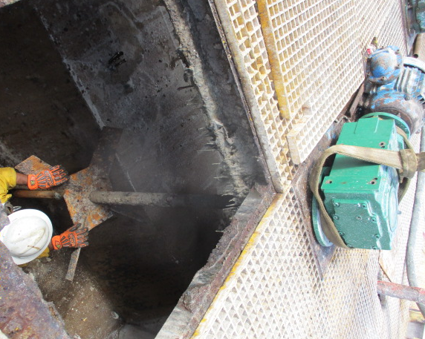
PDO Second Alert
Date:15/12/2021 Incident title: LTI#36 Pattern: Hands and Fingers Potential severity: D3P
Target Audience: Drilling, Operation & Construction
What happened?
On 15.12.2021 at 0855hrs installation of the new mud agitator gear box was in progress. The Asst. Mechanic entered the suction tank in order to install the foundation bolts. The Rig Sr. Mechanic and HIAB Operator were attempting to align the gear box. While doing so, the gear box unexpectedly jerked and the Asst. Mechanic received the injury of his left-hand inner palm. The work was stopped immediately, and the Asst. Mechanic was shifted to the clinic for medical assistance
Why it happened/Finding :
The Asst. Mechanic placed his hands in the line of fire
The Asst. Mechanic was not wearing impact gloves at the time of the incident
The communication between the parties was inadequate
The supervision was inadequate
The Lift Plan was inadequate and did not address the risks and controls of the lift
The PTW controls were not properly implemented
Your learning from this incident..
Always be aware of pinch points and Line of Fire hazards
Always wear proper PPE as the last line of defense
Always perform risk assessment and identify the risks
Always implement the PTW controls prior to authorizing the task
Always supervise the task
Always have a proper approved lift plan
Always ensure to use of right lifting equipment for the task.
Always intervene and STOP unsafe practices to prevent incidents
Notes:
Ensure all dates and titles are input
A short description should be provided without mentioning names of contractors or individuals. You should include, what happened, to who (by job title) and what injuries this resulted in. Nothing more!
Four to five bullet points highlighting the main findings from the investigation. Remember the target audience is the front line staff so this should be written in simple terms in a way that everyone can understand.
The strap line should be the main point you want to get across
The images should be self explanatory, what went wrong (if you create a reconstruction please ensure you do not put people at risk) and below how it should be done.

Slide 2
Management self audit
Date:15/12/2021 Incident title: LTI#36 Pattern: Hands and Fingers Potential severity: D3P
As a learning from this incident and ensure continual improvement all contract managers must review their HSE risk management against the questions asked below
Confirm the following:
Do you ensure that Short Service Employee Management Program is adequately implemented?
Do you ensure that PTW Signatory understands his responsibilities and verifies the controls prior to authorizing the task?
Do you ensure that field personnel comply with PPE requirements?
Do you ensure that field personnel can raise their concerns to the site management and get appropriate actions?
Do you ensure that tasks are being planned properly and prioritized so that there are no conflicts between various tasks?
Do you ensure the proper and approved plan lift for the task?
Do you ensure that personnel have confidence in implementing and understand the Stop Work Authority
Do you ensure the right lifting equipment for the task ?
* If the answer is NO to any of the above questions please ensure you take action to correct this finding
Notes:
Ensure all dates and titles are input
Make a list of closed questions (only ‘yes’ or ‘no’ as an answer) to ask others if they have the same issues based on the management or HSE-MS failings or shortfalls identified in the investigation.
Imagine you have to audit other companies to see if they could have the same issues.
These questions should start with: Do you ensure…………………?

