Slide 1
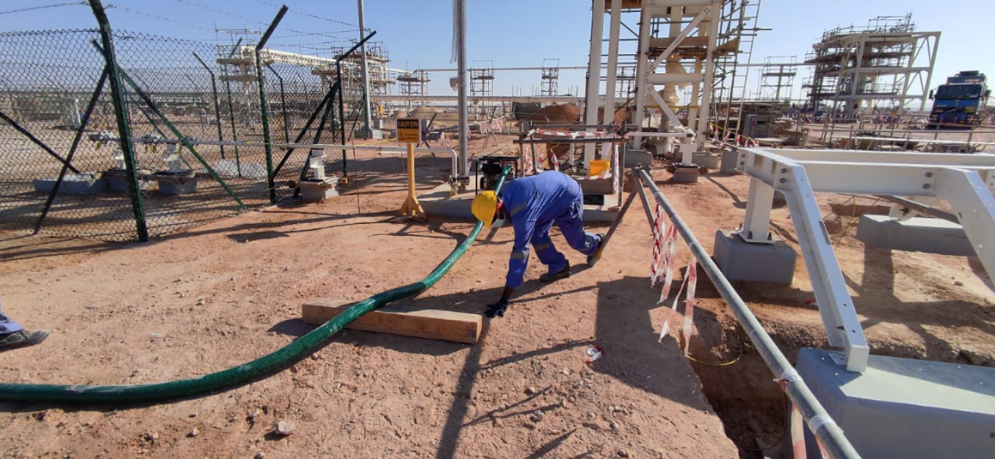
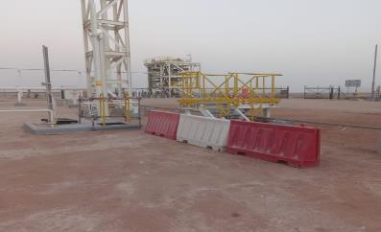
PDO Second Alert
Date:16/12/2021 Incident title: LTI#37 Pattern: Slip & Trip. Potential severity: C2P
Target Audience: Drilling, Logistics, Operation & Construction
What happened?
On 16th Dec 2021 at around 13:35 Hrs in the RMS-06 location, the crew was engaged for draining the water from the drain pit. A helper (IP) of the crew was moving into the barricaded area to support his team member to relocate the flexible drain hose (3” dia), during the movement the helper leg tripped on a hard barrier support pipe which resulted in loss of balance, and he fell on the ground planting his left hand to the ground and onto the wooden runner. This fall caused severe pain and swelling on the wrist of the left arm. Further medical examination revealed colle's fracture of the left radius.
Why it happened/Finding :
As the helper was standing close to the barricade, the helper did not notice the barricade's support pipe, so while moving forward he tripped on the barricade's pipe and fell on the ground.
Not focused on the surrounding obstruction.
Your learning from this incident..
Watch your steps while moving inside the workplace.
Projected obstructions are to be highlighted appropriately for better visibility.
Don’t allow people to stand very close to the barricading.
Ensure that the barricades are not posing a trip hazard.
Notes:
Ensure all dates and titles are input
A short description should be provided without mentioning names of contractors or individuals. You should include, what happened, to who (by job title) and what injuries this resulted in. Nothing more!
Four to five bullet points highlighting the main findings from the investigation. Remember the target audience is the front line staff so this should be written in simple terms in a way that everyone can understand.
The strap line should be the main point you want to get across
The images should be self explanatory, what went wrong (if you create a reconstruction please ensure you do not put people at risk) and below how it should be done.

Slide 2
Management self audit
Date:16/12/2021 Incident title: LTI#37 Pattern: Slip & Trip. Potential severity: C2P
As a learning from this incident and ensure continual improvement all contract managers must review their HSE risk management against the questions asked below
Confirm the following:
Do you ensure the barricade support pipes are not posing a trip hazard?
Do you ensure all Hazards /controls identified in HEMP are addressed in TRIC?
* If the answer is NO to any of the above questions please ensure you take action to correct this finding
Notes:
Ensure all dates and titles are input
Make a list of closed questions (only ‘yes’ or ‘no’ as an answer) to ask others if they have the same issues based on the management or HSE-MS failings or shortfalls identified in the investigation.
Imagine you have to audit other companies to see if they could have the same issues.
These questions should start with: Do you ensure…………………?

