Slide 1
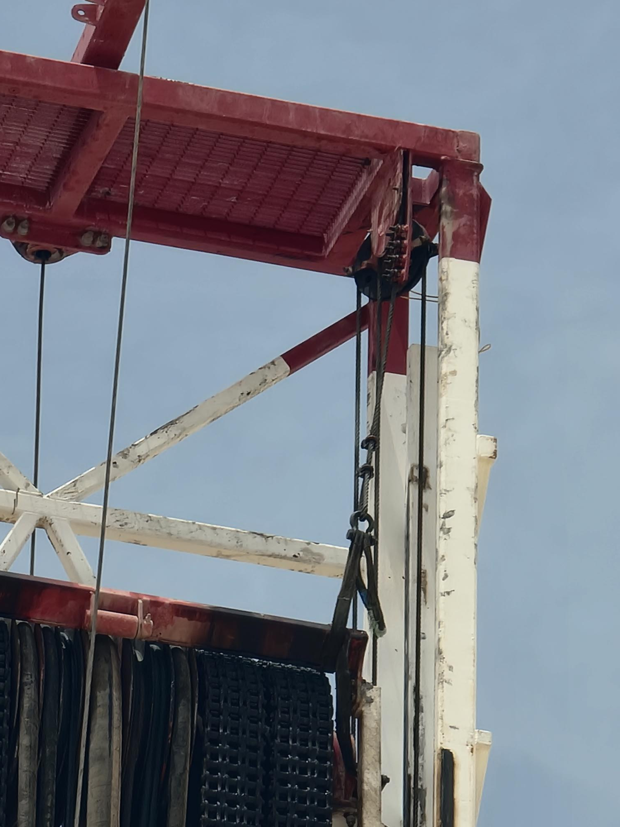
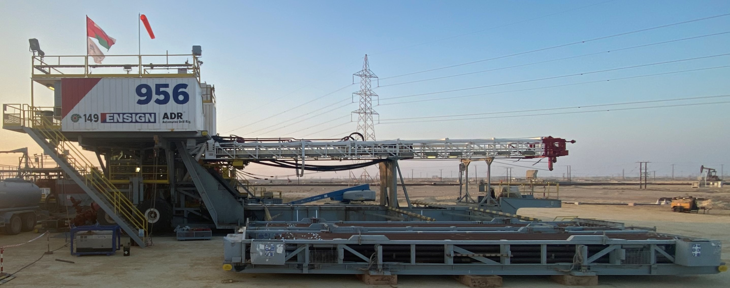
PDO Second Alert
Date: 01/07/2023 Incident title: LTI# Pattern: Injury. Potential severity: B3P Activity: Tightening the Pull-Down Line
Target Audience: Drilling
What happened?
On Saturday 1st July 2023, at approximately 17:35 IP tightening up the pull-down lines on the floating crown. The IP tightened the driller side pull down line and then he moved to off driller side and tightened that pull-down line. After tightening the off driller pull-down line, the IP gave the hand signal to the Floorman to convey to the driller by hand signal to hoist the top drive up. At this time the IP put his right hand on the sheave wheel and his fingers got caught between the sheave wheel and the pull-down line resulted to injury.
Why it happened/Finding :
The work was performed in a restricted work area at height where movement and positioning options were limited, increasing exposure to pinch-point and line-of-fire hazards
The hazards associated with the moving pull-down line, sheave, and mast movement were not fully recognized or communicated within the task risk assessment and JSA
The worker was not in a safe position and fully clear of the danger zone before the signal was given to hoist the top drive.
The approved SOP for the task was not available or properly maintained through the Management of Change (MOC) process, resulting in weaknesses in work planning and hazard control.
The required impact gloves were not being used, reducing protection against hand and finger injury hazards
Learning from this incident:
How do you verify that all line-of-fire and pinch-point hazards have been identified before starting work at height?
What should you do before giving a signal for equipment movement or energization?
How can unexpected equipment movement affect your balance and decision-making during a task?
What controls can be introduced to ensure workers remain clear of moving equipment and rotating components?
What would you do if you discovered that the approved SOP was unavailable or did not reflect current work practices?
How can communication methods be improved when workers are separated by distance or working at height?
Job shall only be done with the Mast lowered
Always clear the danger zone before movement—hands away from pinch points
Notes:
Ensure all dates and titles are input
A short description should be provided without mentioning names of contractors or individuals. You should include, what happened, to who (by job title) and what injuries this resulted in. Nothing more!
Four to five bullet points highlighting the main findings from the investigation. Remember the target audience is the front line staff so this should be written in simple terms in a way that everyone can understand.
The strap line should be the main point you want to get across
The images should be self explanatory, what went wrong (if you create a reconstruction please ensure you do not put people at risk) and below how it should be done.

Slide 2
Management self audit
Date: 01/07/2023 Incident title: LTI# Pattern: Injury. Potential severity: B3P Activity: Tightening the Pull-Down Line
As a learning from this incident and ensure continual improvement all contract managers must review their HSE risk management against the questions asked below
Confirm the following:
Do you ensure all task-specific JSAs clearly identify line-of-fire, pinch-point, and moving equipment hazards?
Has an MOC implemented for the change of the task’s SOP and JSA?
Does the crew understand the right use of the correct gloves for implementing the task?
Does the hand placement and hand injury prevention awareness session and campaign are conducted and rolled out to all personnel?
If the rescue from height procedure applicable for the task and if it is rolled out to all personnel?
Does the Pre tour meeting (PTM) include the job pack Musta’ed which consists of all required documentation for the job such as PTW, SOP, JSA, PTM, PJSM, Pre Job inspection?
Disclaimer
This document is provided for information only. It may not be relied upon for any purpose. Neither PDO nor any party providing information for this document accepts any liability for its accuracy, completeness, omissions, advice, or any consequences arising from its use, even if reasonable care was not exercised. No representation or warranty, express or implied, is made that following this document will achieve any specific results or meet any legal or regulatory requirements. This document does not constitute technical advice; consult a qualified professional if such advice is needed
Notes:
Ensure all dates and titles are input
Make a list of closed questions (only ‘yes’ or ‘no’ as an answer) to ask others if they have the same issues based on the management or HSE-MS failings or shortfalls identified in the investigation.
Imagine you have to audit other companies to see if they could have the same issues.
These questions should start with: Do you ensure…………………?

