Slide 1
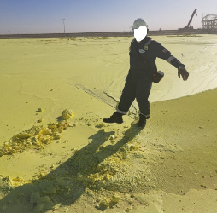

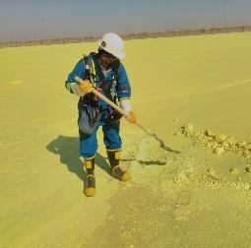

PDO Second Alert
Date:09/02/2023 Incident title: LTI#01: Liquid Sulphur burn to feet Pattern: Chemicals Potential severity: 3B P Activity: Sulphur pouring
Target Audience: Drilling, Logistics, Operation & Construction
What happened?
While a Field Operator and his Supervisor were inside the boundary of the Sulphur blocking area, the Operator used his right foot to remove a build-up of Sulphur. At the same time, he was positioned on a thin crust of solid Sulphur which was covering liquid Sulphur at a temperature of 135c. The weight of the Operator fractured the crust and exposed his feet to the hot liquid underneath, resulting in 2nd degree burns to both feet. He was initially treated at PDO Yibal Clinic before being referred to Nizwa Hospital for further treatment.
Why it happened/Finding :
IP entered the area 1 hour after Sulphur pouring – the procedure highlights no one should enter area for a period of 24 hrs.
The correct specialist PPE was not worn as the operator and supervisor underestimated the risk of liquid Sulphur.
The Sulphur pouring arm had an oil leak which temporarily stopped the pouring process and allowed Sulphur to build up which required operator intervention.
Your learning from this incident..
Always follow the specific requirements of the procedure for your safe work (e.g. SOP, Method Statement, JSA).
Always wear the correct PPE required for specialist activities. If you don’t know what it is…..find out!
Always report equipment that is faulty or needs repairing – it could cause an incident.
Always contact PDO Emergency number (5555) – When an incident happened.
Procedures have specific requirements within them – follow them to keep safe!
Notes:
Ensure all dates and titles are input
A short description should be provided without mentioning names of contractors or individuals. You should include, what happened, to who (by job title) and what injuries this resulted in. Nothing more!
Four to five bullet points highlighting the main findings from the investigation. Remember the target audience is the front line staff so this should be written in simple terms in a way that everyone can understand.
The strap line should be the main point you want to get across
The images should be self explanatory, what went wrong (if you create a reconstruction please ensure you do not put people at risk) and below how it should be done.

Slide 2
Effective Learning
Date:09/02/2023 Incident title: LTI#01: Liquid Sulphur burn to feet Pattern: Chemicals Potential severity: 3B P Activity: Sulphur pouring
As a learning from this incident and ensure continual improvement all contract managers must review their HSE risk management against the questions asked below
Confirm the following:
Do supervisors and staff have access to the correct procedure – is it effectively communicated to them?
In the event of equipment breakdown or recurring issues – does the workforce know how and who to report it to?
Does the induction/training provided to workers adequately cover the risks associated with their work to keep them safe?
Is the correct PPE available to all members of the workforce who need them?
Is access to you Site location adequately managed – how do you control the access arrangements?
When people are injured in an incident – does the workforce know how the correct process for contacting the Emergency services to get help?
* If the answer is NO to any of the above questions please ensure you take action to correct this finding
Disclaimer
This document is provided for information only. It may not be relied upon for any purpose. Neither PDO nor any party providing information for this document accepts any liability for its accuracy, completeness, omissions, advice, or any consequences arising from its use, even if reasonable care was not exercised. No representation or warranty, express or implied, is made that following this document will achieve any specific results or meet any legal or regulatory requirements. This document does not constitute technical advice; consult a qualified professional if such advice is needed
Notes:
Ensure all dates and titles are input
Make a list of closed questions (only ‘yes’ or ‘no’ as an answer) to ask others if they have the same issues based on the management or HSE-MS failings or shortfalls identified in the investigation.
Imagine you have to audit other companies to see if they could have the same issues.
These questions should start with: Do you ensure…………………?

