Slide 1
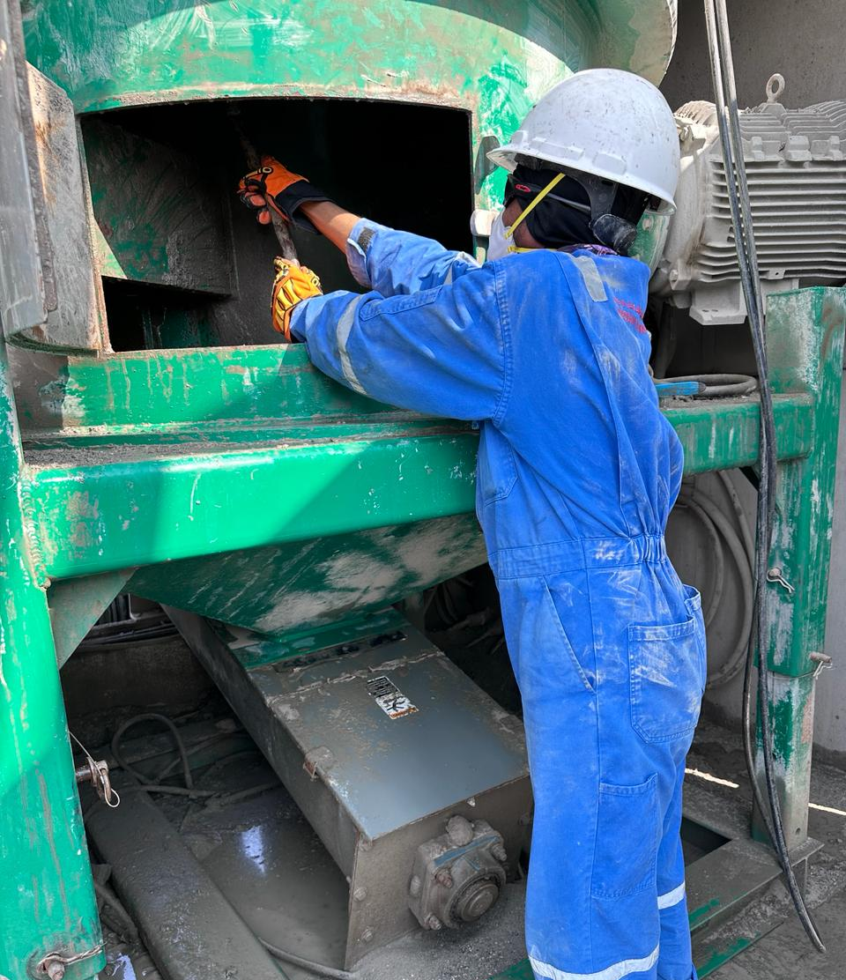
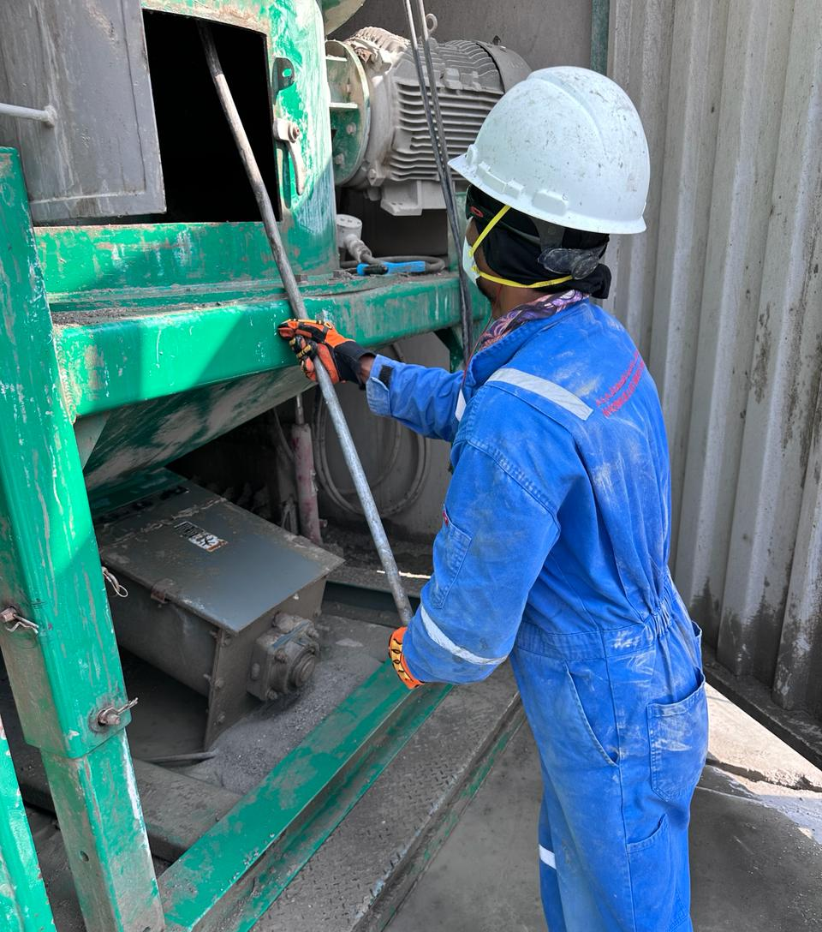
PDO Second Alert – LTI # 04, 06th January 2024, Maqshan Oil & Gas Services
Date:06/01/2024 Incident title: LTI#04, Pattern: Falling Object Potential severity: C3P Activity: Cleaning
Target Audience: Drilling, Logistics, Operation & Construction
What happened?
A Fracture injury occurred on 6th January 2024 at 09.00 AM involving a 47-year-old Pakistani colleague working as a helper for Maqshan Oil & Gas Services in Fahud Hazardous Waste Management Yard.
Before starting the Oil Based Mud cuttings (OBM) treatment operation, the team started to clean the unit by isolating power sources, while doing the cleaning activity by using the metal scrapper tool, a certain amount of solidified dry OBM cuttings (5 kg approx.) fell from the topside of the Vertical Cuttings Dryer (VCD) above the helper’s right-hand forearm consequently hitting his hand to the bottom edge of the inspection hatch resulted in pain on the right-hand forearm.
Later he was taken to Badar Al Sama Hospital in Muscat where the X-rays revealed an incomplete fracture on his right forearm.
Why it happened/Finding :
The hazard and risk of falling objects were not identified and accessed.
Standard Operating Procedure available but not followed.
Lack of Supervision.
The employee has used the short scrapping tool to reach the top section of VCD.
Your learning from this incident:
Asses all seen and unforeseen hazards when planning for any job
Implement and monitor the enforcement of the SOP throughout the operation process
Always ensure work is under effective supervision.
Always use the right tool for the task.
Expect unexpected hazard before commencing any task
Notes:
Ensure all dates and titles are input
A short description should be provided without mentioning names of contractors or individuals. You should include, what happened, to who (by job title) and what injuries this resulted in. Nothing more!
Four to five bullet points highlighting the main findings from the investigation. Remember the target audience is the front line staff so this should be written in simple terms in a way that everyone can understand.
The strap line should be the main point you want to get across
The images should be self explanatory, what went wrong (if you create a reconstruction please ensure you do not put people at risk) and below how it should be done.

Slide 2
Management self audit
Date:06/01/2024 Incident title: LTI#04 Pattern: Falling Object Potential severity: C3P Activity: Cleaning
Confirm the following:
Do you ensure all hazards are identified and controlled before executing any task?
Do you ensure the SOP for the job is properly enforced while performing the task?
Do you ensure the work is effectively supervised?
Do you ensure appropriate tools are available before starting the job?
* If the answer is NO to any of the above questions please ensure you take action to correct this finding
Disclaimer
This document is provided for information only. It may not be relied upon for any purpose. Neither PDO nor any party providing information for this document accepts any liability for its accuracy, completeness, omissions, advice, or any consequences arising from its use, even if reasonable care was not exercised. No representation or warranty, express or implied, is made that following this document will achieve any specific results or meet any legal or regulatory requirements. This document does not constitute technical advice; consult a qualified professional if such advice is needed
Notes:
Ensure all dates and titles are input
Make a list of closed questions (only ‘yes’ or ‘no’ as an answer) to ask others if they have the same issues based on the management or HSE-MS failings or shortfalls identified in the investigation.
Imagine you have to audit other companies to see if they could have the same issues.
These questions should start with: Do you ensure…………………?

