Slide 1
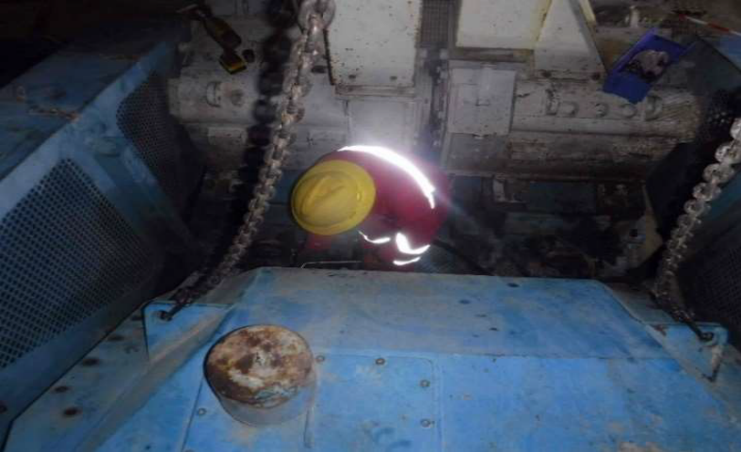
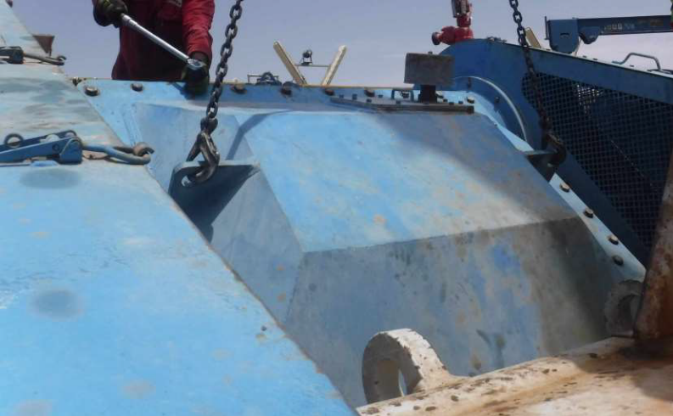
PDO Second Alert
Date:17/05/2023 Incident title: LTI#05 Slip of MP Cover Pattern: Struck by Potential severity: C3P Activity: Service Mud Pump
Target Audience: Drilling, Logistics, Operation & Construction
Photo explaining what was done wrong
What happened?
On 17/05/2023 At 8 PM. The chief mechanic was in the process of opening mud pump # 3 Main
power end cover in preparation for service PM. The cover was secured by crane (lifting gear not in
tension). Once opened the last bolt at the bottom end of cover, it slightly moved and made contacted
with the chief mechanic left leg ( thigh).After receiving first aid at the rig clinic, the CM was referred
to hospital for further medical management.
Operation was stopped immediately, and safety stand down meeting was conducted.
Why it happened/Finding :
Control of Work was in place and TBT done, however, the JSA was not specific as to the LOF risk which caused the incident.
The tension on the chains was not re-applied before IP taking out the last bottom bolt.
The Chief mechanic was involved hands-on in the task rather than only supervising and without help of banksman.
Chief mechanic did not take TOFS time out for safety to re-assess the situation when finding last bolt at the bottom end of cover.
Your learning from this incident..
Always ensure Musta’ed steps are followed before starting any task.
Always ensure an updated JSA is available for the task, highlighting all the foreseeable hazards and associated control measures including all LOF situation.
Before opening any equipment, ensure there is no stored energy which can release and cause an incident.
Task supervisors should never work hands-on and limit their involvement to supervision only
When removing the mud pump cover, start unscrewing the bottom bolts first then the top ones
Any lifting operation, ensure banksman available to guide crane operator and to confirm person away from drop zone.
Photo explaining how it should be done right
Never place yourself in the line of fire
Notes:
Ensure all dates and titles are input
A short description should be provided without mentioning names of contractors or individuals. You should include, what happened, to who (by job title) and what injuries this resulted in. Nothing more!
Four to five bullet points highlighting the main findings from the investigation. Remember the target audience is the front line staff so this should be written in simple terms in a way that everyone can understand.
The strap line should be the main point you want to get across
The images should be self explanatory, what went wrong (if you create a reconstruction please ensure you do not put people at risk) and below how it should be done.

Slide 2
Management self audit
Date:17/05/2023 Incident title: LTI#05 Slip of MP Cover Pattern: Struck by Potential severity: C3P Activity: Service Mud Pump
As a learning from this incident and ensure continual improvement all contract managers must review their HSE risk management against the questions asked below
Confirm the following:
Do you ensure that all E&M daily tasks covered in Look a head plan ?
Do you ensure that the E&M tasks control in place via an effective verification by the supervisors?
Do you ensure that your E&M team are fully aware of the Lone worker hazard?
Do you ensure that your E&M team do not execute any critical task until they consulting with their line supervisors?
* If the answer is NO to any of the above questions please ensure you take action to correct this finding
Disclaimer
This document is provided for information only. It may not be relied upon for any purpose. Neither PDO nor any party providing information for this document accepts any liability for its accuracy, completeness, omissions, advice, or any consequences arising from its use, even if reasonable care was not exercised. No representation or warranty, express or implied, is made that following this document will achieve any specific results or meet any legal or regulatory requirements. This document does not constitute technical advice; consult a qualified professional if such advice is needed
Notes:
Ensure all dates and titles are input
Make a list of closed questions (only ‘yes’ or ‘no’ as an answer) to ask others if they have the same issues based on the management or HSE-MS failings or shortfalls identified in the investigation.
Imagine you have to audit other companies to see if they could have the same issues.
These questions should start with: Do you ensure…………………?

