Slide 1
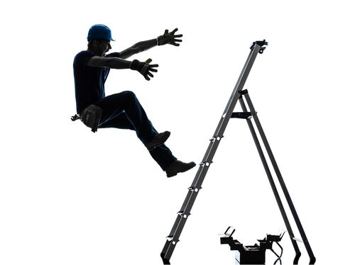
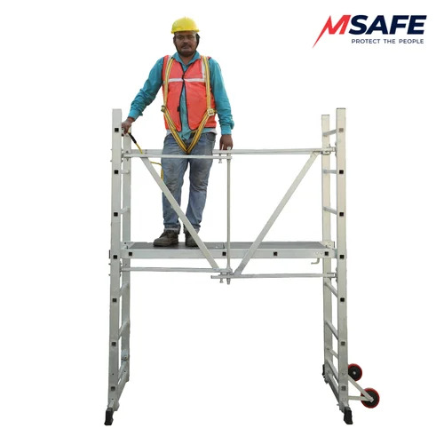
PDO Second Alert
Date:16/05/2023 Incident title: LTI#06 Pattern: Fall from Height Potential severity: C3P Activity: Ac maintenance
Target Audience: Drilling, Logistics, Operation & Construction
What happened?
On the afternoon of the16th May, AC technicians used and A frame Step Ladder to replace a piece of external protective trunking to complete a task . On ascending a supported A Frame step ladder the technician misplaced his footing on the 3rd step as he was rushing to finish the task. On losing his balance he fell backwards and despite his colleague trying to save his fall he landed on the ground with his left arm out right, his left hand impacting the ground causing an indirect fracture to his wrist .
Why it happened/Finding :
The task was started without RAMS, TRIC card, or pre-job briefing, resulting in hazards and controls not being adequately assessed.
The work was not sufficiently planned or supervised after the decision was made to replace the AC unit, leading to the task being completed using individual judgement rather than a structured safe system of work.
An A-frame ladder was selected to access the work location although more suitable access equipment was available, increasing the risk of a fall.
The technician ascended the ladder while carrying the trunking cover and did not maintain three points of contact, resulting in loss of balance and a fall from the ladder.
The task had become routine and normalised, resulting in safety controls, risk assessment requirements, and procedural compliance being overlooked
Your learning from this incident :
How do you ensure a routine task is not been treated as a low-risk task?
How do you determine whether the selected access equipment is suitable for the job?
What could happen if a task is started without a RAMS, TRIC card, or pre-job briefing?
What factors may cause workers to rush a task, and how can these pressures be managed?
When using a ladder, what controls are required to maintain stability and prevent falls?
What should you do if you observe a colleague taking a shortcut or working unsafely?
How does maintaining three points of contact reduce the likelihood of a fall?
Routine tasks can become high-risk when planning, supervision, and safe work controls are overlooked.
Notes:
Ensure all dates and titles are input
A short description should be provided without mentioning names of contractors or individuals. You should include, what happened, to who (by job title) and what injuries this resulted in. Nothing more!
Four to five bullet points highlighting the main findings from the investigation. Remember the target audience is the front line staff so this should be written in simple terms in a way that everyone can understand.
The strap line should be the main point you want to get across
The images should be self explanatory, what went wrong (if you create a reconstruction please ensure you do not put people at risk) and below how it should be done.

Slide 2
Management self audit
Date:16/06/2023 Incident title: LTI#06 Pattern: Fall from Height Potential severity: C3P Activity: Ac maintenance
As a learning from this incident and ensure continual improvement all contract managers must review their HSE risk management against the questions asked below
Confirm the following:
Do you ensure the crew have sufficient time to complete a job? (Those who are in a rush may be more likely to take shortcuts or skip important safety procedures, leading to mistakes that can cause accidents).
Do you ensure the crew have the correct equipment to do the task?
Do you ensure crew are competent for the task they are undertaking?
Do you ensure the crew have the correct RAMS (Risk Assessment & Method Statement) in place and that they are communicated in the correct method?
Do you ensure your crew understand they have the empowerment to intervene for any unsafe action, condition they may see?
Do you ensure that you have a robust assurance procedure in place to identify potential or actual differences in your working practices?
* If the answer is NO to any of the above questions please ensure you take action to correct this finding
Disclaimer
This document is provided for information only. It may not be relied upon for any purpose. Neither PDO nor any party providing information for this document accepts any liability for its accuracy, completeness, omissions, advice, or any consequences arising from its use, even if reasonable care was not exercised. No representation or warranty, express or implied, is made that following this document will achieve any specific results or meet any legal or regulatory requirements. This document does not constitute technical advice; consult a qualified professional if such advice is needed
Notes:
Ensure all dates and titles are input
Make a list of closed questions (only ‘yes’ or ‘no’ as an answer) to ask others if they have the same issues based on the management or HSE-MS failings or shortfalls identified in the investigation.
Imagine you have to audit other companies to see if they could have the same issues.
These questions should start with: Do you ensure…………………?

