Slide 1
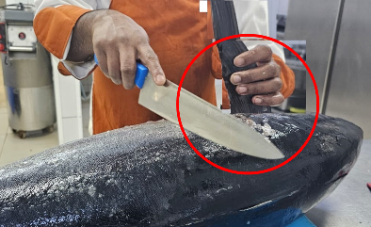
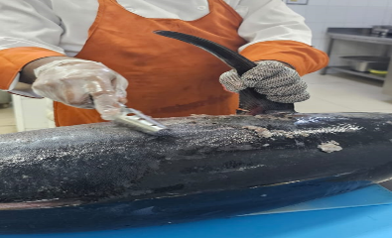
PDO Second Alert
Date: 02/05/2024 Incident title: LWC#07 Pattern: Finger injury Potential severity: C3P Activity: Scaling fish
What happened?
On 2nd May 2024 at around 17:30 in camp, while cleaning the fish scales using a knife, one of the catering crew
( chapati maker cum butcher) got a minor cut on his left index finger. He was reported to camp clinic and the medic
provided him first aid and sent him to Qarn Alam PAC clinic for further treatment. He was then referred to Badr Al Samaa
hospital, Nizwa for further medical evaluation.
Why it happened/Finding :
Knife was used to scale the fish instead of a proper fish scaler.
Proper checks was not made to ensure that all the required tools were available to prepare the fish.
Chain Gloves was not used by the Butcher while scaling the Fish with a knife
Your learning from this incident..
Always ensure that proper tools are available to execute the task and if not do not use improvised tools.
Always ensure that people are aware of right tools and PPE required for the task.
Always ensure that Chain gloves are used while working with sharp tools such as knives.
Photo explaining what was done wrong
Photo explaining how it should be done right
Always ensure that proper tools are available to execute the task and if not do not use improvised tools.
Notes:
Ensure all dates and titles are input
A short description should be provided without mentioning names of contractors or individuals. You should include, what happened, to who (by job title) and what injuries this resulted in. Nothing more!
Four to five bullet points highlighting the main findings from the investigation. Remember the target audience is the front line staff so this should be written in simple terms in a way that everyone can understand.
The strap line should be the main point you want to get across
The images should be self explanatory, what went wrong (if you create a reconstruction please ensure you do not put people at risk) and below how it should be done.

Slide 2
Effective Learning
Date: 02/05/2024 Incident title: LWC#07 Pattern: Finger injury Potential severity: C3P Activity: Scaling fish
To make sure learning is translated to the site day to day activities , please answer the below questions :-
How learning can be implemented at site ?
Do you ensure all the required tools and PPE for the are made available?
- Do you ensure your employees are aware of the right tools and PPE for the job?
- Do you ensure your site supervisors / Team Leaders are conducting regular checks to ensure all tools and PPE are available before performing the task?
- Do you ensure periodic audits and verification are conducted to confirm all the above?
Disclaimer
This document is provided for information only. It may not be relied upon for any purpose. Neither PDO nor any party providing information for this document accepts any liability for its accuracy, completeness, omissions, advice, or any consequences arising from its use, even if reasonable care was not exercised. No representation or warranty, express or implied, is made that following this document will achieve any specific results or meet any legal or regulatory requirements. This document does not constitute technical advice; consult a qualified professional if such advice is needed
Notes:
Guideline for Effective Learning & Sustainability
•Can be replicated across similar contractor / activities
•Shall be SMART- Specific ,Measurable , Achievable ,Realistic & Timebound
•Can be implemented in a months' time

