Slide 1
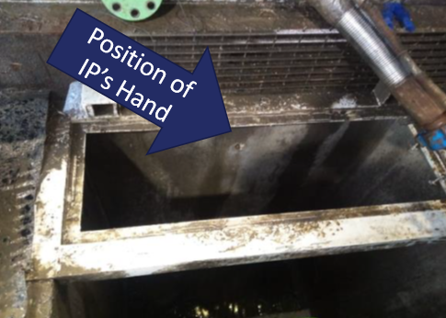
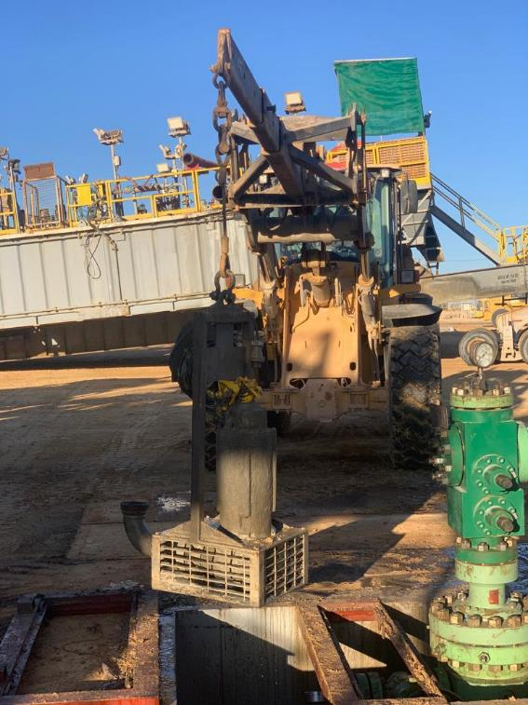
PDO Second Alert
Date:21/05/2023 Incident title: LTI#07 Pattern: Injury. Potential severity: C3P Activity: Rigging Down Operations
Target Audience: All Site Crews
What happened?
On 21-05-2023 at 01:00 am the task was to nipple down BOP to prepare for rig move, while removing the cellar pump the driller was operating the floor (PL8) winch through the rotary table, the floor hand gave the instructions to the crew in the cellar to operate the winch. At the time of incident the IP was holding the cellar pump to guide the pump out of the cellar, once the driller lifted the load, the IP's right hand was caught between the cellar pump and the cellar grating cover, thereby causing injury to the IP's right middle finger.
The first aid responders applied the first aid and sent the IP to the Ensign Medic/Clinic, the medic cleaned the wound and applied a bandage, the IP was transferred to Salalah hospital for further examination and treatment.
The investigation is in progress.
Why it happened/Finding :
The removal of the cellar pump was not included in the approved Rig Move SOP and JSA, resulting in hazards associated with the task not being fully identified.
A Management of Change (MOC) was not implemented following the change to a larger cellar pump, resulting in additional risks not being formally assessed.
The task was conducted using an alternative lifting method that was not the preferred or documented method for removing the cellar pump.
The injured person placed his hand in a pinch point/line-of-fire area while guiding a suspended load, resulting in the hand being trapped between the pump and cellar frame.
Inadequate planning, hazard recognition, supervision, and STOP intervention allowed the task to continue without sufficient controls
Your learning from this incident..
What pinch points or line-of-fire hazards exist in your current task?
How do you verify that the SOP and JSA fully cover the work being performed?.
What should you do when the task differs from the approved procedure?
When is a Management of Change (MOC) required?
How can workers safely guide a suspended load without placing hands in danger zones?
What indicators suggest a task should be stopped and reassessed?
How do you confirm that all lifting hazards have been identified before starting work?
What controls should be in place before lifting equipment is moved in a restricted work area?
Keep Hands Out of the Line of Fire – Stop, Assess, and Control the Lift Before the Load Moves.
Notes:
Ensure all dates and titles are input
A short description should be provided without mentioning names of contractors or individuals. You should include, what happened, to who (by job title) and what injuries this resulted in. Nothing more!
Four to five bullet points highlighting the main findings from the investigation. Remember the target audience is the front line staff so this should be written in simple terms in a way that everyone can understand.
The strap line should be the main point you want to get across
The images should be self explanatory, what went wrong (if you create a reconstruction please ensure you do not put people at risk) and below how it should be done.

Slide 2
Management self audit
Date:21/05/2023 Incident title: LTI#07 Pattern: Injury. Potential severity: C3P Activity: Rigging Down Operations
As a learning from this incident and ensure continual improvement all contract managers must review their HSE risk management against the questions asked below
Confirm the following:
Do you ensure supervisors routinely verify compliance with lifting plan, SOPs and JSAs in the field?
Does the crew know the right procedure to install and remove the cellar pump safely?
Do you ensure pre-job briefings clearly communicate hazards, controls, and individual responsibilities?
Are supervisors aware and applying the correct sequence of the pump installation and removal for rigging up and rigging down (Rig Move)?
Do you ensure work scope changes are assessed through the Management of Change (MOC) process?
Do you ensure personnel maintain hands-free positioning whenever practicable during lifting activities?
Do you ensure periodic audits are conducted to verify that lifting controls, MOC requirements, and hazard management processes remain effective?
Disclaimer
This document is provided for information only. It may not be relied upon for any purpose. Neither PDO nor any party providing information for this document accepts any liability for its accuracy, completeness, omissions, advice, or any consequences arising from its use, even if reasonable care was not exercised. No representation or warranty, express or implied, is made that following this document will achieve any specific results or meet any legal or regulatory requirements. This document does not constitute technical advice; consult a qualified professional if such advice is needed
Notes:
Ensure all dates and titles are input
Make a list of closed questions (only ‘yes’ or ‘no’ as an answer) to ask others if they have the same issues based on the management or HSE-MS failings or shortfalls identified in the investigation.
Imagine you have to audit other companies to see if they could have the same issues.
These questions should start with: Do you ensure…………………?

