Slide 1
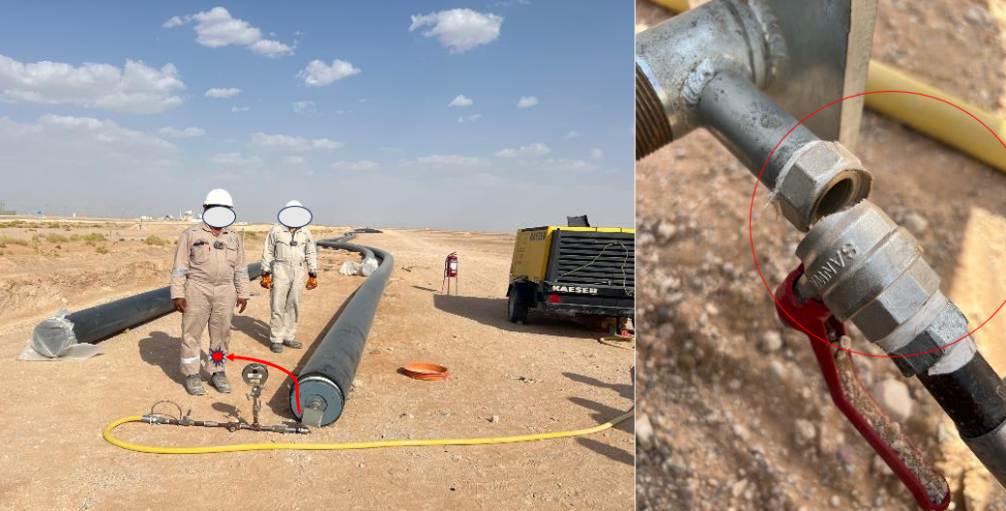
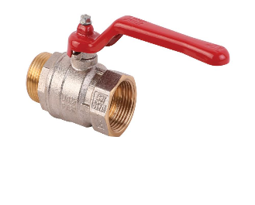

PDO Second Alert
Date:17/05/2023 Incident title: LTI#08, Pattern: Struck by Potential severity: C4P Activity: Pneumatic testing
Target Audience: Drilling, Logistics, Operation & Construction
What happened?
At around 15:40 Hrs a Sub-Contractor crew was performing pneumatic testing activity for 16" HDPE liner at Dhulaima Water Injection (WI) line section. The helper closed the ball valve to check intermediate pressure. While walking away from the set up, the ball valve on the test plug unit failed and the manifold section detached and swung due to sudden release of pressure. The manifold hit the helper’s left leg causing injuries. After first aid, the helper was evacuated to Ibri hospital for treatment where X ray revealed displaced oblique fracture of tibia and fibula.
Why it happened/Finding :
The replaced ball valve was not independently tested and certified before being used in a pressure test.
The risk assessment did not adequately consider valve failure and uncontrolled energy release scenarios.
The manifold assembly was not sufficiently secured to prevent movement if a component failed.
Critical controls such as equipment certification, anchoring requirements, and pressure-release safeguards were not fully specified or verified.
Contractor and subcontractor assurance processes did not verify the integrity and certification of all critical pressure-testing components
Your learning from this incident..
How do you verify that pressure-testing equipment is certified and fit for use?
What could happen if a pressure-containing component fails during testing?
What controls should be in place to prevent equipment movement following a pressure release?
How do you identify stored/release energy hazards before starting a pressure test?
What barriers are available to protect personnel from flying or swinging equipment?
How do you confirm subcontractor equipment meets project and PDO requirements?
What lessons from this incident can be applied to other pressure-related activities?
Pressure Can Kill – Verify Certification, Secure Equipment, and Stay Out of the Line of Fire
Notes:
Ensure all dates and titles are input
A short descrhelpertion should be provided without mentioning names of contractors or individuals. You should include, what happened, to who (by job title) and what injuries this resulted in. Nothing more!
Four to five bullet points highlighting the main findings from the investigation. Remember the target audience is the front line staff so this should be written in simple terms in a way that everyone can understand.
The strap line should be the main point you want to get across
The images should be self explanatory, what went wrong (if you create a reconstruction please ensure you do not put people at risk) and below how it should be done.

Slide 2
Management self-audit
Date:17/05/2023 Incident title: LTI#08 Pattern: Struck by Potential severity: C4P Activity: Pneumatic Testing
As a learning from this incident and ensure continual improvement all contract managers must review their HSE risk management against the questions asked below
Confirm the following:
Do you ensure all pressure-testing equipment has valid certification and inspection records before use?
Do you ensure replacement or refurbished components are tested, certified, and approved before installation?
Do you ensure manifolds, hoses, and test assemblies are adequately restrained or anchored against movement?
Do you ensure personnel remain outside potential line-of-fire zones during pressurization and monitoring activities?
Do you ensure subcontractor equipment certifications are reviewed and verified before work starts?
Do you ensure supervisors conduct field verification of pressure-testing controls before commencing the test?
* If the answer is NO to any of the above questions please ensure you take action to correct this finding
Disclaimer
This document is provided for information only. It may not be relied upon for any purpose. Neither PDO nor any party providing information for this document accepts any liability for its accuracy, completeness, omissions, advice, or any consequences arising from its use, even if reasonable care was not exercised. No representation or warranty, express or implied, is made that following this document will achieve any specific results or meet any legal or regulatory requirements. This document does not constitute technical advice; consult a qualified professional if such advice is needed
Notes:
Ensure all dates and titles are input
Make a list of closed questions (only ‘yes’ or ‘no’ as an answer) to ask others if they have the same issues based on the management or HSE-MS failings or shortfalls identified in the investigation.
Imagine you have to audit other companies to see if they could have the same issues.
These questions should start with: Do you ensure…………………?

