Slide 1
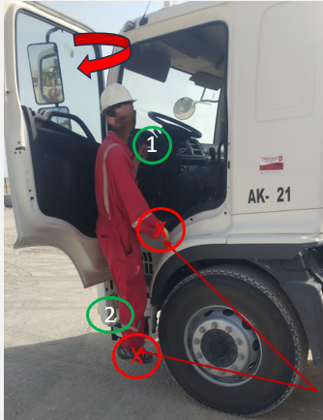
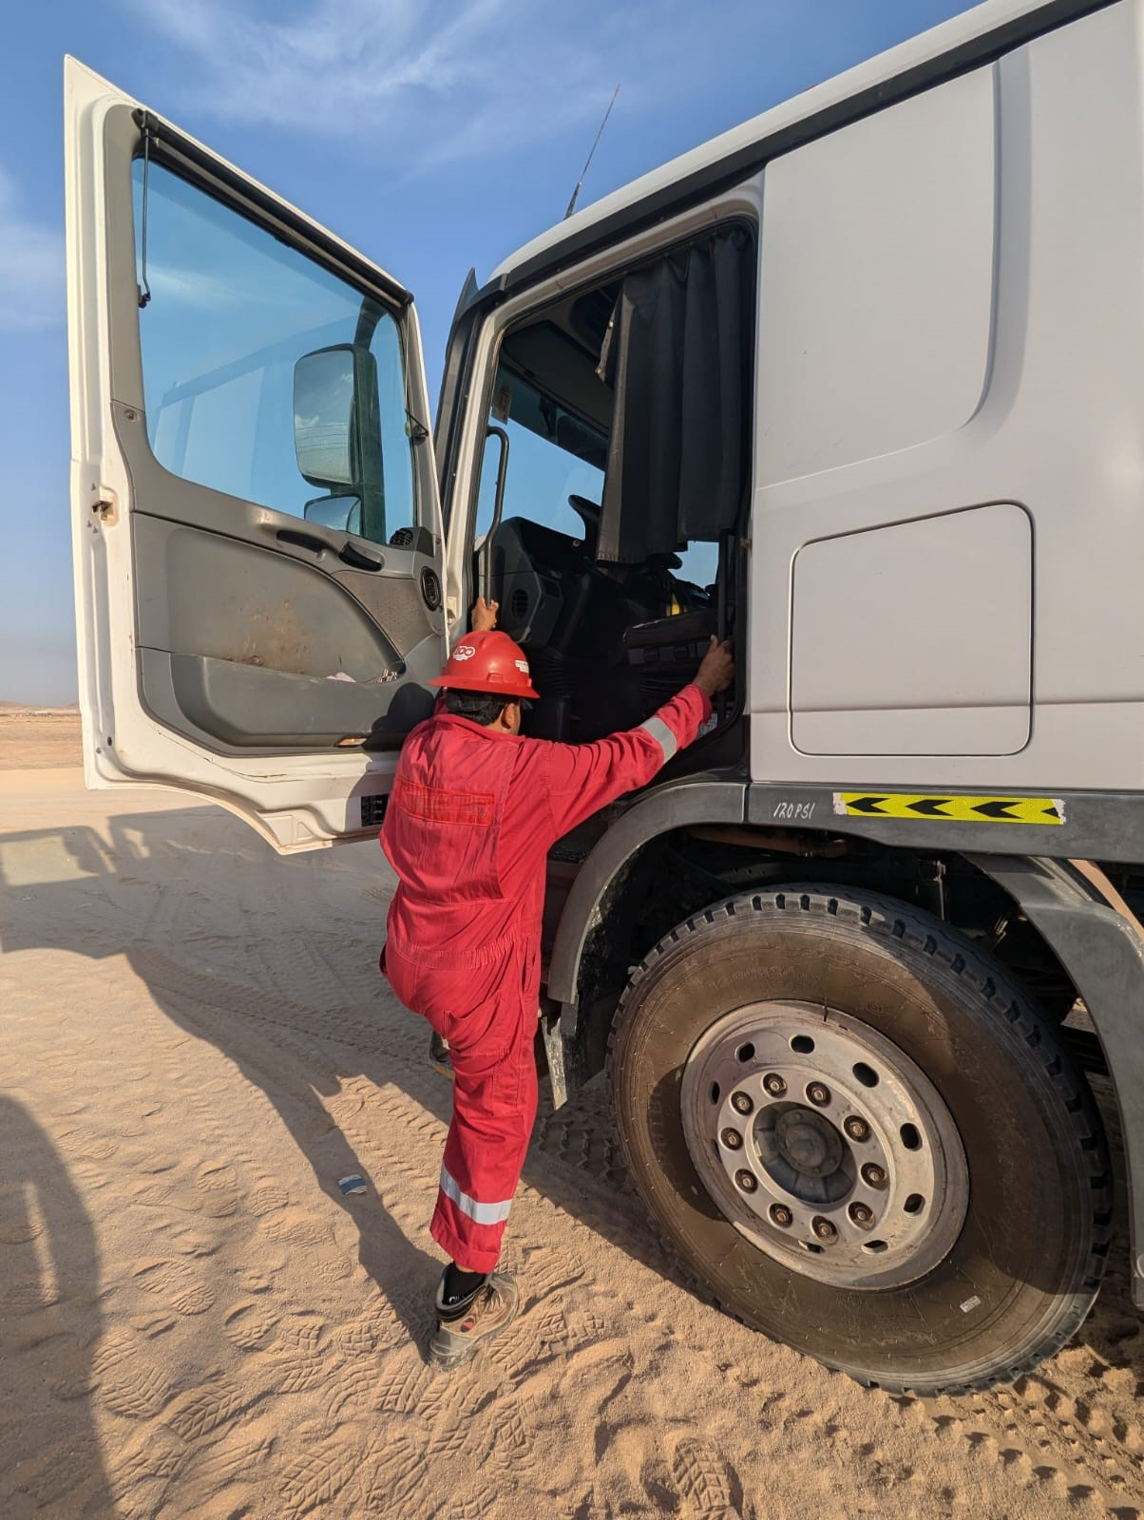
PDO Second Alert
Date: 05/07/2024 Incident title: LTI#09 Pattern: Hand Injury Potential severity: C3P Activity: Descending from the truck cabin
Target Audience: Drilling, Logistics, Operation & Construction
What happened?
On 05th July 2024 at 1500hrs, a 3rd party driver completed offloading liquids at Rig-45, he stopped the tanker outside the location and while exiting the truck cabin to sign out from rig and collect his H2S card. The driver lost his balance at the last step of truck cabin while rotating his body to face forward. He tried to break his fall by using his outstretched right hand. Soon after, he felt pain and swelling in his right-hand wrist. He was transferred to rig medic and first aid given. The driver was sent to Fahud PDO clinic for first diagnoses and then was sent to Muscat for treatment. The X-ray revealed right hand was fractured.
Why it happened/Finding
Improper body position while descending the truck cabin.
Losing the three points of contact prior landing on the ground.
Over-familiarity of previously using an unsafe exit method without incident.
Being distracted with collecting his H2S Card and losing his situational awareness.
Unclear sign In/Out process from location.
Your learning from this incident
The importance of positioning the human body correctly while descending from the truck cabin.
Using three points of contact while climbing and descending from trucks.
Assessing the hazard and risks from normalizing routine activities.
Photo explaining how it should be done right
Always ensure to use three points of contact while climbing and descending from trucks.
Notes:
Ensure all dates and titles are input
A short description should be provided without mentioning names of contractors or individuals. You should include, what happened, to who (by job title) and what injuries this resulted in. Nothing more!
Four to five bullet points highlighting the main findings from the investigation. Remember the target audience is the front line staff so this should be written in simple terms in a way that everyone can understand.
The strap line should be the main point you want to get across
The images should be self explanatory, what went wrong (if you create a reconstruction please ensure you do not put people at risk) and below how it should be done.

Slide 2
Management Self-audit
Date: 05/07/2024 Incident title: LTI#09 Pattern: Hand Injury Potential severity: C3P Activity: Descending from the truck cabin
Confirm the following:
Do you discuss the importance of positioning the human body correctly while descending from the truck cabin?
Do you ensure employees are aware of the importance of three points of contact while climbing and descending from trucks?
Do you ensure employees are assessing the hazards and risks from normalizing routine activities?
Do you ensure the crew is empowered to stop and intervene on unsafe acts or conditions?
Disclaimer
This document is provided for information only. It may not be relied upon for any purpose. Neither PDO nor any party providing information for this document accepts any liability for its accuracy, completeness, omissions, advice, or any consequences arising from its use, even if reasonable care was not exercised. No representation or warranty, express or implied, is made that following this document will achieve any specific results or meet any legal or regulatory requirements. This document does not constitute technical advice; consult a qualified professional if such advice is needed
Notes:
Ensure all dates and titles are input
Make a list of closed questions (only ‘yes’ or ‘no’ as an answer) to ask others if they have the same issues based on the management or HSE-MS failings or shortfalls identified in the investigation.
Imagine you have to audit other companies to see if they could have the same issues.
These questions should start with: Do you ensure…………………?

