Slide 1
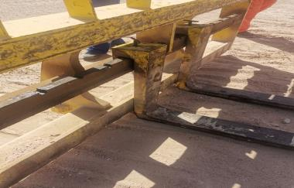
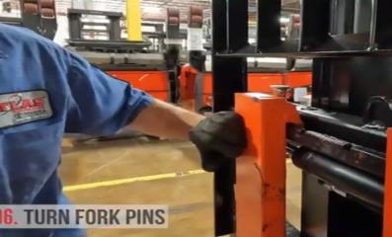
PDO Second Alert
Date:22/05/2023 Incident title: LWC Pattern: Finger . Potential severity: 3P Activity: Lifting chemical bags
Target Audience: ALL
What happened?
On the 22nd May 2023 at around 11:30 the Roustabout, (who was in old location SR-347 together with driver for the purpose of doing the remaining housekeeping, collecting some torn chemical bags with help of Forklift provided from a near by Hoist), was assisting the Forklift as to adjust the Forks of the Forklift to come closer to each other in order to be able taking the stuff. By doing so he accidentally placed his index finger at the pinch point (between the Fork itself and the Forks holder) resulting in crush finger injury. The IP was taken to Saih Rawl clinic for first aid then he was referred to Nizwa Hospital for X-ray and further to Khoula Hospital.
Why it happened/Finding :
The housekeeping activity at the previous location was not adequately planned, supervised, or monitored as an out-of-sight task.
Communication between the requesting team and the supporting team was not clear regarding the equipment required, resulting in a forklift arriving with forks instead of a bucket.
The work continued despite the equipment being unsuitable for safely collecting the torn chemical bags.
Roles and responsibilities were not clearly defined, leading the roustabout to assist with adjusting forklift forks, a task that should have been performed by the forklift operator.
Pinch point hazards associated with adjusting forklift forks were not adequately recognized or controlled before the task commenced.
Your learning from this incident..
What checks should be completed before sending personnel to perform an out-of-sight activity?
How can we verify that the correct equipment has been selected and provided before work starts?
What actions should be taken when the available equipment is not suitable for the intended task?
Who is authorized to adjust, operate, or modify equipment such as forklift forks?
What pinch points are commonly present on equipment used at your worksite?
How can teams improve communication when work involves more than one contractor or work group?
What should workers do if the actual task differs from the planned scope discussed during the TBT or risk assessment?
How can supervisors ensure effective oversight of remote or unsupervised work activities?
What personal actions can each worker take to keep their hands clear of line-of-fire and pinch-point hazards?
Photo explaining what was done wrong
Photo explaining how it should be done right
Always keep hands clear of pinch points and allow only authorized person to adjust equipment
Notes:
Ensure all dates and titles are input
A short description should be provided without mentioning names of contractors or individuals. You should include, what happened, to who (by job title) and what injuries this resulted in. Nothing more!
Four to five bullet points highlighting the main findings from the investigation. Remember the target audience is the front line staff so this should be written in simple terms in a way that everyone can understand.
The strap line should be the main point you want to get across
The images should be self explanatory, what went wrong (if you create a reconstruction please ensure you do not put people at risk) and below how it should be done.

Slide 2
Management self audit
Date:22/05/2023 Incident title: LWC Pattern: Finger injury . Potential severity: 3P Activity: Lifting chemical bags
As a learning from this incident and ensure continual improvement all contract managers must review their HSE risk management against the questions asked below
Confirm the following:
Do you ensure all out-of-sight activities are subject to additional planning, supervision, and risk review?
Do you ensure a competent supervisor is assigned and accountable for remote or out-of-sight work activities?
Do you ensure the scope of work is clearly communicated and understood by all parties before work starts?
Do you ensure the equipment requested for a task matches the equipment provided at site?
Do you ensure roles and responsibilities are clearly defined before personnel begin work?
Do you ensure only trained and authorized operators adjust, maintain, or operate equipment under their control?
What personal actions can each worker take to keep their hands clear of line-of-fire and pinch-point hazards?
How can supervisors ensure effective oversight of remote or unsupervised work activities?
How can teams improve communication when work involves more than one contractor or work group?
* If the answer is NO to any of the above questions please ensure you take action to correct this finding
Disclaimer
This document is provided for information only. It may not be relied upon for any purpose. Neither PDO nor any party providing information for this document accepts any liability for its accuracy, completeness, omissions, advice, or any consequences arising from its use, even if reasonable care was not exercised. No representation or warranty, express or implied, is made that following this document will achieve any specific results or meet any legal or regulatory requirements. This document does not constitute technical advice; consult a qualified professional if such advice is needed
Notes:
Ensure all dates and titles are input
Make a list of closed questions (only ‘yes’ or ‘no’ as an answer) to ask others if they have the same issues based on the management or HSE-MS failings or shortfalls identified in the investigation.
Imagine you have to audit other companies to see if they could have the same issues.
These questions should start with: Do you ensure…………………?

