Slide 1
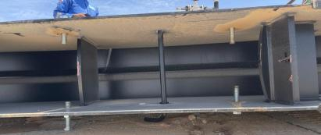
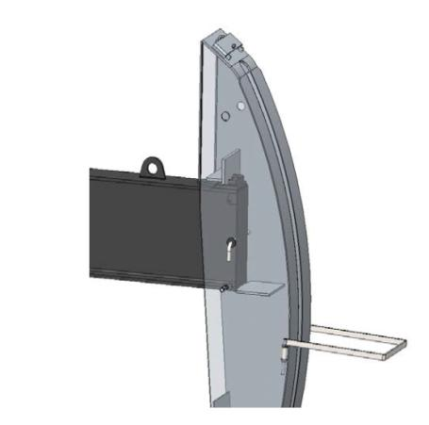
PDO Second Alert
Date:04/06/2023 Incident title: LTI#10 Pattern: Drops Potential severity: C4P Activity: Beam Pump Installation
Target Audience: Drilling, Logistics, Operation & Construction
What happened?
On 04 June 2023, Mechanical/Instrument crew were engaged in pre-commissioning activity for Al Burj 213 well. ATE Instrument fitter was removing the load cell cable tape standing near the monkey ladder of beam pump, meanwhile Mechanical PH was aligning the load cell unit fitted on polish rod by operating the manual gear on the rear side of beam pump. During the course of action, the horse head got detached from walking beam, fell on the polish rod of X-mas tree and slid towards monkey ladder, hitting the fitter’s left leg and resulting in injury.
Why it happened/Finding :
The horse head was not fully secured to the walking beam because the safety bar was incorrectly installed and did not pass through all required slots.
Verification of the horse head installation relied on assumption and visual confirmation was inadequate to identify the unsafe condition.
The hazard associated with horse head installation and potential structural failure was not adequately identified in the risk assessment and work planning process.
Personnel were working within the potential dropped-object and line-of-fire zone during commissioning activities.
Communication between work groups was ineffective, and personnel were not alerted before movement of the beam pump system was initiated.
Management of Change was not applied when a different beam pump design was introduced, and the change-related risks were not adequately assessed.
Your learning from this incident..
How do you verify that a critical component has been correctly installed before releasing equipment for operation?
What independent verification or second-check process is used for high-risk tasks at your worksite?
How do you identify and control line-of-fire and dropped-object hazards before work starts?
How do you ensure effective communication between different work groups performing simultaneous operations?
Safety bar went through horse head but missed walking beam slot
Safety bar should go through the slots on the horse head and walking beam.
Verify critical installations, establish exclusion zones, and keep people out of the line of fire.
Notes:
Ensure all dates and titles are input
A short description should be provided without mentioning names of contractors or individuals. You should include, what happened, to who (by job title) and what injuries this resulted in. Nothing more!
Four to five bullet points highlighting the main findings from the investigation. Remember the target audience is the front line staff so this should be written in simple terms in a way that everyone can understand.
The strap line should be the main point you want to get across
The images should be self explanatory, what went wrong (if you create a reconstruction please ensure you do not put people at risk) and below how it should be done.

Slide 2
Management self audit
Date:04/06/2023 Incident title: LTI#10 Pattern: Drops Potential severity: C4P Activity: Beam Pump Installation
As a learning from this incident and ensure continual improvement all contract managers must review their HSE risk management against the questions asked below
Confirm the following:
Do you ensure critical installations are independently verified before equipment is placed into service?
Do you ensure exclusion zones are clearly identified, established, and maintained during commissioning activities?
Do you ensure personnel are kept clear of line-of-fire and dropped-object zones before equipment movement?
Do you ensure all simultaneous operations are coordinated through effective communication and supervision?
Do you ensure pre-job risk assessments identify all task-specific hazards and failure scenarios?
Do you ensure Management of Change is applied whenever equipment design, method, or scope changes?
Do you ensure critical controls identified in TRIC, JSP, and Risk Assessments are field verified before work begins?
Do you ensure supervisors conduct periodic checks to confirm controls remain effective throughout the task?
* If the answer is NO to any of the above questions please ensure you take action to correct this finding
Disclaimer
This document is provided for information only. It may not be relied upon for any purpose. Neither PDO nor any party providing information for this document accepts any liability for its accuracy, completeness, omissions, advice, or any consequences arising from its use, even if reasonable care was not exercised. No representation or warranty, express or implied, is made that following this document will achieve any specific results or meet any legal or regulatory requirements. This document does not constitute technical advice; consult a qualified professional if such advice is needed
Notes:
Ensure all dates and titles are input
Make a list of closed questions (only ‘yes’ or ‘no’ as an answer) to ask others if they have the same issues based on the management or HSE-MS failings or shortfalls identified in the investigation.
Imagine you have to audit other companies to see if they could have the same issues.
These questions should start with: Do you ensure…………………?

