Slide 1
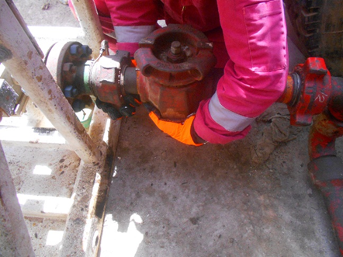
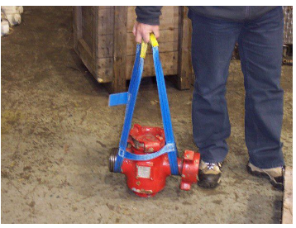
PDO Second Alert
Date: 09/06/2023 Incident title: LTI#11 Pattern: Hand and finger Potential severity: C3P Activity: Manual Handling
Target Audience: Roustabouts ,Supervisors ,Third parties ,PSl’s ,
What happened?
At around 19:15 Hrs., near the waste pit, A roustabout was helping the directional driller to install a low torque valve on the geo span unit. The low torque valve was installed but crossed threaded the connection by hand and was difficult to remove. The directional driller turned around to bring the hammer, meanwhile the IP was still holding and fixing the position of the low torque valve when suddenly it disconnected from its connection and tumbled from an approximate height of 1ft, resulting into pinching IP Right hand ring finger between the low torque valve and the ground.
Why it happened/Finding:
The task-specific hazards associated with manual handling, pinch points, and line-of-fire exposure were not adequately identified and discussed before starting the work.
The Job Safety Analysis (JSA) used for the task was generic and did not effectively address the actual work steps, equipment weight, or required controls.
Hands-free lifting and positioning devices were not used during the handling of the 38 kg low torque valve, exposing personnel to pinch-point hazards.
The partially connected and cross-threaded valve created an abnormal condition, but the work area was not made safe before corrective action was attempted
Supervision was ineffective at a critical moment, resulting in the worker remaining in the line of fire after the instruction to stop work was given
Repeated performance of the task led to normalization of risk and reduced recognition of the hazards associated with manual handling and pinch points
Your learning from this incident..
How do you verify that all pinch points and line-of-fire hazards have been identified before starting a task?
What actions would you take if equipment becomes stuck, cross-threaded, or does not assemble as intended?
How do you ensure your hands and body always remain clear of dropped-object and pinch-point hazards?
How do you confirm that the JSA and TBT fully reflect the actual task being performed?
When should hands-free tools or lifting aids be used, and how do you verify they are available before work starts?
How do you challenge unsafe practices that may have become accepted as "the normal way" of performing the job?
Position while dealing with low torque valve
Always ensure Hands free Equipment's are used
No hand belongs in a pinch point—stop, reassess, and use hands-free tools
Notes:
Ensure all dates and titles are input
A short description should be provided without mentioning names of contractors or individuals. You should include, what happened, to who (by job title) and what injuries this resulted in. Nothing more!
Four to five bullet points highlighting the main findings from the investigation. Remember the target audience is the front line staff so this should be written in simple terms in a way that everyone can understand.
The strap line should be the main point you want to get across
The images should be self explanatory, what went wrong (if you create a reconstruction please ensure you do not put people at risk) and below how it should be done.

Slide 2
Management self audit
Date:09 June 2023 Incident title: LTI#11 Pattern: Hands and fingers Potential severity: C3P
As a learning from this incident and ensure continual improvement all contract managers must review their HSE risk management against the questions asked below
Confirm the following:
Do you ensure task-specific JSAs are reviewed and verified before work starts?
Do you ensure all pinch-point and line-of-fire hazards are identified and discussed during TBTs?
Do you ensure hands-free tools are available and used whenever manual handling hazards exist?
Do you ensure manual handling controls are implemented for equipment exceeding approved weight limits?
Do you ensure supervisors remain focused on supervision and do not become directly involved in the task when critical oversight is required?
Do you ensure the latest approved JSA and controlled documents are available and used at the worksite?
Do you ensure unsafe practices and normalized-risk behaviors are challenged and corrected through active leadership engagement?
* If the answer is NO to any of the above questions please ensure you take action to correct this finding
Disclaimer
This document is provided for information only. It may not be relied upon for any purpose. Neither PDO nor any party providing information for this document accepts any liability for its accuracy, completeness, omissions, advice, or any consequences arising from its use, even if reasonable care was not exercised. No representation or warranty, express or implied, is made that following this document will achieve any specific results or meet any legal or regulatory requirements. This document does not constitute technical advice; consult a qualified professional if such advice is needed
Notes:
Ensure all dates and titles are input
Make a list of closed questions (only ‘yes’ or ‘no’ as an answer) to ask others if they have the same issues based on the management or HSE-MS failings or shortfalls identified in the investigation.
Imagine you have to audit other companies to see if they could have the same issues.
These questions should start with: Do you ensure…………………?

