Slide 1
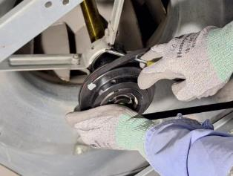
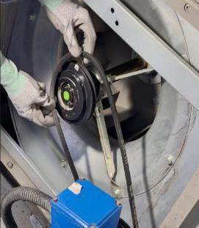
PDO Second Alert
Date:18/06/2023 Incident title: LTI#12, Pattern: Hands & Fingers Potential severity C3P Activity: HVAC Maintenance
…..
Target Audience: Drilling, Logistics, Operation & Construction
What happened?
During HVAC routine maintenance a technician was replacing belts on an Air Handling Unit (AHU) motor and blower. The technician used a screwdriver to attempt to remove and replace the belts without loosening the tension, this resulted in a fractured middle finger when the screwdriver slipped, and the finger was crushed under the belt.
Why it happened/Finding :
The Permit Holder was performing the physical work instead of maintaining effective supervision of the work team as required by the permit process
A shortcut was taken by attempting to remove the belt using a screwdriver instead of first releasing the belt tension through the designed adjustment process.
An inappropriate tool was used for the task, creating a pinch-point hazard and increasing the likelihood of a sudden release of stored energy.
The HVAC method statement and risk assessment did not adequately identify the hazards associated with belt tension release and replacement activities
Over-reliance on experience and familiarity with the task resulted in poor hazard recognition and acceptance of unsafe work practice
Your learning from this incident:
How do you identify and select the right tool before starting maintenance work?
How do you identify pinch points and line-of-fire hazards before beginning a maintenance task?
How do supervisors ensure they remain focused on supervision rather than becoming part of the work crew?
How can workers challenge shortcuts that have become accepted practices over time?
What could happen when experience and confidence replace compliance with procedures?
No shortcuts, no line of fire, no hands in pinch points.
Notes:
Ensure all dates and titles are input
A short description should be provided without mentioning names of contractors or individuals. You should include, what happened, to who (by job title) and what injuries this resulted in. Nothing more!
Four to five bullet points highlighting the main findings from the investigation. Remember the target audience is the front line staff so this should be written in simple terms in a way that everyone can understand.
The strap line should be the main point you want to get across
The images should be self explanatory, what went wrong (if you create a reconstruction please ensure you do not put people at risk) and below how it should be done.

Slide 2
Management self-audit
Date:18/06/2023 Incident title: LTI#12, Pattern: Hands & Fingers Potential severity: C3P Activity: HVAC Maintenance
As a learning from this incident and ensure continual improvement all contract managers must review their HSE risk management against the questions asked below
Confirm the following:
Do you ensure workers use only tools designed and approved for the task being performed?
Do you ensure risk assessments identify all stored-energy, pinch-point, and line-of-fire hazards associated with maintenance tasks?
Do you ensure compliance with procedures is regularly monitored through field verification and worksite visits?
Do you ensure lessons learned from previous incidents are incorporated into risk assessments, procedures, and training?
Do you ensure adequate supervision levels are maintained all the times?
Do you ensure Toolbox Talks and TRIC discussions specifically address task-specific hazards and controls?
If the answer is NO to any of the above questions please ensure you take action to correct this finding
Disclaimer
This document is provided for information only. It may not be relied upon for any purpose. Neither PDO nor any party providing information for this document accepts any liability for its accuracy, completeness, omissions, advice, or any consequences arising from its use, even if reasonable care was not exercised. No representation or warranty, express or implied, is made that following this document will achieve any specific results or meet any legal or regulatory requirements. This document does not constitute technical advice; consult a qualified professional if such advice is needed
Notes:
Ensure all dates and titles are input
Make a list of closed questions (only ‘yes’ or ‘no’ as an answer) to ask others if they have the same issues based on the management or HSE-MS failings or shortfalls identified in the investigation.
Imagine you have to audit other companies to see if they could have the same issues.
These questions should start with: Do you ensure…………………?

