Slide 1
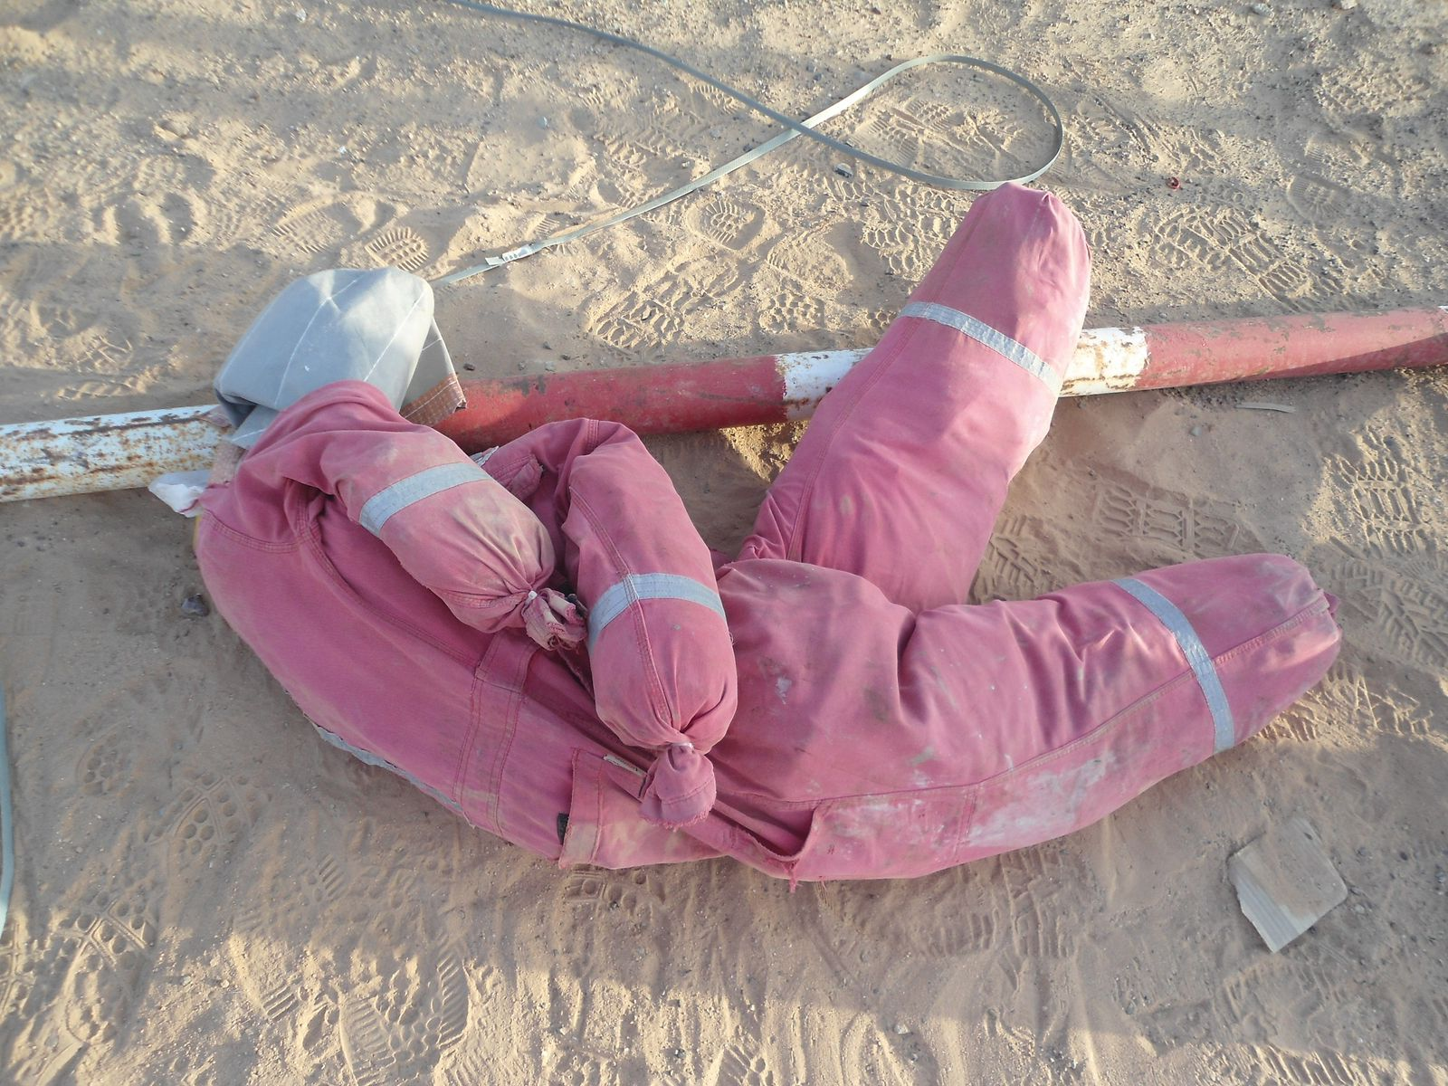
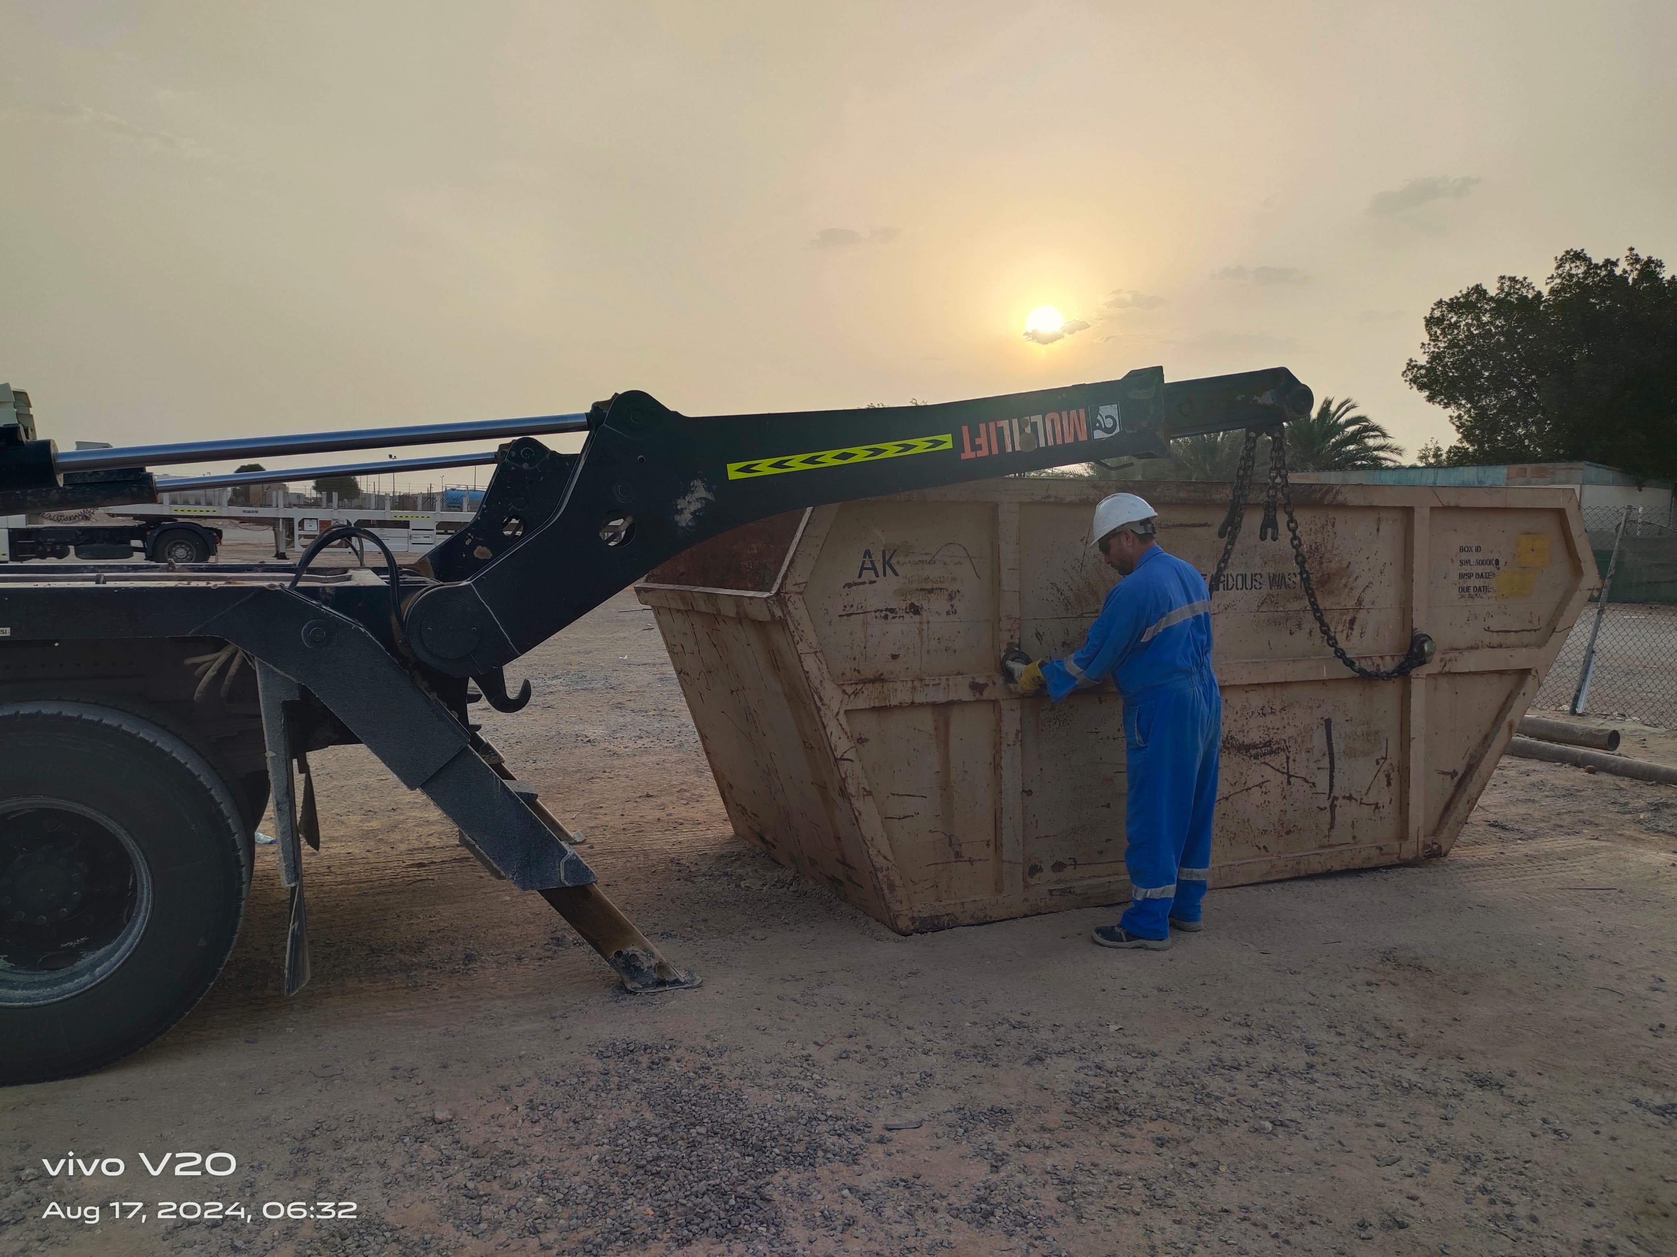
PDO Second Alert
Date: 08/08/2024 Incident title: 3rd party HIPO Pattern: MVI Potential severity: C 4P Activity: Driving
Target Audience: Logistics
What happened?
on the 11th August, During the skip collection activity scheduled at Rig 74 site, the driver & helper were loading skip boxes on to the truck. Unfortunately, while returning from hooking the chains for the second skip box , the helper was injured when swinging under the barrier, causing it to fall on him and resulting in fractured jaw.
Why it happened/Finding :
Helper went under the barricade instead of following safe access arrangements
Helper did not request assistance and chose the quickest/unsafe route.
Pipe barrier was loose, not properly secured, and unstable.
Helper underestimated the risk of passing under the barrier.
Your learning from this incident.
How do you ensure all hazards are identified and communicated before starting and during the task?
How do you ensure that employees are away from (LOF) line of fire?
How do you confirm an area is safe before entering or passing through it?
How do you ensure your crew are complied with SOP?
Always ensure to have a clearly defined safe access/egress route before starting work
Notes:
Ensure all dates and titles are input
A short description should be provided without mentioning names of contractors or individuals. You should include, what happened, to who (by job title) and what injuries this resulted in. Nothing more!
Four to five bullet points highlighting the main findings from the investigation. Remember the target audience is the front line staff so this should be written in simple terms in a way that everyone can understand.
The strap line should be the main point you want to get across
The images should be self explanatory, what went wrong (if you create a reconstruction please ensure you do not put people at risk) and below how it should be done.

Slide 2
Management self audit
Date: 11/08/2024 Incident title: LTI#12 Pattern: Falling object Potential severity: C4P Activity: Loading of skip box, Rig 74
As a learning from this incident and ensure continual improvement all contract managers must review their HSE risk management against the questions asked below
Confirm the following:
How do you ensure that employees are away from (LOF) line of fire?
How do you ensure all hazards are identified and communicated before starting and during the task?
How do you ensure the work is effectively supervised?
How do you ensure crew are adhered to Safe Operating Procedure (SOP) while performing the task?
* If the answer is NO to any of the above questions please ensure you take action to correct this finding
Disclaimer
This document is provided for information only. It may not be relied upon for any purpose. Neither PDO nor any party providing information for this document accepts any liability for its accuracy, completeness, omissions, advice, or any consequences arising from its use, even if reasonable care was not exercised. No representation or warranty, express or implied, is made that following this document will achieve any specific results or meet any legal or regulatory requirements. This document does not constitute technical advice; consult a qualified professional if such advice is needed
Notes:
Ensure all dates and titles are input
Make a list of closed questions (only ‘yes’ or ‘no’ as an answer) to ask others if they have the same issues based on the management or HSE-MS failings or shortfalls identified in the investigation.
Imagine you have to audit other companies to see if they could have the same issues.
These questions should start with: Do you ensure…………………?

