Slide 1
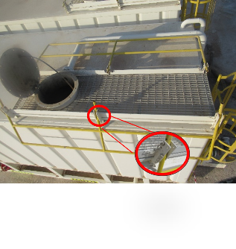
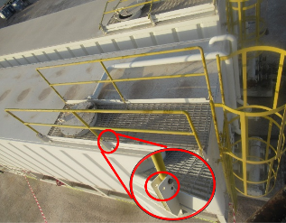
PDO Second Alert
Date: 21/09/2024 Incident title: LTI#15/HiPo#29 Pattern: Slip& Fall Potential severity: C4P Activity: Monitoring fluid level
Target Audience: AD, Derrickman, Roustabout, and Mud logger
What happened?
On 21st Sep 2024 @ 9:30 AM, the operation was cleaning mud tank and transferring the water-based mud from rig tanks to Frac tanks. As part of the operation, the Roustabout climbed to the top of the Frac tank to monitor the mud level. While doing so, he leaned on the handrail of the Frac tank, which was not secured with the securing pins causing the roustabout to fall from the Frac tank to the ground approximately 3.5 m and land on his right side. Immediately, he was evacuated by rig ambulance to PDO Yibal clinic.
Why it happened/Finding:
The frac tank handrail was not secured with designated pin.
The roustabout climbed the frac tank without safety harness.
The tank mobilized to the tank without 3rd party mobilization checklist
No supervision for the mud transferring job.
No COW conducted for the transferring job.
No-pre job check conducted on the frac tank before starting the transferring task.
Your learning from this incident..
Ensure that Musta’ed is properly implemented, including 3rd party operations & equipment.
Always ensure that specific SOP and risk assessment for the planned operations are available on hand.
Always ensure to conduct an effective TBT with all involved parties.
Always ensure to stop the work if no/unclear instructions are given.
Always ensure to follow the 3rd party checklist when dealing with 3rd party operations and equipment.
Always ensure all activates are supervised including out of sight (OOS) activities.
Ensure to update the out of sight register to include working at frac tanks.
Always ensure all handrails are properly secured!
Notes:
Ensure all dates and titles are input
A short description should be provided without mentioning names of contractors or individuals. You should include, what happened, to who (by job title) and what injuries this resulted in. Nothing more!
Four to five bullet points highlighting the main findings from the investigation. Remember the target audience is the front line staff so this should be written in simple terms in a way that everyone can understand.
The strap line should be the main point you want to get across
The images should be self explanatory, what went wrong (if you create a reconstruction please ensure you do not put people at risk) and below how it should be done.

Slide 2
Management Self-Audit
Date: 21/09/2024 Incident title: LTI#15/HiPo#29 Pattern: Fall from height Potential severity: C4P
As a learning from this incident and ensure continual improvement all contract managers must review their HSE risk management against the questions asked below
Confirm the following:
Do you ensure that all 3rd equipment are received with 3rd party checklist?
Do you ensure the SOP of 3rd party related operations is available ?
Do you ensure all out of sight area, equipment & activities are captured in your out of sight register?
Do you ensure that all of the activities performed in your site are controlled with proper COW?
Do you ensure the implementation of the working at height system during relevant operations?
* If the answer is NO to any of the above questions please ensure you take action to correct this finding
Disclaimer
This document is provided for information only. It may not be relied upon for any purpose. Neither PDO nor any party providing information for this document accepts any liability for its accuracy, completeness, omissions, advice, or any consequences arising from its use, even if reasonable care was not exercised. No representation or warranty, express or implied, is made that following this document will achieve any specific results or meet any legal or regulatory requirements. This document does not constitute technical advice; consult a qualified professional if such advice is needed
Notes:
Ensure all dates and titles are input
Make a list of closed questions (only ‘yes’ or ‘no’ as an answer) to ask others if they have the same issues based on the management or HSE-MS failings or shortfalls identified in the investigation.
Imagine you have to audit other companies to see if they could have the same issues.
These questions should start with: Do you ensure…………………?

