Slide 1
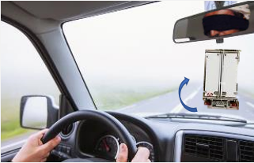
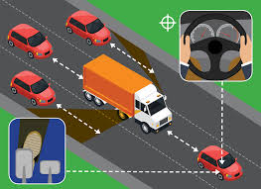
PDO Second Alert
Date: 23/09/2024 Incident title: LTI#16/HiPo#30 Pattern: MVI Potential severity: C4P Activity: Driving
Target Audience: All
What happened?
A Riyadh Card Holder (RCH) driver (subcontractor) was en route to Marmul to deliver flanges loaded from Nadhira Samail. After loading the driver departed onto the Muscat highway towards Nizwa. Soon after joining the highway, he was forced to apply the brakes harshly. This was due to the actions of a 3rd party vehicle in front as the 3rd party moved to the left lane in front . At this point, the driver has attempted to avoid a collision and steered back to the inside lane (to the right) however was unable to and lost control of the vehicle as the left steering tyre burst , with the prime mover crossing through the centre median before coming to rest across the opposite carriageway. The driver was able to exit the vehicle moments before it caught fire. The load was scattered over both sides of the carriageway.
Why it happened/Finding:
Driver not focused on road and road conditions.
A lack of oversight of the maintenance and condition of the vehicle
Inadequate review of road hazards before overtaking.
The vehicle has been overloaded with respect to the recommended capacity
Carelessness and noncompliance of the 3rd party driving behaviors
Your learning from this incident..
Always ensure you review the maintenance of the vehicle
Always ensure you scan the route before overtaking
Always ensure you follow your defensive driver training
Always ensure you drive at a speed according to the road condition
Always ensure to avoid overtaking if the road is not clear
Be Alert to the Actions of Other Road Users !
Notes:
Ensure all dates and titles are input
A short description should be provided without mentioning names of contractors or individuals. You should include, what happened, to who (by job title) and what injuries this resulted in. Nothing more!
Four to five bullet points highlighting the main findings from the investigation. Remember the target audience is the front line staff so this should be written in simple terms in a way that everyone can understand.
The strap line should be the main point you want to get across
The images should be self explanatory, what went wrong (if you create a reconstruction please ensure you do not put people at risk) and below how it should be done.

Slide 2
Management Self-Audit
Date: 23/09/2024 Incident title: LTI#16/HiPo#30 Pattern: MVI Potential severity: C4P Activity: Driving
As a learning from this incident and ensure continual improvement all contract managers must review their HSE risk management against the questions asked below
Confirm the following:
Do you ensure drivers are learning from previous incidents?
Do you ensure your drivers are regularly briefed on following defensive driving techniques?
Do you ensure that the inspect the vehicles using proper equipment?
Do you ensure that you have a record for the vehicle maintenance before it’s being used ?
Do you ensure that your vehicle is compliant with SP2000 V5 or you are mitigating via a step out?
Do you Ensure that your vehicle is fitted with the ABS System or you are mitigating the risk if not fitted.
Do you ensure that DFMS & TPMS are functioned on your vehicle
* If the answer is NO to any of the above questions please ensure you take action to correct this finding
Disclaimer
This document is provided for information only. It may not be relied upon for any purpose. Neither PDO nor any party providing information for this document accepts any liability for its accuracy, completeness, omissions, advice, or any consequences arising from its use, even if reasonable care was not exercised. No representation or warranty, express or implied, is made that following this document will achieve any specific results or meet any legal or regulatory requirements. This document does not constitute technical advice; consult a qualified professional if such advice is needed
Notes:
Ensure all dates and titles are input
Make a list of closed questions (only ‘yes’ or ‘no’ as an answer) to ask others if they have the same issues based on the management or HSE-MS failings or shortfalls identified in the investigation.
Imagine you have to audit other companies to see if they could have the same issues.
These questions should start with: Do you ensure…………………?

