Slide 1

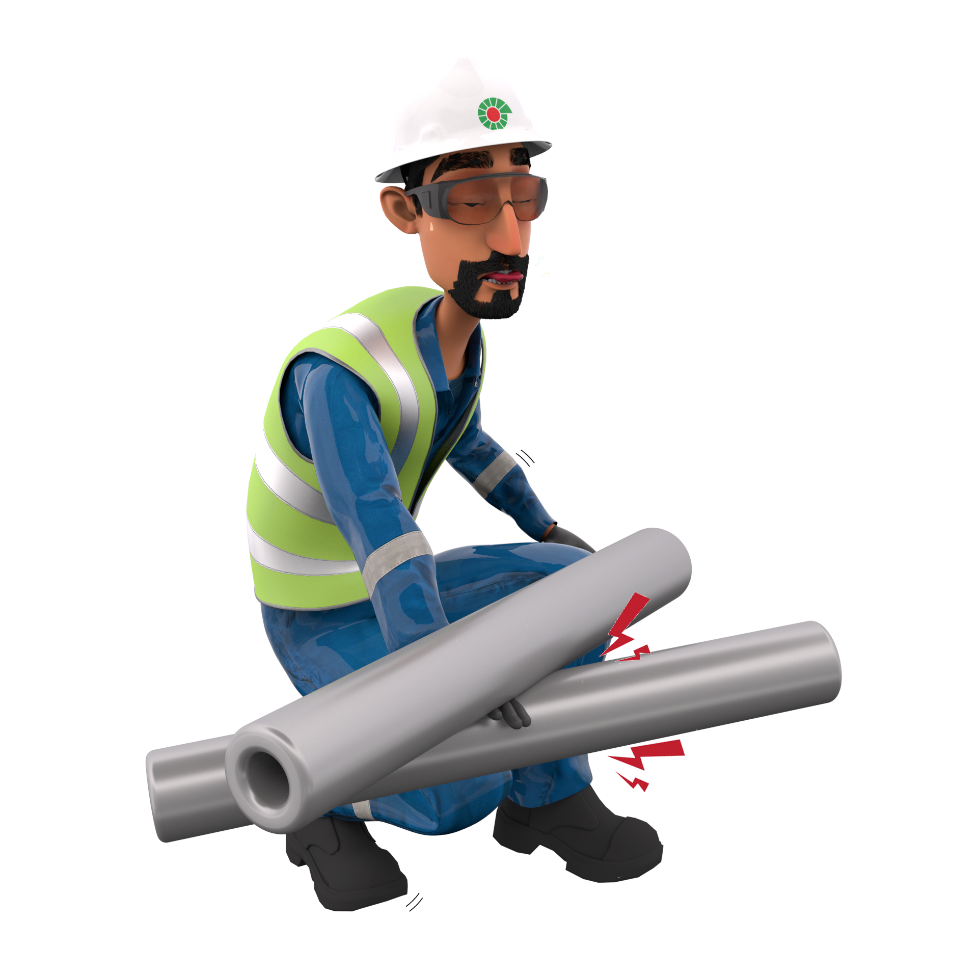
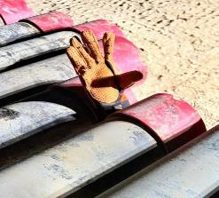
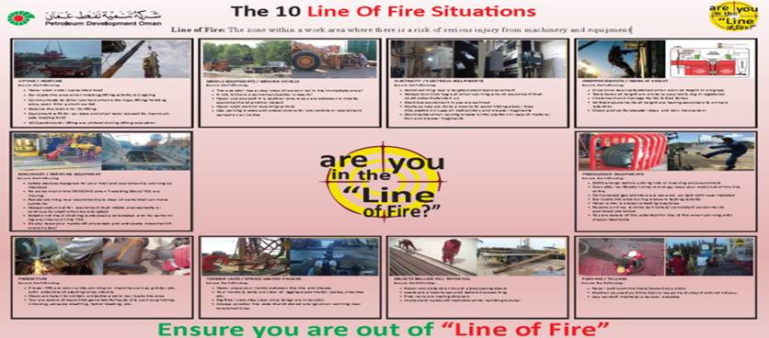
Learning From Incident - First Alert
Event ID # | 26017500 | Date & Time | 12.12.2025 / 16:30 | Location | Marmul
Incident Type | LTI#20 | Category | Hit/struck by | Activity | Drilling Operations
Prevent
Target Audience: ALL
What happened:
While measuring the casing joints using measuring tape, a measuring tape became stuck between two casing joints. To free the tape, a forklift was utilized to reposition the casing. While the floorman was attempting to remove the tape, the casing joints unexpectedly slipped from the forklift’s forks and rolled back onto the rack. As a result, the floorman’s right hand was caught between two joints, causing a fracture to his right forearm.
Initial Findings:
Although the initial TBT and JSA were discussed, the team did not stop and reassess the recovery plan when the task changed after the measuring tape became stuck.
The casing joints were lifted without confirming they were securely positioned on the forklift forks.
The Red Zone / No-Go Zone was not properly managed during dynamic risk changes, and personnel were not cleared from hazardous areas..
The crew failed to identify the risk of casing joints rolling back and positioned themselves in the line of fire.
The forklift operator was not included in the initial Toolbox Talk (TBT).
The crew started the forklift without ensuring all employees were safely away from the line of fire.
Engagement Questions:
When a task changes unexpectedly, what steps should we take before continuing?
How can we ensure that equipment, like forklift forks, is secure before moving heavy loads?
What strategies can we use to manage Red Zones or No-Go Zones effectively during dynamic operations?
How do we identify and avoid positioning ourselves in the line of fire during lifting operations?
Why is it important to include all involved personnel, such as forklift operators, in the Toolbox Talk?
Before starting equipment, what checks should we perform to confirm everyone is in a safe position?
How can we empower team members to stop work when they notice unsafe act/conditions?
Always ensure the No-Go Zone management is adhered and stay away for Line of Fire.
In case of an emergency please call PDO Emergency Number (Toll Free): 2467-5555
Notes:
Mr Musleh image on the top right will change according to incident pattern, MSE3 will provide you with the image as per the pattern
What happened: A short description should be provided without mentioning names of contractors or individuals. You should include, what happened, to who (by job title) and what injuries this resulted in. Nothing more!
Initial Finding: Four to five bullet points highlighting the initial main findings from the investigation. Remember the target audience is the front-line staff so this should be written in simple terms in a way that everyone can understand.
Learnings: Four to five learning message in the form of questionnaires linked with initial findings
The strap line should be the main learning point you want to get across
The images should be self explanatory, what went wrong (if you create a reconstruction please ensure you do not put people at risk) and below how it should be done.

