Slide 1

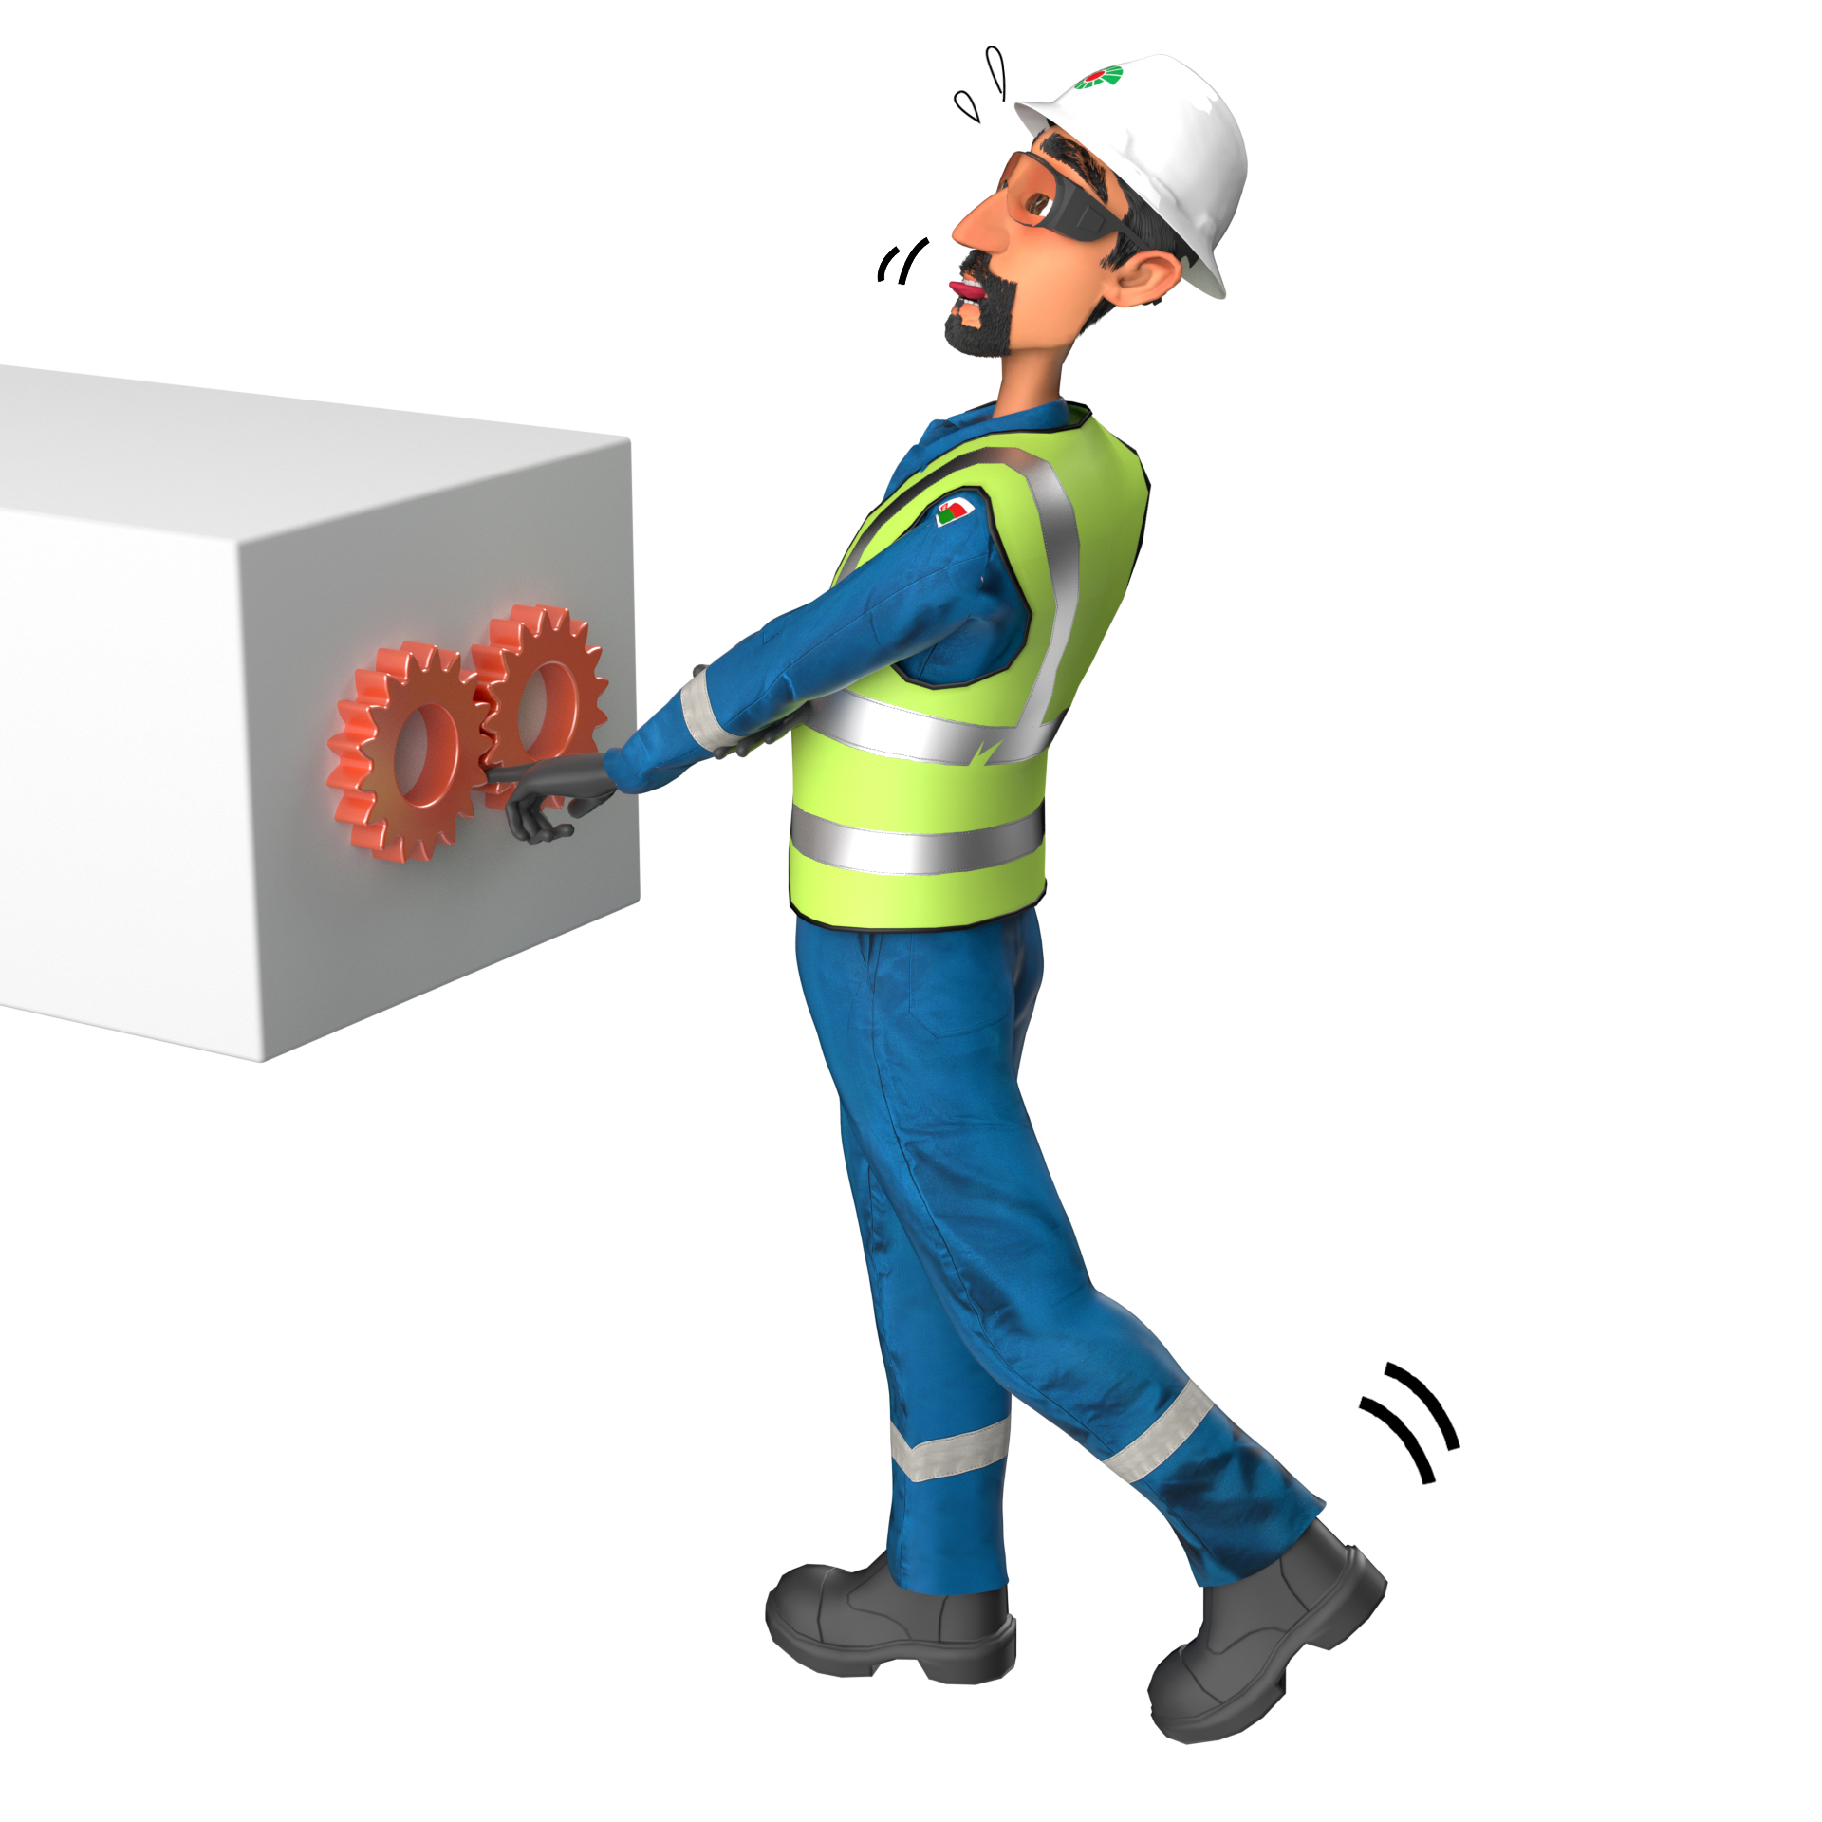
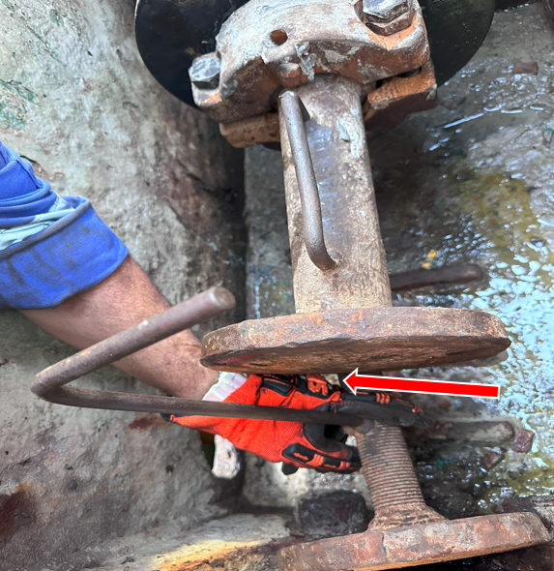
Learning From Incident - First Alert
Event ID # | 2602822 | Date & Time | 15.12.2025 / 11:40 | Location | Nimr
Incident Type | LTI#21 | Category | Pinched point (Hands & Fingers) | Activity | Drilling Operations
Prevent
Target Audience: ALL
What happened:
While the derrick man was removing the liner from the mud pump using the spacer liner removal tool, he signaled the floorman to manually operate the drive motor. During this operation, the tool suddenly shifted, resulted in pinching derrickman’s left index finger causing fracture.
Initial Findings:
Inadequate job planning and risk assessment for using an extension tool during liner removal.
Improper tool adaptation without safety compliance checks.
Unsafe hand positioning and failure to use dedicated handles.
Lack of effective communication and stop-work intervention.
Supervisor did not identify hazards associated with the chosen method.
hand placement and incorrect tool usage
Engagement Questions:
How can we ensure all tools used are properly risk-assessed before starting the job?
What steps should we take to keep hands and fingers away from moving parts during maintenance?
How can supervisors and crew improve communication and intervene when unsafe practices are observed?
What planning measures can prevent the need for improvised tools in the field?
How can we make hazard identification a shared responsibility among all team members?
Always use risk-assessed tools and maintain safe hand positioning. Keep hands and fingers away from moving parts (LoF).
Correct tool with hand free
In case of an emergency please call PDO Emergency Number (Toll Free): 2467-5555
Notes:
Mr Musleh image on the top right will change according to incident pattern, MSE3 will provide you with the image as per the pattern
What happened: A short description should be provided without mentioning names of contractors or individuals. You should include, what happened, to who (by job title) and what injuries this resulted in. Nothing more!
Initial Finding: Four to five bullet points highlighting the initial main findings from the investigation. Remember the target audience is the front-line staff so this should be written in simple terms in a way that everyone can understand.
Learnings: Four to five learning message in the form of questionnaires linked with initial findings
The strap line should be the main learning point you want to get across
The images should be self explanatory, what went wrong (if you create a reconstruction please ensure you do not put people at risk) and below how it should be done.

