Slide 1
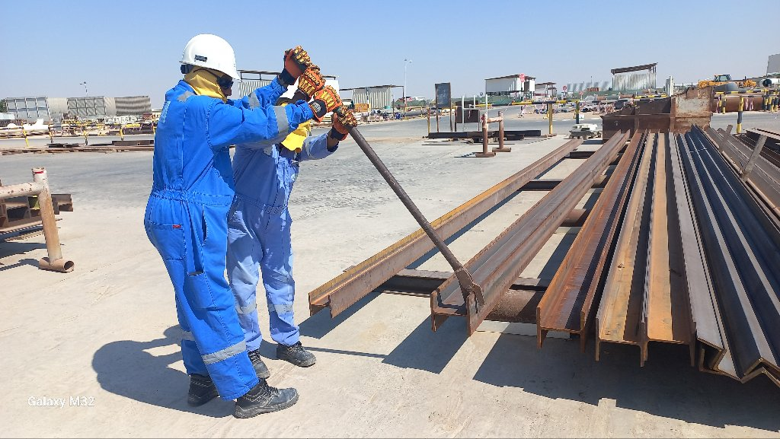
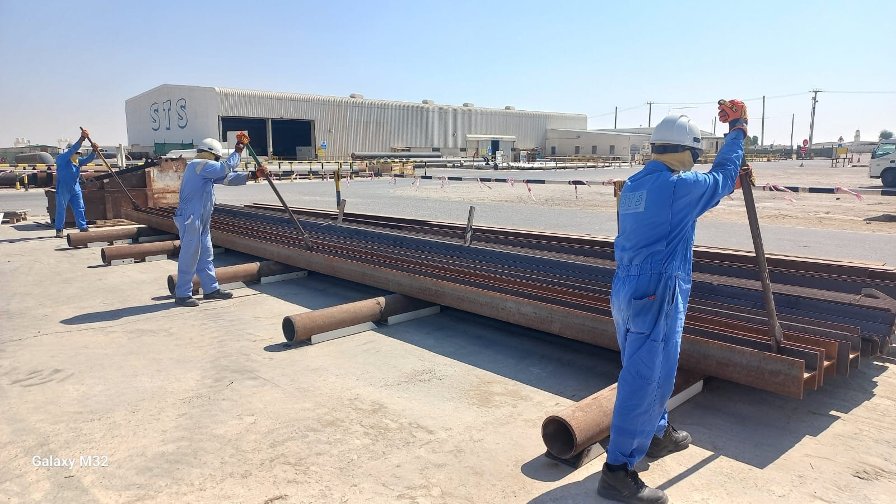
PDO Second Alert
Date: Time: | 28/10/2024 11:45am | Incident title: PIM# | LTI#22 1171897 | Risk Category: Injury / Asset Damaged: | Other Shoulder Dislocation | Actual Severity: Potential severity: | 3P B3P | Activity: Location: | Structural Fabrication Yibal
Target Audience: Fabrication, Construction & Maintenance
What happened?
A Mechanical crew was conducting structural fabrication work at the industrial yard. During the activity, the crew’s Chargehand decided to rotate a H-beam for marking and cutting, with assistance from a Rigger. While rotating the beam using a lever-clamp, the Rigger experienced an unexpected jolt due to a height difference (9.8 cm) in the dunnage, resulting in pain in his left shoulder.
Why it happened/Finding :
Beam rotation over dunnage with height difference (9.8 cm).
Rotation of beam using a lever-clamp from one end of the beam
Ineffective supervision for the task.
Inadequate enforcement of the procedure on Managing industrial yard activities
Reflective Questions
How do you comply with right method of handling heavy material ?
How do you evaluate the hazards involved in the task ?
Are you aware of the manual handling risks including load dynamics associated with the task?
Have you normalized the risk involved in pushing, pulling & rotating activities ?
As a supervisor, do you ensure you are aware of your roles and responsibilities?
Always be aware of manual handling risks
Notes:
Ensure all dates and titles are input
A short description should be provided without mentioning names of contractors or individuals. You should include, what happened, to who (by job title) and what injuries this resulted in. Nothing more!
Four to five bullet points highlighting the main findings from the investigation. Remember the target audience is the front line staff so this should be written in simple terms in a way that everyone can understand.
The strap line should be the main point you want to get across
The images should be self explanatory, what went wrong (if you create a reconstruction please ensure you do not put people at risk) and below how it should be done.

Slide 2
Management Reflective Questions
As a learning from this incident and to ensure continual improvement, all contract managers must review their HSE risk management against the questions asked below
Confirm the following:
- Do you ensure your manual handling procedures are updated to cover all tasks?
- Do you ensure compliance with your procedure on managing industrial yard activities?
- Do you ensure all the risks associated with your activities are assessed and managed?
- Do you ensure effective supervision at Industrial yard activities?
* If the answer is NO to any of the above questions please ensure you take action to correct this finding
Disclaimer
This document is provided for information only. It may not be relied upon for any purpose. Neither PDO nor any party providing information for this document accepts any liability for its accuracy, completeness, omissions, advice, or any consequences arising from its use, even if reasonable care was not exercised. No representation or warranty, express or implied, is made that following this document will achieve any specific results or meet any legal or regulatory requirements. This document does not constitute technical advice; consult a qualified professional if such advice is needed
Notes:
Make a list of closed questions (only ‘yes’ or ‘no’ as an answer) to ask others if they have the same issues based on the management or HSE-MS failings or shortfalls identified in the investigation.
Imagine you have to audit other companies to see if they could have the same issues.
These questions should start with: Do you ensure…………………?

