Slide 1


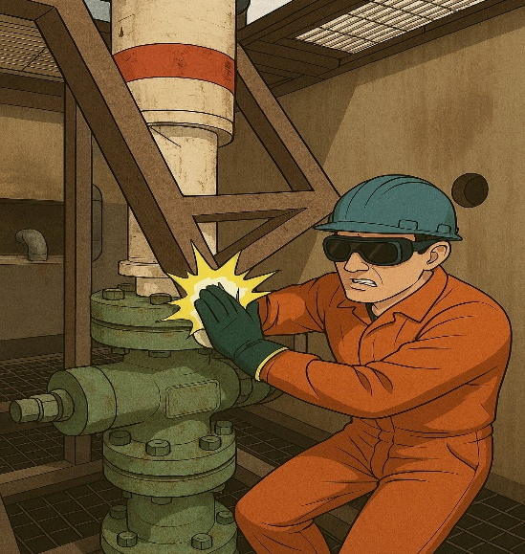
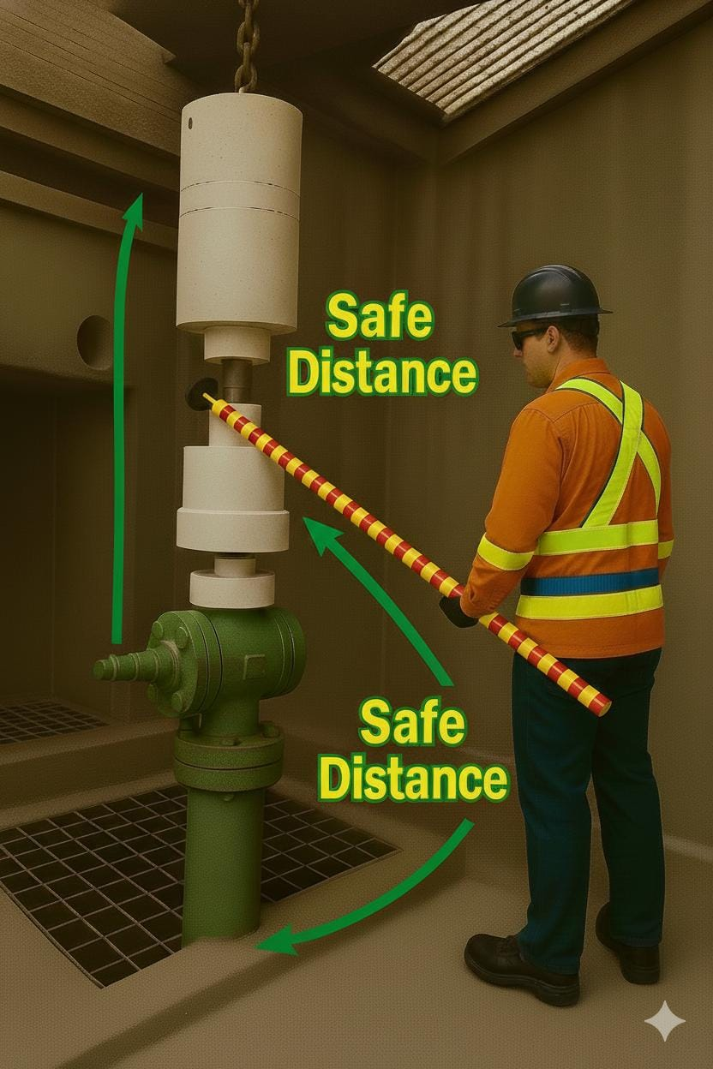
Learning From Incident - First Alert
Event ID # | 26187430 | Date & Time | 30.12.2025 / 14:00 | Location | Fahud
Incident Type | LTI#23 | Category | Struck by (Hands & Fingers) | Activity | Drilling Operations
Prevent
Target Audience: ALL
What happened:
During the slickline rig-up phase, an assembled Pressure Control Equipment (PCE) was lowered by crane into a deep cellar to align with the X-mass tree. While attempting to connect the PCE, the assistant operator stood on the cellar platform and experienced difficulty aligning the connection. He signaled the banksman to lift the PCE for adjustment. During the lifting process, the PCE touched the cellar grating frame, causing the frame to fall and strike the operator’s right index finger resulting in an injury.
Initial Findings:
Zone management was not properly implemented
SOP and risk assessment did not fully address rig-up in deep cellars.
Interaction risks (e.g., PCE contacting grating frames) were not considered during area preparation.
Hands were in the line of fire; push/pull sticks were not used.
Toolbox talk did not emphasize the hands-off rule.
Final checks failed to ensure grating frames were secure.
Abnormal situation during rig-up was not identified early; work continued without reassessment.
Engagement Questions:
How can we ensure SOPs and risk assessments cover site-specific conditions like deep cellars?
What steps can be taken to identify and mitigate interaction risks during area preparation?
How can we reinforce the hands-off rule during toolbox talks?
What methods can be used to keep hands out of the line of fire during alignment tasks?
How can we improve final checks to confirm that grating frames are secure before operations?
What should trigger a stop-work decision when abnormal situations arise during rig-up?
Always ensure proper zone management and adherence to hands-off practices
Correct tool with hand free
In case of an emergency please call PDO Emergency Number (Toll Free): 2467-5555
Notes:
Mr Musleh image on the top right will change according to incident pattern, MSE3 will provide you with the image as per the pattern
What happened: A short description should be provided without mentioning names of contractors or individuals. You should include, what happened, to who (by job title) and what injuries this resulted in. Nothing more!
Initial Finding: Four to five bullet points highlighting the initial main findings from the investigation. Remember the target audience is the front-line staff so this should be written in simple terms in a way that everyone can understand.
Learnings: Four to five learning message in the form of questionnaires linked with initial findings
The strap line should be the main learning point you want to get across
The images should be self explanatory, what went wrong (if you create a reconstruction please ensure you do not put people at risk) and below how it should be done.

