Slide 1
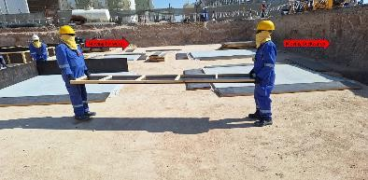
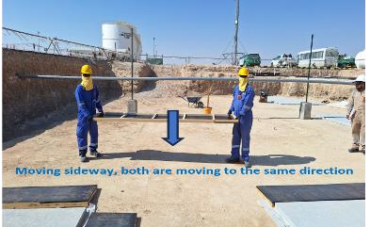
PDO Second Alert
Date: 23.11.2024 Incident title: LTI#24 Pattern: Slips, Trips and Falls Potential severity: C3P
Activity: Manual Handling
Target Audience: Drilling, Logistics, Operation & Construction
What happened?
On 23rd of November 2024, at 09:35 am., while two Carpenters were shifting the shuttering frames manually, one of the Carpenters unfortunately lost his balance and fell down, landing on his right-hand resulting to a fracture of his wrist.
Why it happened/Finding :
Carpenter was walking backward while doing the manual handling
Proper manual handling techniques were not followed
The hazards associated with the chosen manual handling method were not identified
Your learning from this incident:
Have you assessed the possible hazard and risk related with the work prior to perform the task ?
Do you ensure the safe manual handling techniques has been followed ?
Have you pay proper attention on the surroundings while performing the task
To avoid the trip, ensure where to step

Slide 2
Management self-audit
Date: 23/11/2024 Incident title: LTI#24
Pattern: Wrist Fracture. Potential severity: C3P Activity: Manual Handling
As a learning from this incident and ensure continual improvement all contract managers must review their HSE risk management against the questions asked below
Confirm the following:
-Do you ensure safe work method has been followed at site?
-Do you ensure that the hazards involved have been effectively assessed and captured in the TBT discussion prior to deploying
the crew for the task?
-Do you ensure that the workers are aware of their authority to stop unsafe work practices
-Do you ensure risk assessments and method statements are adequately capturing key stages of the activities involved?
* If the answer is NO to any of the above questions please ensure you take action to correct this finding
Disclaimer
This document is provided for information only. It may not be relied upon for any purpose. Neither PDO nor any party providing information for this document accepts any liability for its accuracy, completeness, omissions, advice, or any consequences arising from its use, even if reasonable care was not exercised. No representation or warranty, express or implied, is made that following this document will achieve any specific results or meet any legal or regulatory requirements. This document does not constitute technical advice; consult a qualified professional if such advice is needed

