Slide 1
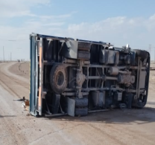
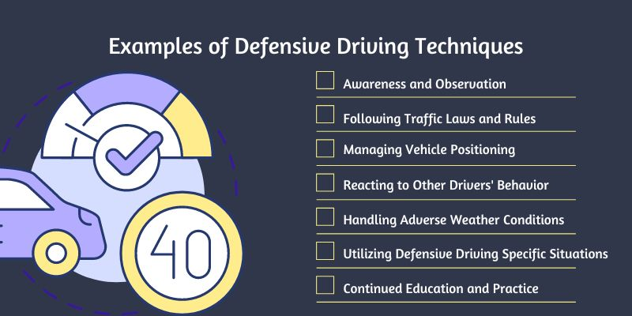
PDO Second Alert
Date: Time: | 17/10/2024 03:04 | Incident title: PIM# | HiPo#35D 1171576 | Risk Category: Injury / Asset Damaged: | MVI Rollover Minor vehicle damage | Actual Severity: Potential severity: | 2A D5P | Activity: Location: | Driving Qarn Alam
Target Audience: Drivers and Journey Managers
What happened?
On October 17th at 3:04 pm, a 3-ton Galfar ODC canter skidded on a wet road and rolled over while returning from the Tibr project site to Wadi Musallam camp. The driver lost control during corrective maneuvers. All occupants, wearing seatbelts, exited safely, and the incident was promptly reported to PDO emergency services.
Why it happened/Finding:
The road was wet, contributing to the vehicle skidding.
The driver attempted to maneuver the vehicle both anti-clockwise and clockwise to avoid the wet road, but he lost control causing the roll over.
Reflective Questions:
As a Driver, do you have adequate knowledge of defensive driving techniques, particularly for handling vehicles in adverse weather and wet road conditions?
As a Journey Manager, do you have a system in place to assess and communicate road and weather conditions to drivers before starting a journey?
Are the vehicles fitted with anti skid systems ?
Safe driving considering soil condition /speed limit according to road condition
Always adjust your speed according to the road conditions
Notes:
Ensure all dates and titles are input
A short description should be provided without mentioning names of contractors or individuals. You should include, what happened, to who (by job title) and what injuries this resulted in. Nothing more!
Four to five bullet points highlighting the main findings from the investigation. Remember the target audience is the front line staff so this should be written in simple terms in a way that everyone can understand.
The strap line should be the main point you want to get across
The images should be self explanatory, what went wrong (if you create a reconstruction please ensure you do not put people at risk) and below how it should be done.

Slide 2
Management Reflective Questions
As a learning from this incident and to ensure continual improvement, all contract managers must review their HSE risk management against the questions asked below
Confirm the following:
Are drivers adequately trained in defensive driving techniques, particularly for handling vehicles in adverse weather and road conditions?
Is there a system in place to assess and communicate road and weather conditions to drivers before starting a journey?
Do drivers have clear guidelines on how to adjust their driving behavior (e.g., speed and maneuvering) based on road and weather conditions?
Are regular inspections performed on vehicles to ensure they are equipped with suitable tires and other safety features for all weather conditions?
Is there an established process for reviewing near-miss incidents and accidents to identify root causes and update safety protocols?
Does current DD course cover the techniques useful for sudden rains and Wadi conditions on roads?
Disclaimer
This document is provided for information only. It may not be relied upon for any purpose. Neither PDO nor any party providing information for this document accepts any liability for its accuracy, completeness, omissions, advice, or any consequences arising from its use, even if reasonable care was not exercised. No representation or warranty, express or implied, is made that following this document will achieve any specific results or meet any legal or regulatory requirements. This document does not constitute technical advice; consult a qualified professional if such advice is needed
Notes:
Make a list of closed questions (only ‘yes’ or ‘no’ as an answer) to ask others if they have the same issues based on the management or HSE-MS failings or shortfalls identified in the investigation.
Imagine you have to audit other companies to see if they could have the same issues.
These questions should start with: Do you ensure…………………?

