Slide 1
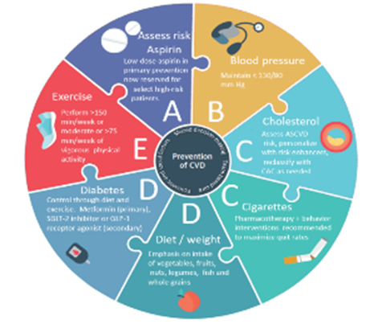
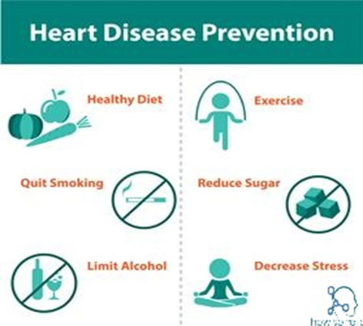
PDO Second Alert
Date: 15.02.2021 Incident title: NAD#03
What happened?
While the deceased was joining duty after rest days on Monday 15/02/2021 and on the way from Marmul Airport to Marmul Camp in a PDO approved vehicle with two other colleagues, he collapsed in the vehicle. He was given CPR by his colleagues while driving to Marmul Clinic. Reached Marmul Clinic at 09:30 Hrs and was attended by medics. Despite all efforts to resuscitate him, he was declared dead at 10:45 Hrs by the doctor.
Your learning from this incident..
Know the symptoms and seek medical attention in time.
Always ensure first aid is given while medical professional is called
Always ensure 5555 is called
Always ensure correct medical emergency vehicle is used
Always follow Medical emergency procedure
Always be active and maintain healthy living style
Call Emergency number (5555) to seek timely assistance
Notes:
No names or detail of company to link this to any recent specific incident

