Slide 1
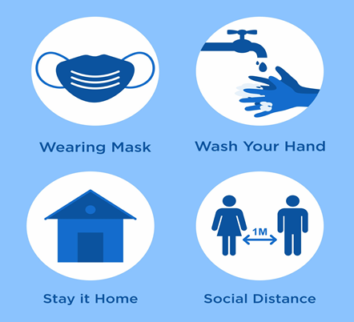
PDO Second Alert
Date: 17.04.2021 Incident title: NAD#05
What happened?
A subcontractor employee have been given permission three times to visit hospital for the same symptoms of body pain and fatigue. During these visits the doctors advised quarantine and PCR test which was not reported or done by the employee. On the third visit he became very sick at the start of the journey and collapsed in bus within office premises. He was taken to the clinic by his colleagues for emergency intervention but could not be revived.
Your learning from this incident..
Always follow COVID-19 precautions
Avoid going to public places and shopping where the risk is unknown
Report your medical conditions, hospital reports and medical advises immediately to your supervisor
Watch for the COVID-19 symptoms of your colleagues/room mates and escalate it for timely treatment and precautions.
Always report health conditions including COVID-19 symptoms
Notes:
No names or detail of company to link this to any recent specific incident

