Slide 1
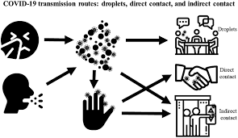
PDO Second Alert
Date: 06.05.2021 Incident title: NAD#09
What happened?
The forklift operator was under isolation following four suspected cases at site and was then moved to the Yibal Motel. About five to six days after testing positive the forklift operator started having health issues. He was then transported to Nizwa hospital. Over the following month in hospital, he developed complications and his condition continued to deteriorate. unfortunately passed away on the 6th May 2021.
Your learning from this incident..
Prevent any movement of staff between operating units whilst potential cases have been reported/ pending PCR test results and, ensure that all staff are contained at the originating unit.
Ensure that your Covid-19 response plan covers due process for 3rd party quarantine facilities.
Ensure that reliable transportation arrangements are in place to transport Covid positive cases from the field.
Ensure that effective and routine health monitoring for all Covid positive cases is implemented, maintained and communicated.
Validate the integrity and implementation of Covid-19 control measures.
Ensure your Covid-19 response plan is effective
Notes:
No names or detail of company to link this to any recent specific incident

