Slide 1
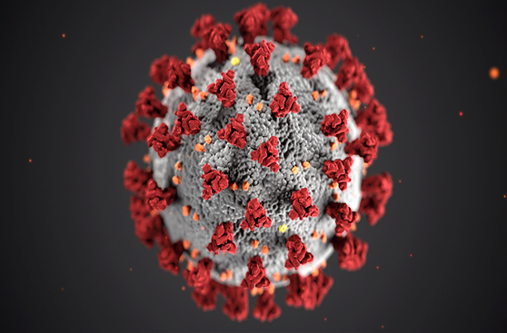
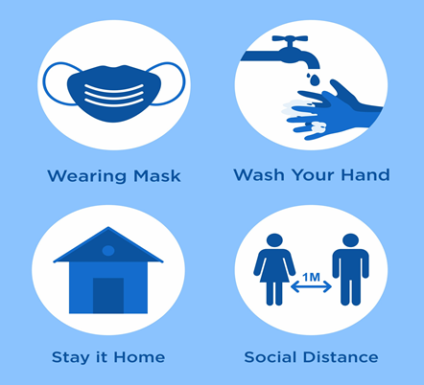
PDO Second Alert
Date: 22.05.2021 Incident title: NAD#10
What happened?
On 01 May 2021, a contractor employee was quarantined in camp as his room mate was symptomatic. Few days later he became symptomatic, admitted in hospital and then shifted to ICU/ventilator as his condition deteriorated over time. He was given highest possible medical/hospital support. On 22 May 2021 he was declared dead at 12:30 Hrs despite the best efforts from the medical team.
Your learning from this incident..
Always follow COVID-19 precautions
Avoid going to public places and shopping where the risk is unknown
Watch for the COVID-19 symptoms of your colleagues/room mates and escalate it for timely treatment and precautions.
Employees who have Chronic illness such as diabetics, high BP, etc. shall regularly visit site medical facilities to ensure they are taking right medicine or right dose.
Avoid public places including shopping and always comply with COVID precautions
Notes:
No names or detail of company to link this to any recent specific incident

