Slide 1
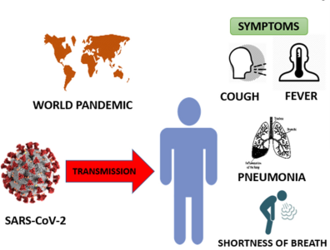
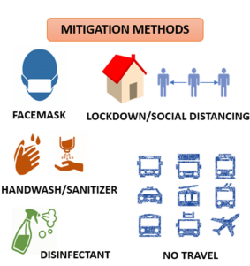
PDO Second Alert
Date: 20.05.2021 Incident title: NAD #11
What happened?
A 51 yrs. old expat employee working as Sr Site Manager who was tested positive for covid-19 and was being treated as an inpatient at Burjeel Hospital, declared dead by the hospital authorities on 20 May 2021
Your learning from this incident..
Always adhere to COVID protocols
Always keep a distance of 6 feet while you are talking
Always consult doctor upon having slightest of symptoms
Always communicate your health issues
Always do follow up health condition checks of employees as per medical records.
Anyone can get a virus, no one is invincible
Notes:
No names or detail of company to link this to any recent specific incident

