Slide 1
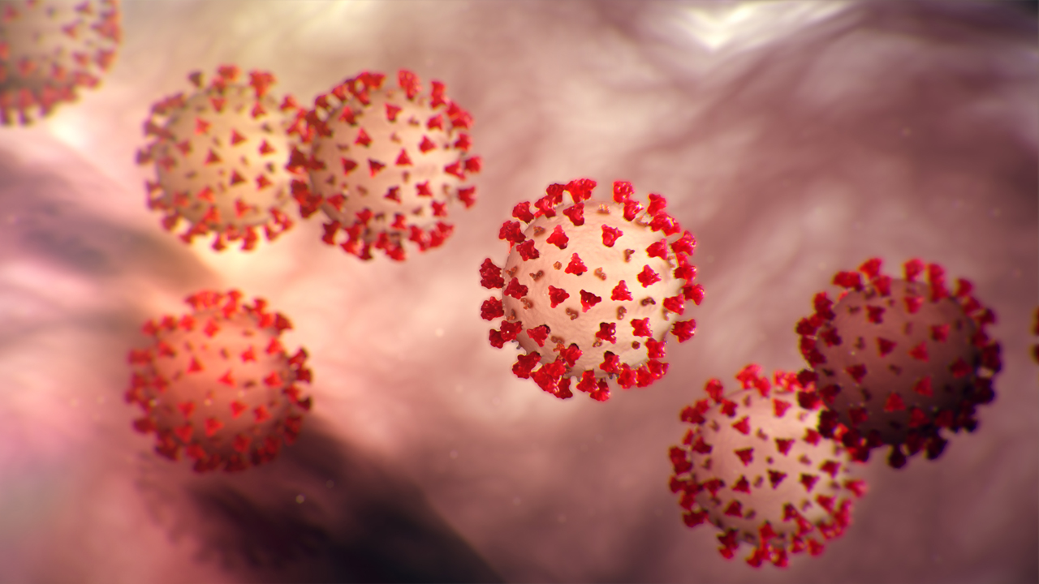
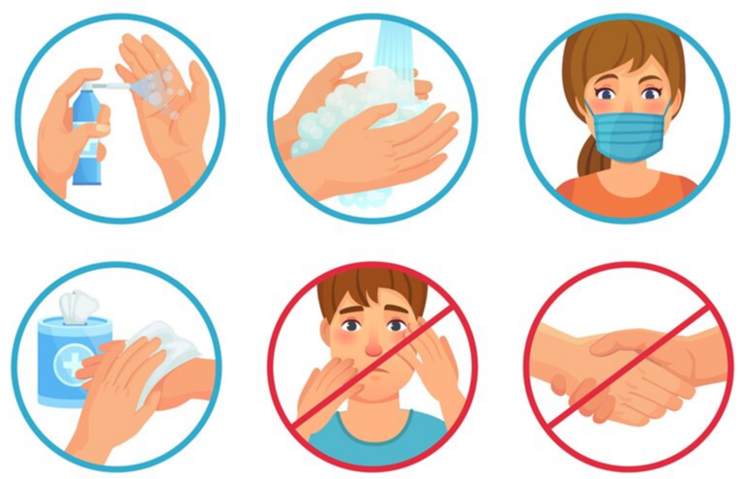
PDO Second Alert
Date: 24.06.2021 Incident title: NAD#13
What happened?
The Civil Foreman reported at Mabrouk site clinic on 23rd May 2021 with symptoms of fever and headache. He was initially admitted in Badr Al Sama Hospital in Nizwa. Later, his condition deteriorated and was transferred to Badr Al Sama Hospital in Sohar for an intensive care unit. Despite all medical efforts, he was pronounced dead on 24th June 2021 at 05:16 hrs.
Your learning from this incident..
Get Vaccinated as soon as possible.
Continue to adhere with Covid – 19 Protocols.
Stay Safe, Stay Healthy
Notes:
No names or detail of company to link this to any recent specific incident

