Slide 1
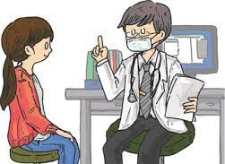
PDO Second Alert
Date: 29.06.2021 Incident title: NAD # 15
What happened?
A 43-year-old expat carpenter working in MPP3 camp, exited his room at around 0245 hrs vomiting blood and collapsed in the walkway outside. His roommates escalated the incident and emergency services activated thereafter. He was shifted to Tawoos clinic for medical care. Despite of all the efforts he was declared dead at 04:00 hrs
Your learning from this incident..
Always reveal past medical conditions when joining the site
Always share your health concerns with your Supervisors
Always seek medical help whenever required
Always carry out periodic health check ups
Always initiate PDO emergency response number in case of any emergency.
CONCEALING HEALTH STATUS
Open up your issues,
concealing can harm you more than you think it can
Notes:
No names or detail of company to link this to any recent specific incident

