Slide 1
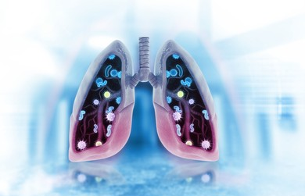
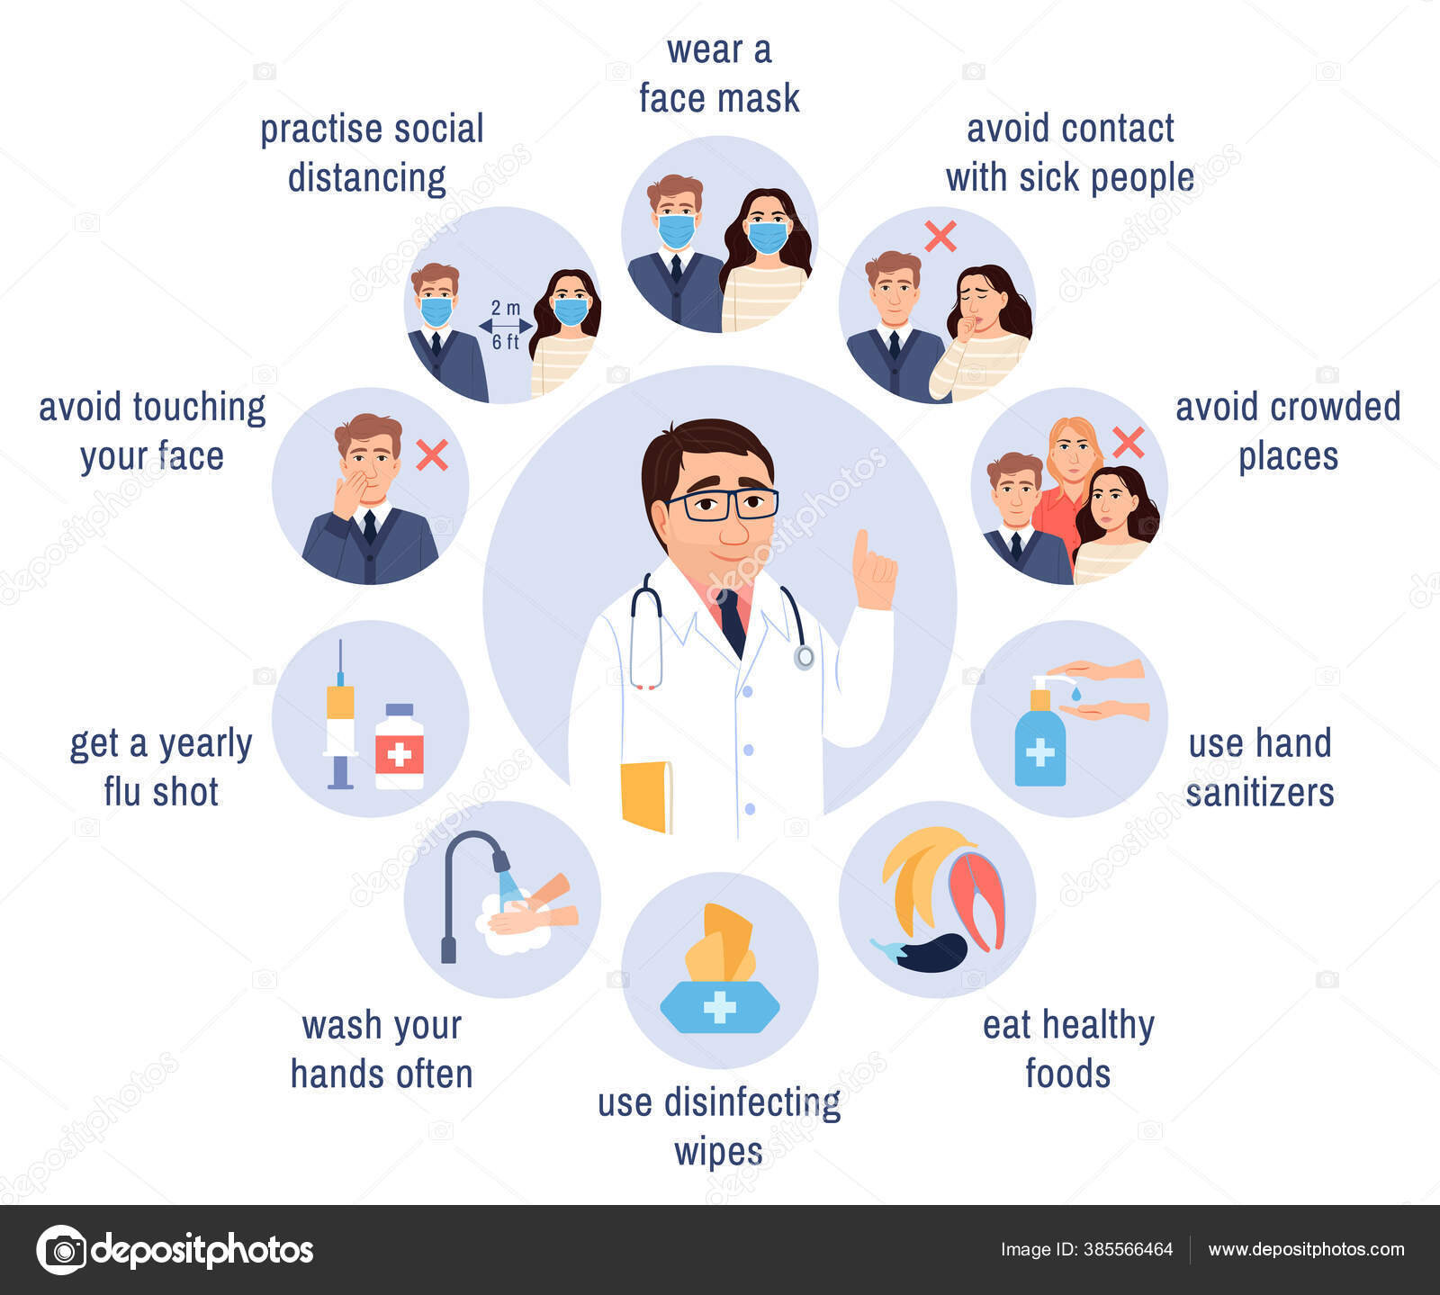
PDO Second Alert
Date: 04.10.2021 Incident title: NAD#19
What happened?
Deceased reported to site clinic at around 10:00 Hrs with complaints of breathing problems and uneasiness. Site doctor after medical examination suspected pneumonia and administered oxygen nebulization at site clinic. After deceased becoming stable it was decided to shift him to Badr al Sama hospital in Nizwa for further treatment. He was transferred at 11:06 Hrs and reached Nizwa Badr Al Sama at around 15:00 Hrs. Upon arrival, the deceased developed fever on arrival at hospital. As the treatment commenced and continued, the medical conditions of deceased started to deteriorate. At around 18:58 Hrs, examining doctor at Badr Al Sama declared him dead.
Your learning from this incident..
Ensure immediate reporting of any illness symptoms
Ensure the use of appropriate vehicle for medevac
Ensure regular medical check up of all vitals parameters for chronic patients
Verify all medications obtained out of country with PDO / site doctor
Pulmonary infections
Preventive measures
Healthy habits prevents infections
Notes:
No names or detail of company to link this to any recent specific incident

